Slide 1
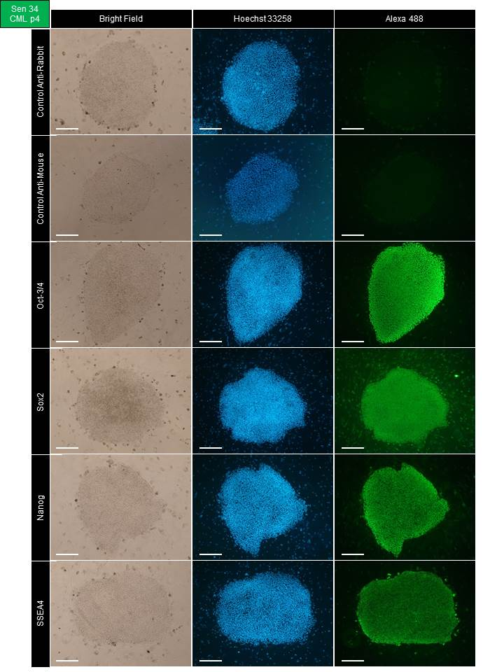
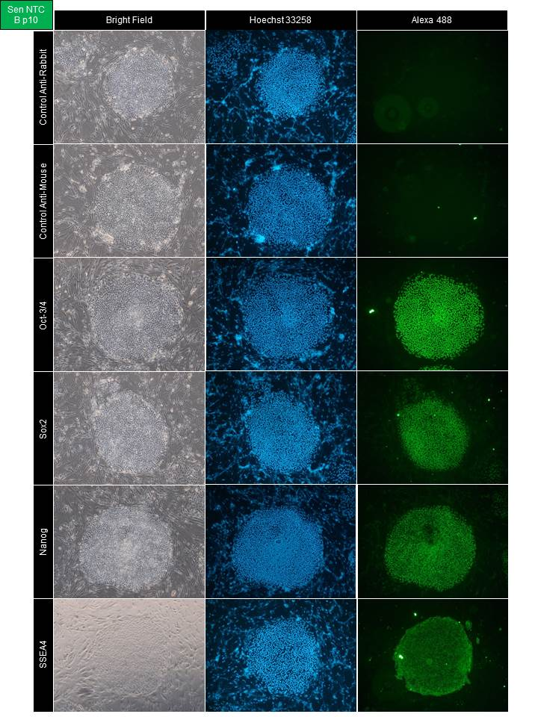
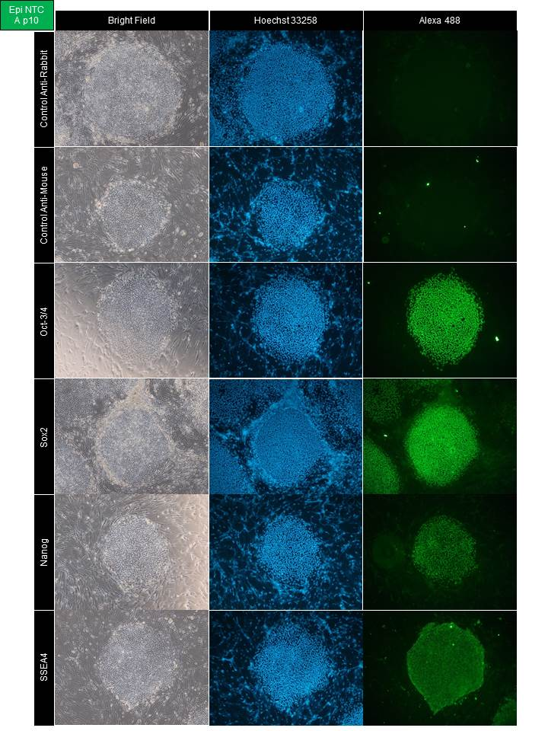
Ctrl Rabbit
Ctrl Mouse
Oct 3/4
Sox2
Nanog
SSEA4
CBIA-3
CBIA-5
CBIA-7

