Slide 1
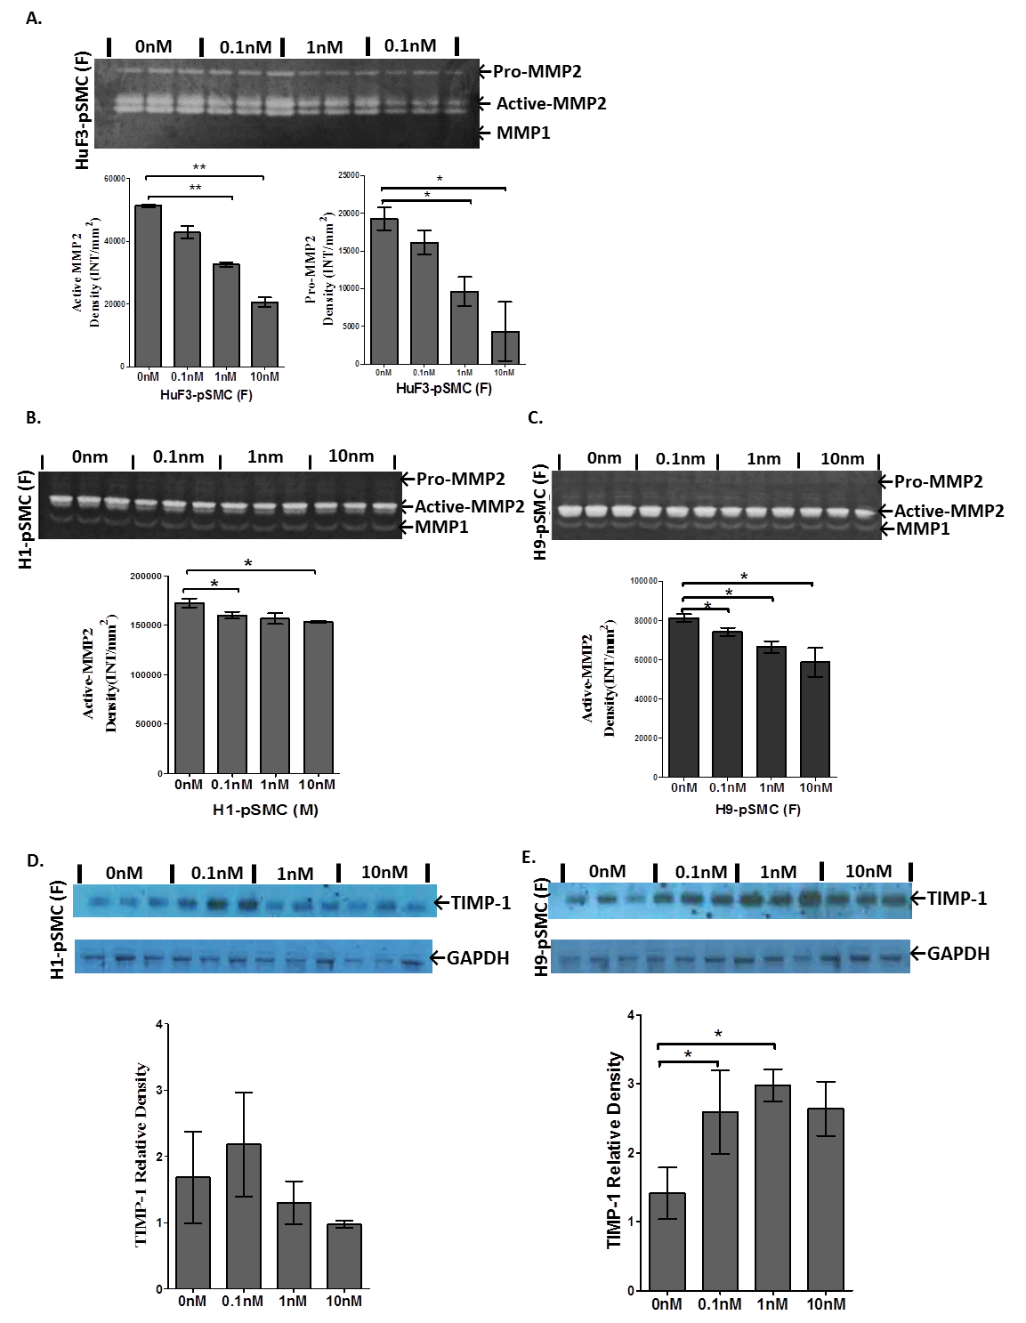
Figure S3
Figure S3. Sex differences in the expression of MMP-2 and TIMP-1 proteins in hPSC-derived pSMCs. (A), (B) and (C). Gelatin zymography of MMP activities in concentrated condition media from HuF3-pSMC, H1-pSMC, and H9-pSMC co-cultured with different concentrations of 17β-estradiol. Graphs show the densitometric data of active-MMP-2 and/or pro-MMP-2 activities. (D) and (E). Western blot analysis of TIMP-1 in the concentrated supernatants from male H1-pSMC and female H9-pSMCs. *p< 0.05 and **p<0.01, compared to untreated cells; data were analyzed by one- and two-way ANOVA followed by Tukey post hoc test. Data shown represent the mean ± SD from three independent experiments, each performed in triplicate.

