Slide 1
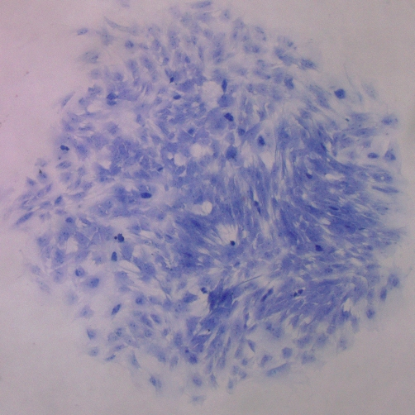
Supplementary Figure 1
A.
B.

