Slide 1
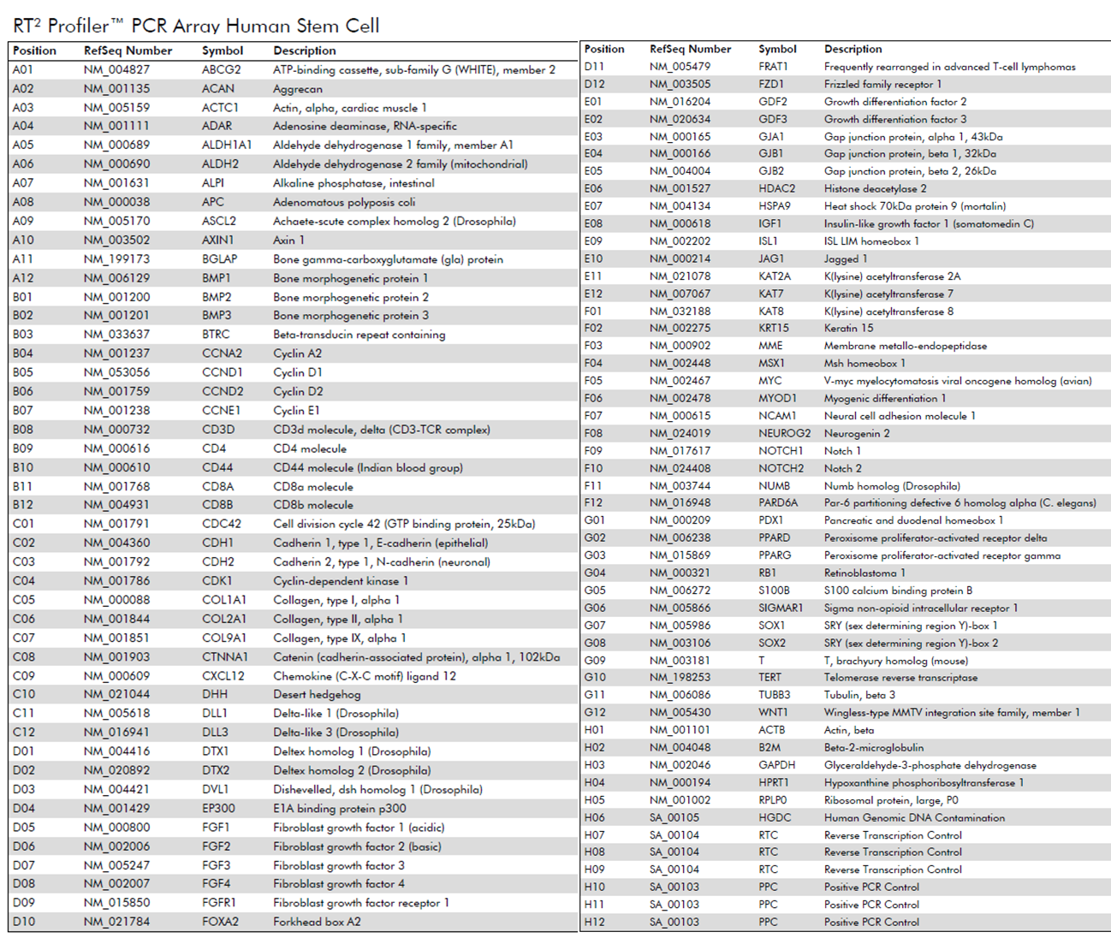
Notes:
Supplementary Figure S1. Detailed information on the contents of the RT² ProfilerTM Human Stem Cell PCR Array as supplied by Qiagen, including gene description and position in array.

