Slide 1
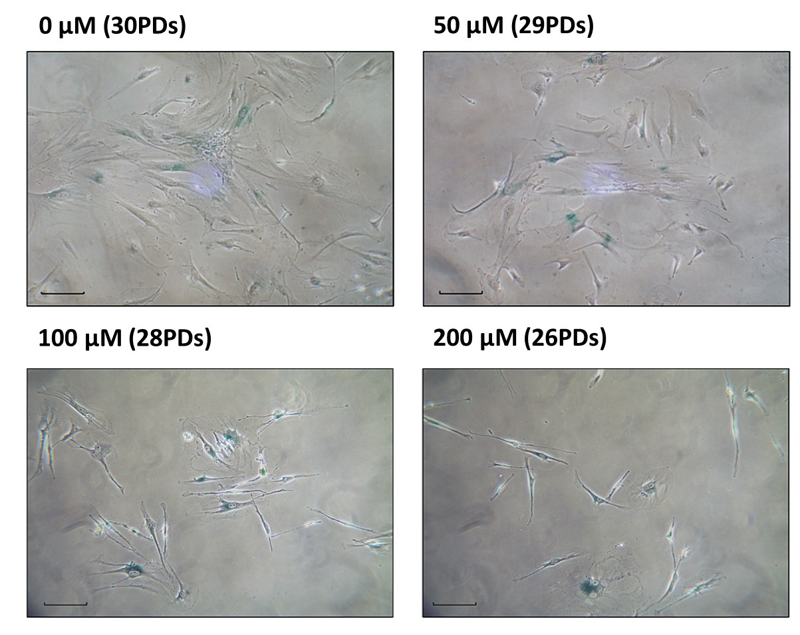
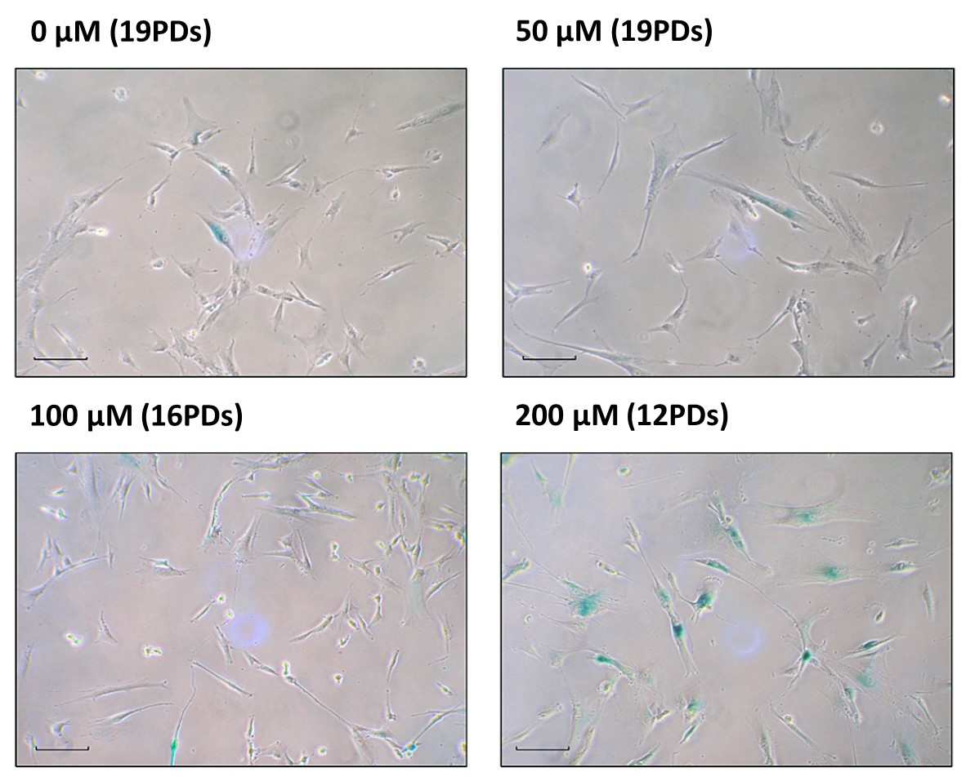
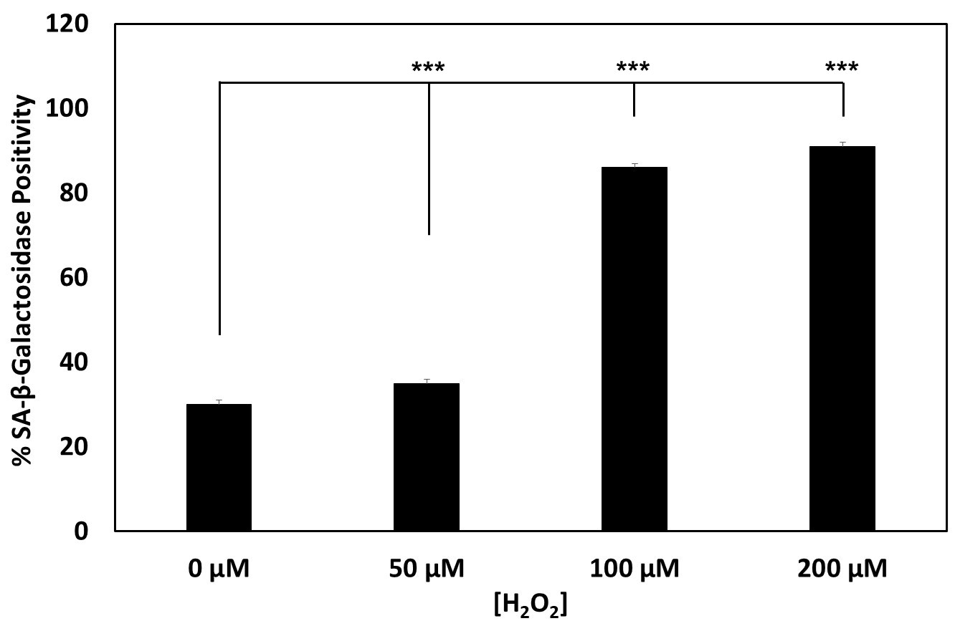
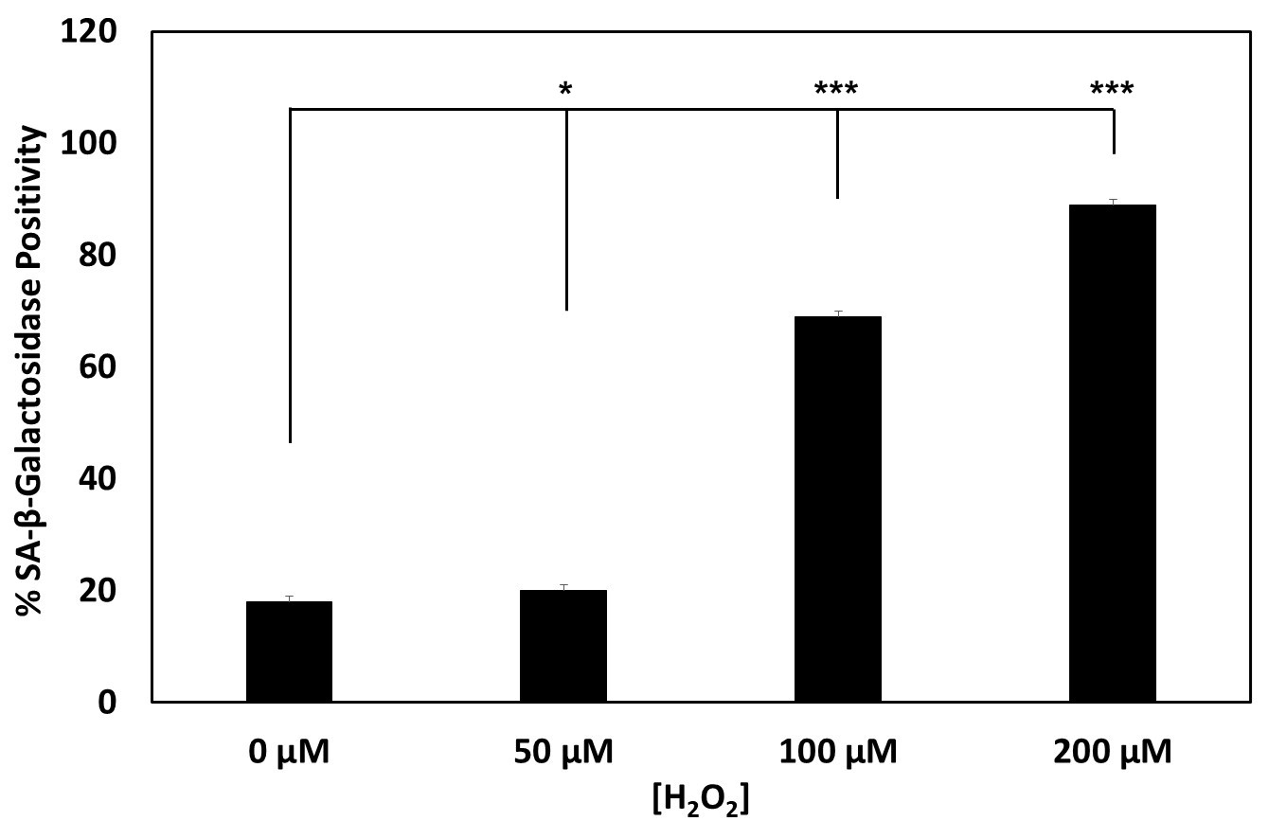
Supplementary Fig. S1
a
b
Detection of SA-β-galactosidase staining in low proliferative DPSC sub-populations. Representative SA-β-galactosidase microscopy images and % positively stained cell calculations for low proliferative sub-populations, (a) A2 (2-10PDs) and (b) C3 (2-10PDs). Scale bar 100μm, ×10 magnification. N=3, values represent the mean ± SEM. *p<0.05, ***p<0.001 versus untreated DPSC controls.

