Slide 1
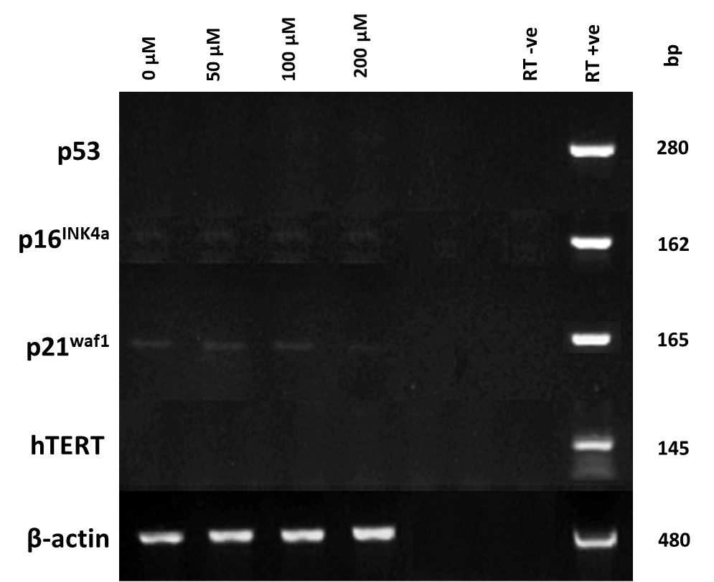
Supplementary Fig. S2
Detection of senescence-related marker (p53, p16^{INK4a}, p21^{waf1}, hTERT) expression in low proliferative DPSC sub-population, A2 (2-10PDs), during extended culture with or without exogenous H₂O₂ (50-200 μM) treatment. β-actin was used as the housekeeping gene. Right-hand lanes represent separate total human RNA positive controls, water and RT negative controls. bp = base pairs.

