Slide 1
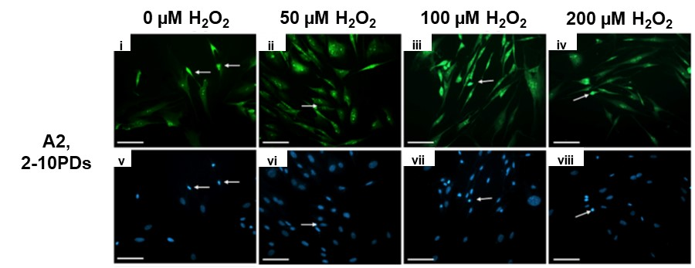
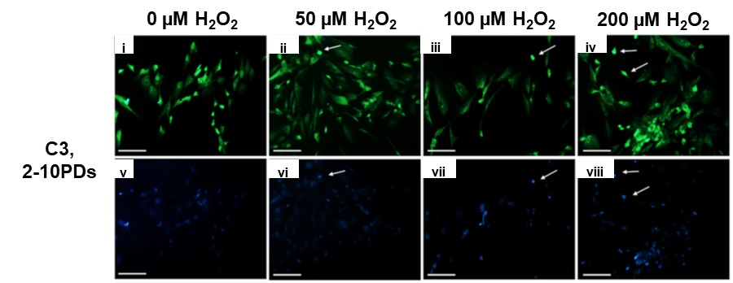
Supplementary Fig. S3
a
b
Immunocytochemical detection of oxidative DNA damage in low proliferative DPSC sub-populations, A2 (2-10PDs) and C3 (2-10PDs), during extended culture with or without exogenous H₂O₂ (50-200 μM) treatment. Representative FITC (green, i-iv) fluorescence microscopy images of 8-OHdG marker detection (arrowed) and Hoechst nuclear stain (blue, v-viii). N=3, scale bar 100 μm, ×200 magnification.

