Slide 1
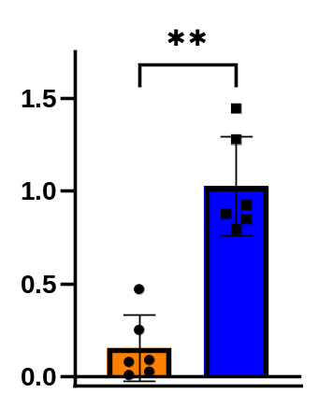
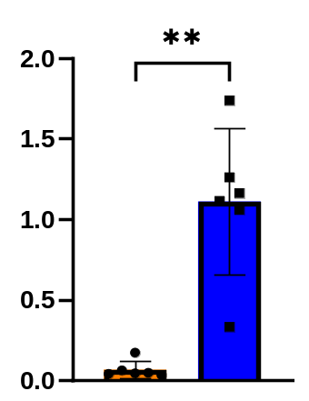
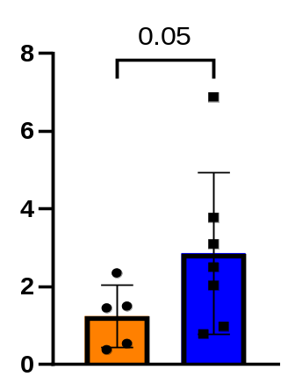
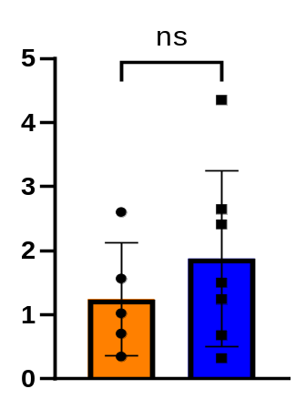
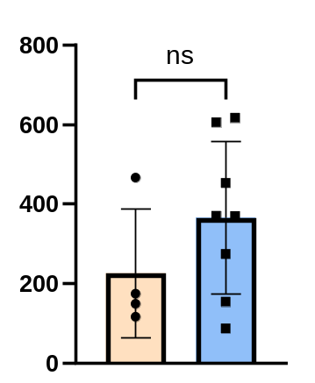
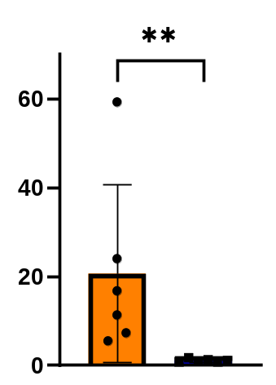
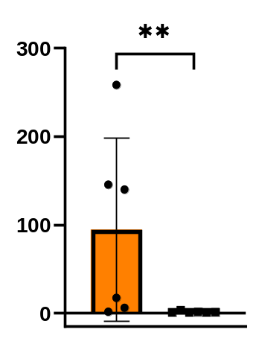
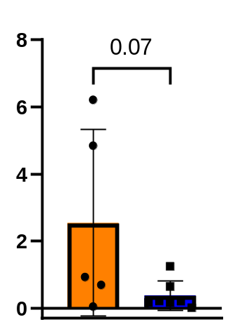
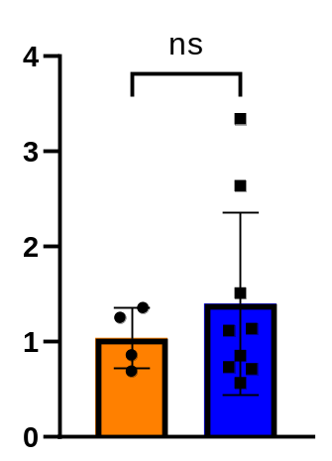
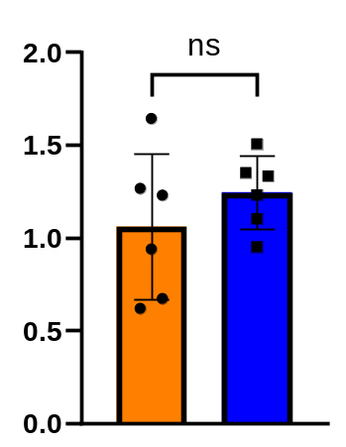
A
VCAM1
IGFBP2
ITBG8
THBS1
B
TSP1
Fold change (vs. GAPDH)
ng/mL
C
TNFRS11A
BMP2
PENK
D
miR let-7a-5p
miR-140-5p
Fold change (vs. GAPDH)
Fold change (vs. GAPDH)
Control-MSC
DKD-MSC
Control-MSCcm
DKD-MSCcm
Notes:
Final version

