Slide 1
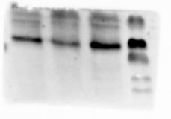
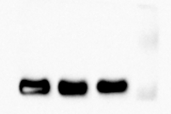
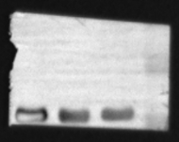
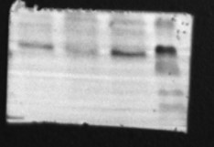
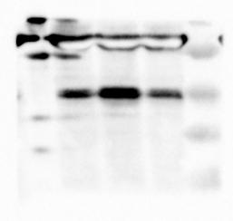
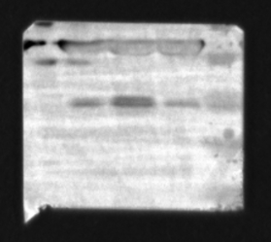
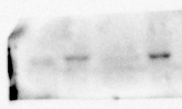



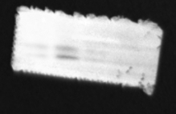

GAPDH
Runx2
VD-C
VD-D
VD-E
PPARγ
VD-C
VD-D
VD-E
ALP
VD-C
VD-D
VD-E
VD-C
VD-D
VD-E
Ocn
C/EBPα
VD-D
VD-E
VD-C
VDR
VD-C
VD-D
VD-E
VD-C
VD-D
VD-E
Supplementary Figure 1 Full-length blots/gels of related genes on VDR and adipogenesis and osteogenic differentiation in the P3 BMSCs

Slide 2
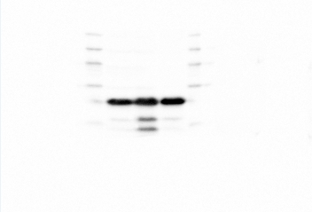
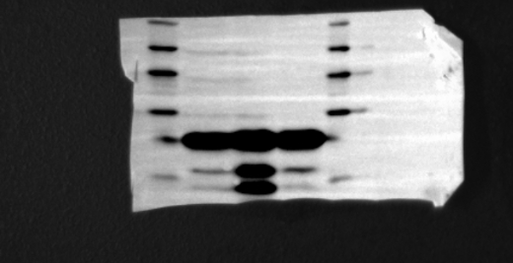
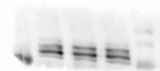
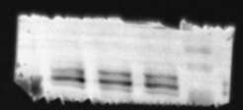


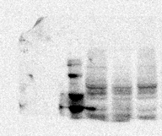
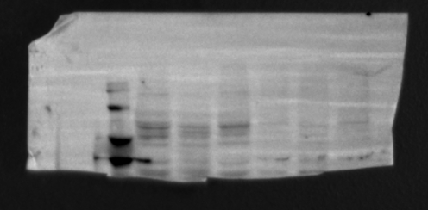


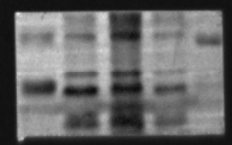
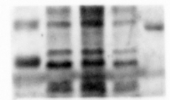
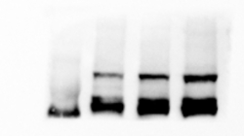


GAPDH
OPA1
VD-C
VD-D
VD-E
VD-E
VD-D
VD-C
Pink1
Mfn1
VD-C
VD-D
VD-E
p62
VD-E
VD-D
VD-C
LC3b
VD-C
VD-D
VD-E
Drp1
VD-C
VD-D
VD-E
Pgc1α
VD-C
VD-D
VD-E
VD-C
VD-D
VD-E
Supplementary Figure 2 Full-length blots/gels of related genes for mitochondrial function in the P3 BMSCs

Slide 3
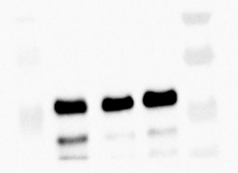
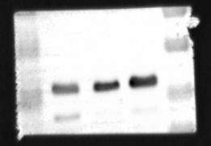
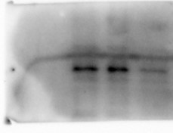
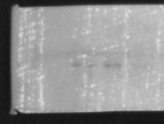



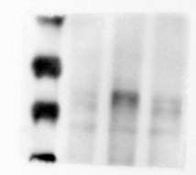


GAPDH
ALP
VD-C
VD-D
VD-E
Ocn
VD-C
VD-D
VD-E
C/EBPα
PPARγ
VD-C
VD-D
VD-E
VD-C
VD-D
VD-E
Runx2
VDR
VD-C
VD-D
VD-E
VD-C
VD-D
VD-E
VD-E
VD-D
VD-C
Supplementary Figure 3 Full-length blots/gels of related genes on adipogenesis and osteogenic differentiation in the BMSCs under induction with related adipogenic and osteogenic reagents

Slide 4
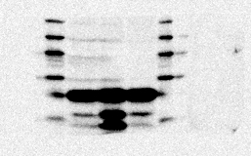
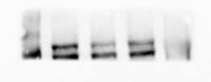



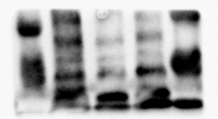
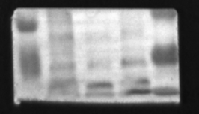






GAPDH
Drp1
Opa1
VD-C
VD-D
VD-E
VD-C
VD-D
VD-E
Pgc1α
VD-E
VD-D
VD-C
LC3b
VD-C
VD-D
VD-E
p62
VD-C
VD-D
VD-E
Mfn1
VD-C
VD-D
VD-E
Pink1
VD-C
VD-D
VD-E
VD-C
VD-D
VD-E
Supplementary Figure 4 Full-length blots/gels of related genes for mitochondrial function in the BMSCs
after the induction with related adipogenic reagents

Slide 5



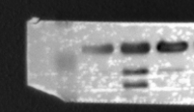


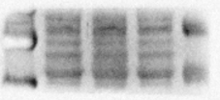
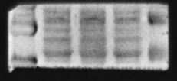
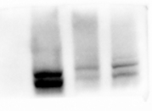
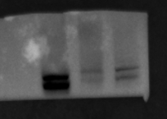





GAPDH
Drp1
VD-C
VD-D
VD-E
VD-C
VD-D
VD-E
Mfn1
p62
VD-C
VD-D
VD-E
VD-C
VD-D
VD-E
Opa1
LC3b
VD-C
VD-D
VD-E
VD-C
VD-D
VD-E
Pgc1α
Pink1
VD-C
VD-D
VD-E
VD-C
VD-D
VD-E
Supplementary Figure 5 Full-length blots/gels of related genes for mitochondrial function in the BMSCs
after the induction with related osteogenic reagents

Slide 6





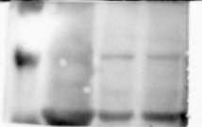
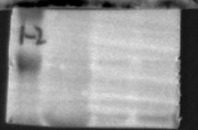

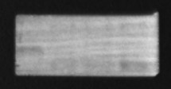
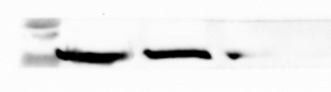


GAPDH
PPARγ
Control
NC-VDR
ShRNA-VDR
Control
NC-VDR
ShRNA-VDR
Runx2
C/EBPα
Control
NC-VDR
ShRNA-VDR
ALP
Control
NC-VDR
ShRNA-VDR
VDR
Control
NC-VDR
ShRNA-VDR
Ocn
Control
NC-VDR
ShRNA-VDR
Control
NC-VDR
ShRNA-VDR
Supplementary Figure 6 Full-length blots/gels of related genes on VDR and adipogenesis and osteogenic differentiation in the VDR knockout BMSCs

Slide 7
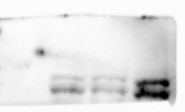
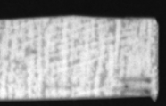
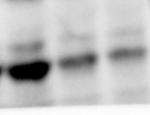
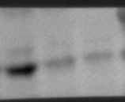

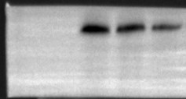
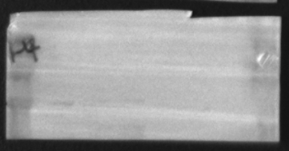

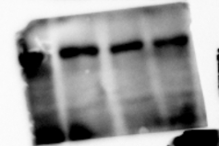
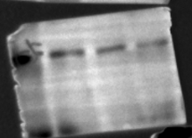


GAPDH
Opa1
Control
NC-VDR
ShRNA-VDR
LC3b
Control
NC-VDR
ShRNA-VDR
Pink1
Control
Control
NC-VDR
NC-VDR
ShRNA-VDR
ShRNA-VDR
Drp1
p62
Control
NC-VDR
ShRNA-VDR
Mfn1
Pgc1α
Control
NC-VDR
ShRNA-VDR
Control
Control
NC-VDR
NC-VDR
ShRNA-VDR
ShRNA-VDR
Supplementary Figure 7 Full-length blots/gels of related genes for mitochondrial function in the VDR knockout BMSCs

Slide 8



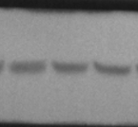

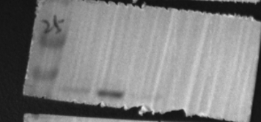
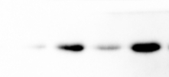
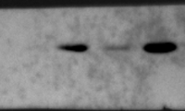




GAPDH
GAPDH
Ocn
Control
NC-VDR
ShRNA-VDR
Control
NC-VDR
ShRNA-VDR
Runx2
Control
NC-VDR
ShRNA-VDR
PPARγ
Control
NC-VDR
ShRNA-VDR
Control
NC-VDR
ShRNA-VDR
ALP
C/EBPα
Control
NC-VDR
Control
ShRNA-VDR
NC-VDR
ShRNA-VDR
Supplementary Figure 8 Full-length blots/gels of related genes on the adipogenesis and osteogenic differentiation in the VDR knockout BMSCs under induction with related adipogenic and osteogenic reagents

Slide 9
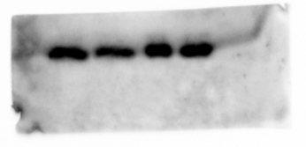
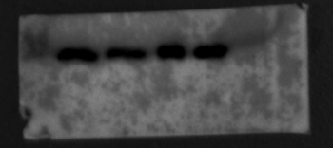
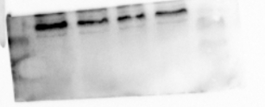









GAPDH
PPARγ
2nM
10nM
50nM
2nM
100nM
10nM
50nM
100nM
Runx2
C/EBPα
2nM
10nM
50nM
100nM
2nM
10nM
50nM
100nM
ALP
Ocn
VDR
2nM
10nM
50nM
2nM
100nM
10nM
50nM
2nM
100nM
10nM
50nM
100nM
Supplementary Figure 9 Full-length blots/gels of related genes on VDR and adipogenesis and osteogenic differentiation in the HuMSCs under the different VD interventions

Slide 10














GAPDH
Opa1
2nM
10nM
50nM
100nM
2nM
10nM
50nM
Pink1
100nM
LC3b
2nM
10nM
50nM
100nM
2nM
10nM
50nM
100nM
Pgc1α
Drp1
2nM
10nM
50nM
2nM
100nM
10nM
50nM
100nM
Mfn1
p62
2nM
10nM
50nM
100nM
2nM
10nM
50nM
100nM
Supplementary Figure 10 Full-length blots/gels of related genes for mitochondrial function in the HuMSCs under the different VD interventions

Slide 11











GAPDH
GAPDH
2nM
10nM
50nM
100nM
2nM
10nM
50nM
PPARγ
100nM
Runx2
2nM
10nM
100nM
50nM
2nM
10nM
50nM
100nM
ALP
C/EBPα
2nM
10nM
50nM
100nM
Ocn
2nM
10nM
50nM
100nM
2nM
10nM
50nM
100nM
Supplementary Figure 11 Full-length blots/gels of related genes on the adipogenesis and osteogenic differentiation in the HuMSCs under the different VD interventions by inducing with related adipogenic and osteogenic reagents respectively

