Slide 1
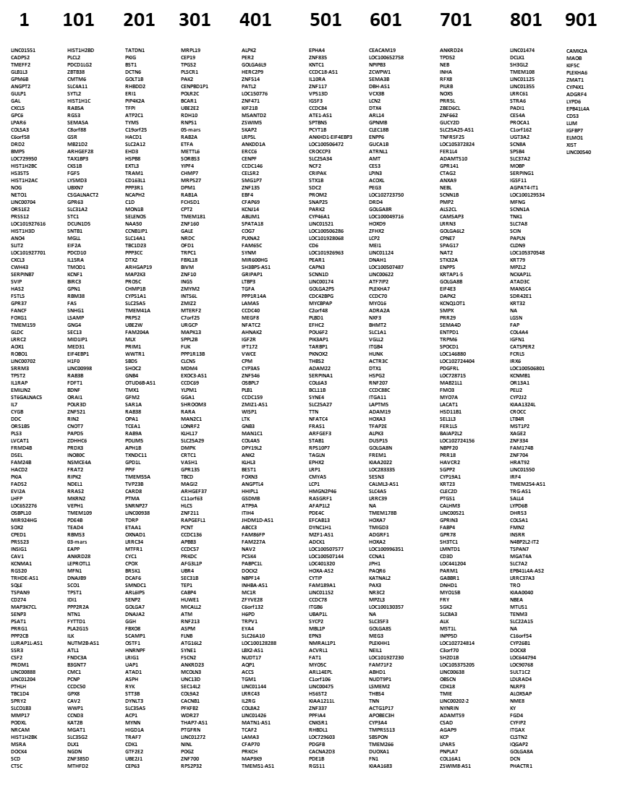
Top 915 differentially expressed genes between Gb and GbT.
Table S1: transcriptional landscape…

Slide 2
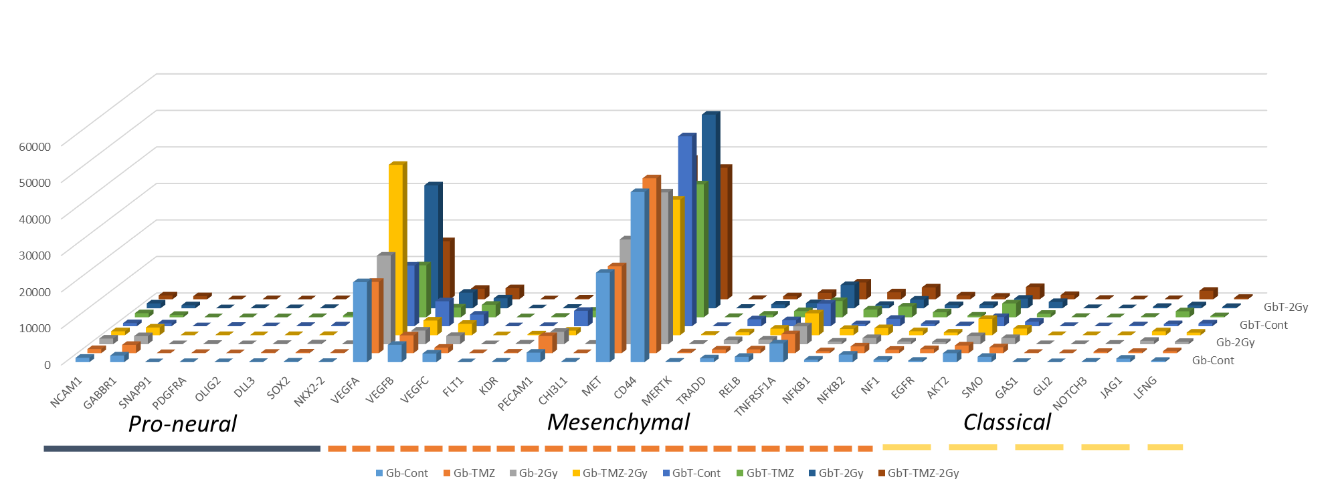
Gene counts from GBM subtypes markers (taken from references 22 and 23)
Figure S1: transcriptional landscape…

