Slide 1
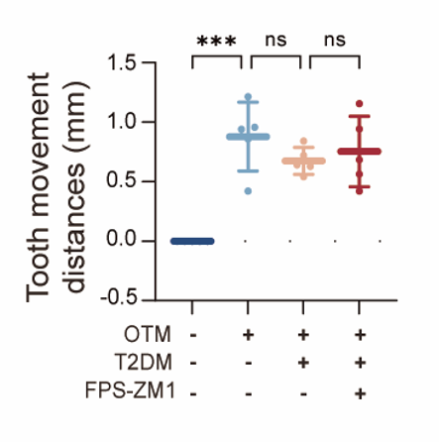
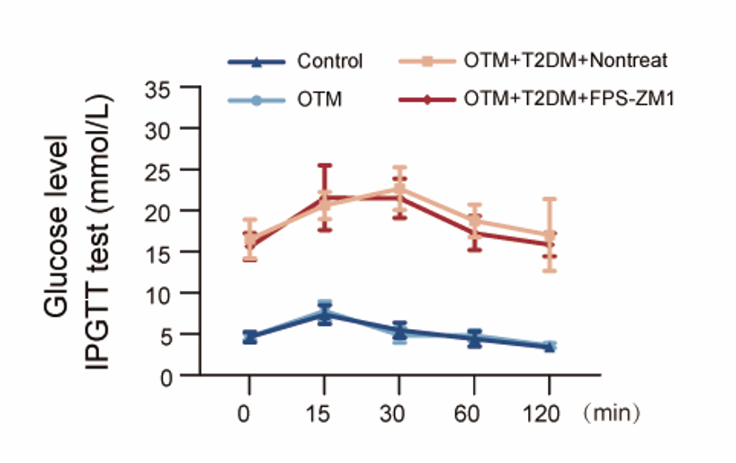
S1
Figure S1. The statistical chart of orthodontic tooth movement distance in rats.
S2
Figure S2. Statistical chart of blood glucose measurements in rats (IPGTT).

Slide 2
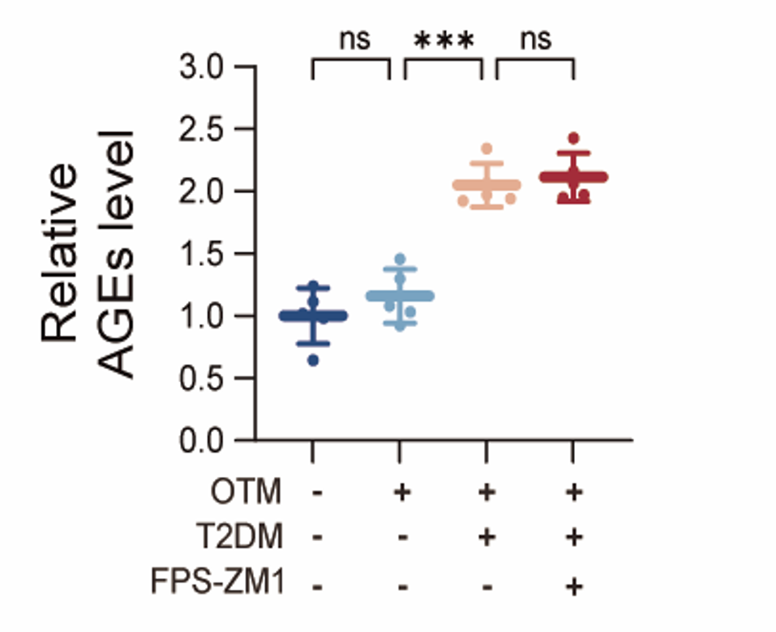
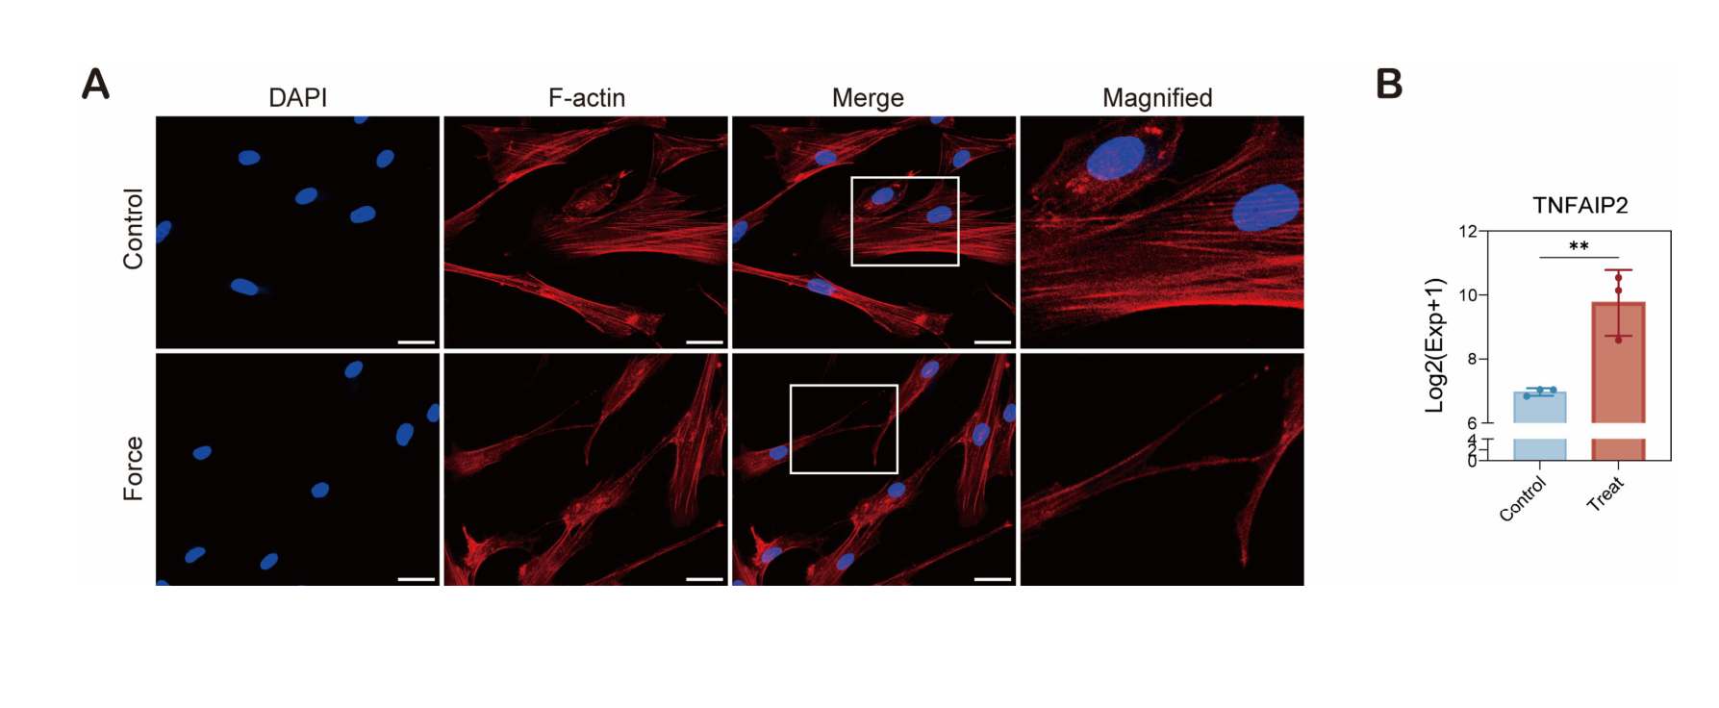
S3
Figure S3. Relative content of AGEs in rat serum.
S4
Figure S4. (A) The application of force promoted the formation of TNTs. (B) The expression of TNFAIP2 was upregulated and associated with OE-KDM6B.

