Slide 1
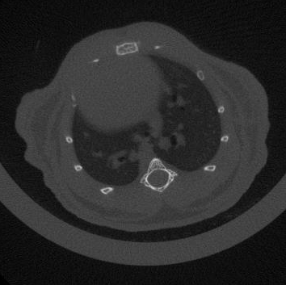
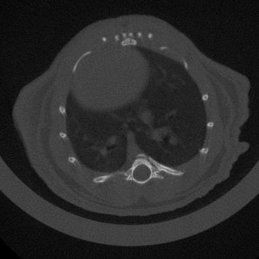
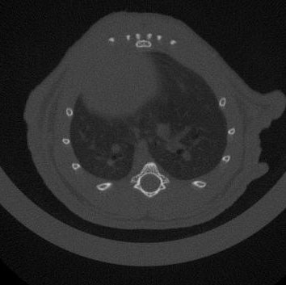
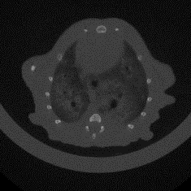
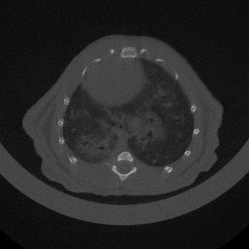
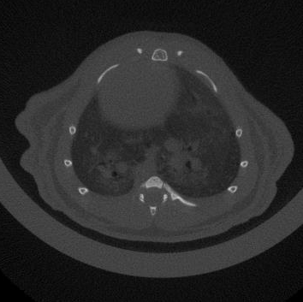
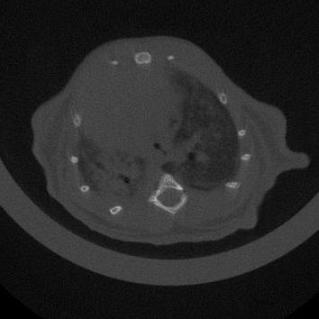
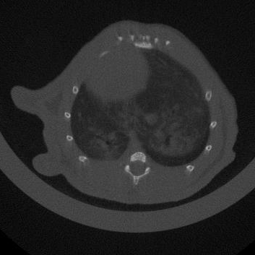
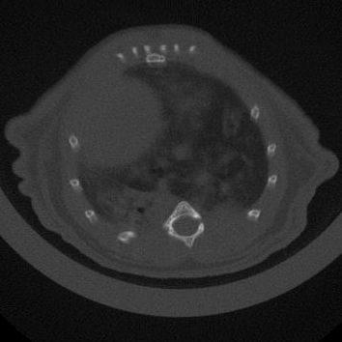
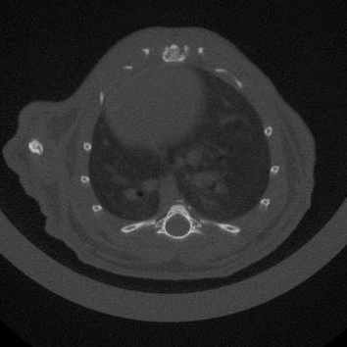
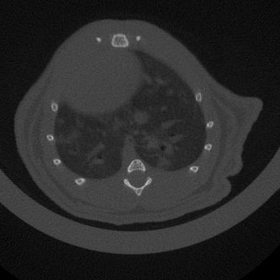
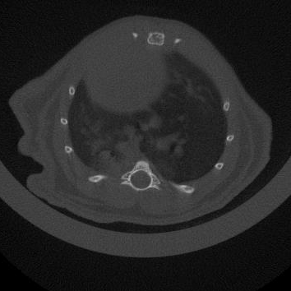
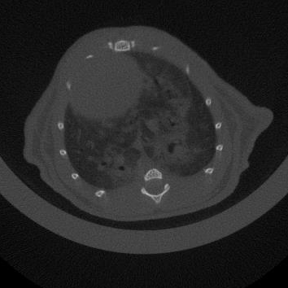
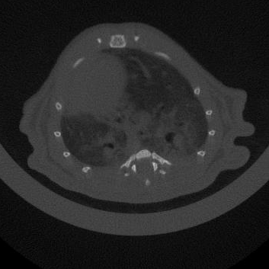
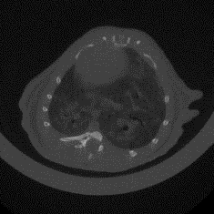
A
Saline or BLM intratracheal
Saline
UCMSC Secretome
PLMSC Secretome
MicroCT
Final measure
B
1
3
9
16
18
21 days
30
Ctrl
D
BLM+Saline
Ctrl
25
BLM+DMEM
Body Weight /g
*
BLM+UCMSC S
BLM+PLMSC S
20
0
3
6
9
12
15
18
21
Saline
C
DMEM
E
BLM
650
p=0.0449
p=0.0839
UCMSC
Secretome
600
550
Lung volume / mm³
500
450
PLMSC
Secretome
400
350
BLM
+
+
+
+
-
Ctrl
Saline
DMEM
UC S
PL S
Figure S1. UCMSC secretome demonstrates a superior therapeutic efficacy for lung injuries
(A) A schematic demonstration for the animal experiments. Mice were used to receive intratracheal bleomycin (BLM; 2.5 mg/kg body weight) or the same amount of saline at day 1. At day 3, two groups of BLM-challenged mice were subject to an intravenous (I.V.) injection of 200 ul secretomes produced from UCMSC or PLMSC (1×106 cells cultured at 10,000 ul medium for 48 h), via the caudal vein, while one group of BLM-challenged mice and the group of control mice (without BLM-challenge) received the same volume of saline treatment. Mice were randomly grouped (n=5 per group). (B) Body weight alteration in the mice (n=5) subjected to various treatments. *: p< 0.1. (C) Kaplan-Meier survival curves of mice receiving different interventions. (D) Representative micro-CT images of lungs from mice in the experiment. The images were taken at 18th day post-injury. Three repeats from 5 mice were shown. (E) Lung volumes evaluated based on the three-dimensional reconstruction data from micro-CT; n=5, p values were calculated.

Slide 2
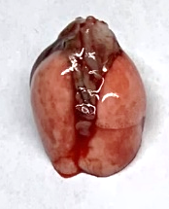
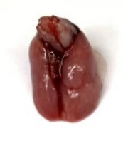

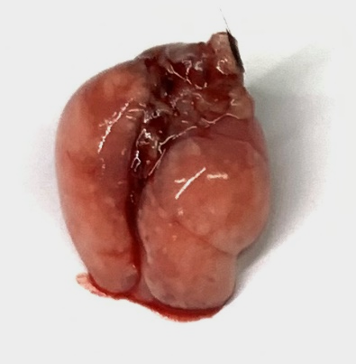

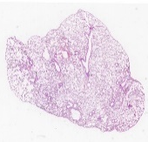
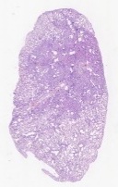
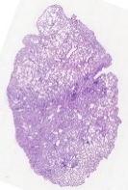
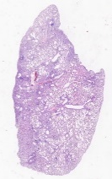
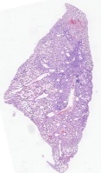
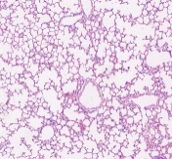
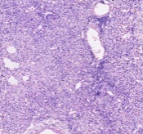
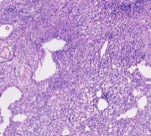
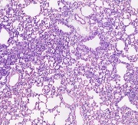
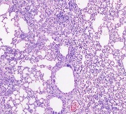
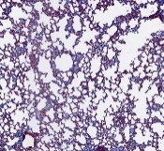
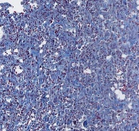
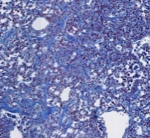
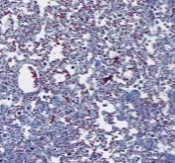
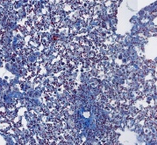
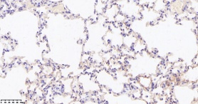
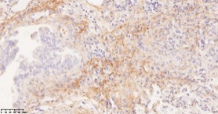
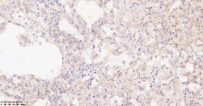
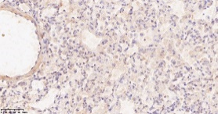
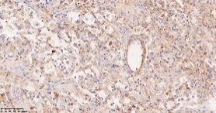
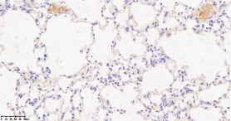
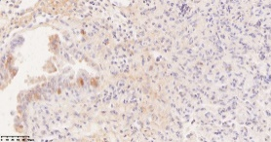
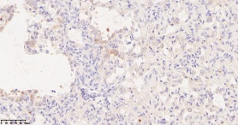
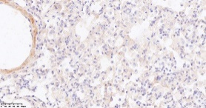
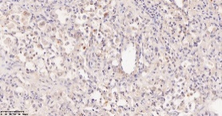
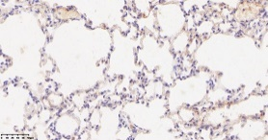
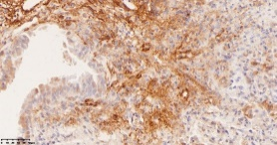
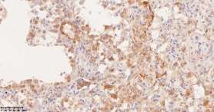
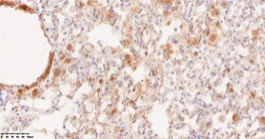
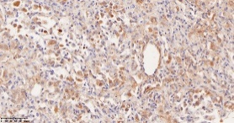
BLM
Ctrl
Saline
DMEM
UCMSC Secretome
PLMSC
Secretome
A
E
p＜0.0001
p＜0.0001
B
10
p＜0.0001
p＜0.0001
8
p=0.0012
Ashcroft score
6
C
4
2
0
-
+
+
+
+
D
BLM
Ctrl
Saline
DMEM
PLMSC S
UCMSC S
F
Ctrl
Saline
DMEM
UCMSC Secretome
PLMSC
Secretome
Col1a1
Col3a1
ACTA2
G
5
5
4
12
4
9
Col1a1
Col3a1
3
3
Relative mRNA Expression
Fibronectin
Relative mRNA Expression
Relative mRNA Expression
2
2
6
1
1
3
0
-
+
+
+
+
0
0
BLM
BLM
-
+
+
+
+
BLM
-
+
+
+
+
Ctrl
Ctrl
Saline
Ctrl
Saline
DMEM
Saline
PLMSC S
DMEM
DMEM
PLMSC S
UCMSC S
PLMSC S
UCMSC S
UCMSC S
Figure S2

Slide 3
Figure S2. UCMSC secretomes effectively alleviated fibrosis induced by Bleomycin
(A) Representative macroscopic views of whole lungs from mice at 21-day post-injury. (B) Representative whole histological lung sections stained with H&E from mice at 21 days post-injury. Scale bars, 500 μm. (C) Representative histology of lung sections stained with H&E from mice at 21 days post-injury Scale bars, 50 μm. (D) Representative histology of lung sections stained with Masson’s trichrome from mice at 21 days post-injury. Scale bars, 50 μm. (E) Quantitative presentations of fibrotic severity with the Ashcroft score in lungs of mice receiving different interventions. (F) Representative images of immunostaining against Col1a1, Col3a1 and ACTA2 in serial sections of lung tissues (n=5). Bronchiolar regions are demarcated with an arrowhead in control sections. (G) Quantitative PCR analyses for the relative mRNA levels of Col1A1, Col3A1, and Fibronectin in the lung tissues of mice under different treatments.

Slide 4
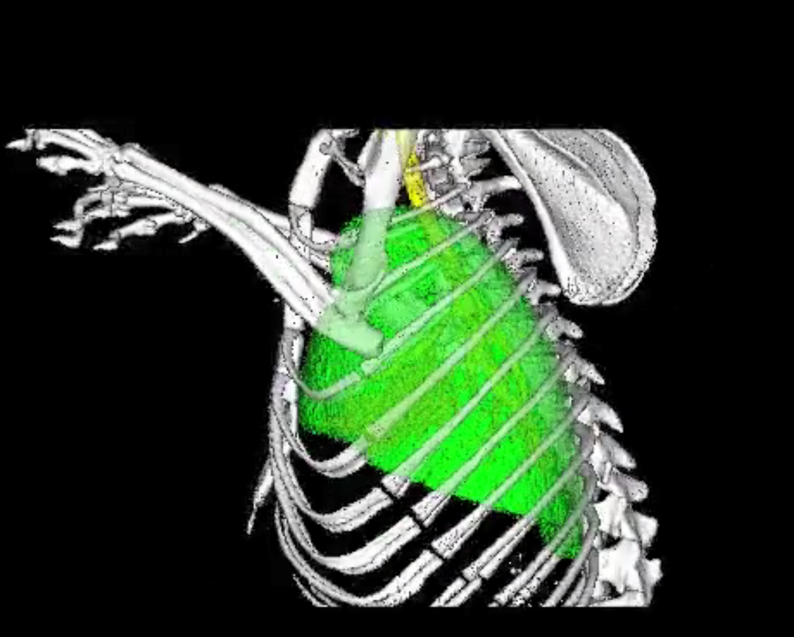
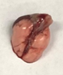











A
B
BLM
Ctrl
Saline
UCMSC
PLMSC
Top
Middle
C
Bottom
D
Figure S3. UCMSCs partially reversed pulmonary fibrosis and demonstrated a superior efficacy compared to PLMSCs
(A) A three-dimensional reconstruction image from micro CT images. The position of the cross-section showed by ‘Top’, ‘Middle’, ‘Bottom’ related to Figure 3B. (B) Representative macroscopic views of whole lungs from mice at 21-day post-injury. (C) Representative histological lung sections stained with H&E from mice at 21 days post-injury. Scale bars, 500 μm. (D) Representative enlarged histological lung sections stained with H&E from mice at 21 days post-injury Scale bars, 50 μm.

Slide 5







A
D
50
MMP1
45
Expression
40
35
30
UCMSC
PLMSC
B
Average
Expression
UC
Identity
PL
Percent
C
Features
Figure S4. The features of UCMSCs and PLMSCs
(A) The violin plots displaying the top 10 highly expressed genes of UCMSC and PLMSC within each subpopulation. (B) A dot plot illustrating the average levels of secreted proteins and membrane proteins in UCMSCs and PLMSCs from scRNA-seq analyses. (C) UMAP projection of single-cell analyses highlighting the highly expressed secreted proteins IL1B, CXCL8, CXCL6, FGF1, FGF5, and WNT5A in both UCMSCs and PLMSCs.

Slide 6









A
UCMSC VS PLMSC
B
8
Type I interferon signaling pathway
response to virus
6
response to type I interferon
Response to molecule of bacterial origin
-log10(p-adj)
response to interferon-gamma
4
Up
Regulation of multi-organism process
Down
Interferon-gamma-mediated
signaling pathway
2
No Significant
defense response to virus
cellular response to type I interferon
UCMSCs
0
cellular response to interferon-gamma
PLMSCs
-5
0
5
10
0
25
50
75
100
log2(foldchang$\frac{UC}{PL}$)
Count
C
Cytokine
D
E
F
Receptor
Inflammatory regulator gene
Anti-inflammatory cytokine
TGFβ1
OAS2
IL18BP
OASL
2
OAS1
1
MX1
0
OAS3
-1
IDO1
-2
BST2
IDO2
PD-L1
IL10
TGFβ2
TGFβ3
Crtl
4-F
Crtl
4-F
Crtl
4-F
Crtl
4-F
Crtl
4-F
Crtl
4-F
Crtl
4-F
Crtl
4-F
UCMSCs
PLMSCs
UCMSCs
PLMSCs
UCMSCs
PLMSCs
UCMSCs
PLMSCs
Figure S5. UCMSCs regulated the gene expression in macrophages in response to inflammation challenges
(A) Scatter plots displaying the differentially expressed genes (DEGs) between UCMSCs and PLMSCs. Up-regulated genes are highlighted in red. Down-regulated genes are highlighted in gray. Blue dots represent non-DEGs (< 2-fold change). (B) A GO enrichment analysis comparing upregulated genes in UCMSCs and PLMSCs upon priming by 4 cytokines (4-F). (C-E) Clustered heatmaps of expressed genes encoding cytokines (C), inflammatory regulators (D), anti-inflammatory cytokines (E) and receptors (F) in UCMSCs and PLMSCs upon 4 cytokine priming (4-F).

Slide 7












A
B
CD11b (Percp-cy5.5)
Control
UCMSCs
PLMSCs
F4/80 (APC)
C
D
Ctrl
BLM+PBS
BLM+UC
BLM+PL
91.69%
79.22%
87.28%
91.35%
60
Day21
40
Siglec-F (PE)
M1 percentage
20
CD11b (FITC)
84.86%
97.30%
84.15%
81.99%
0
SSC-A
Medium
PLMSC
UCMSC
CD206 (PE)
Figure S6. UCMSCs induced macrophage polarization to M2
(A) A representative contour plot displaying the identification of macrophages using F4/80 and CD11b markers. (B) Morphology images depicting macrophages co-cultured with UCMSCs and PLMSCs. (C) Proportion of M1 macrophages co-cultured with UCMSCs and PLMSCs. (D) Representative flow cytometry dot plots showing expression of Siglec-F, CD11b, CD206 in alveolar macrophages from mice with different treatments on day 21 post BLM challenge.

Slide 8








A
Relative mRNA Expression
B
D
SSC-A
CD45(Percp-cy5.5)
F4/80(APC)
FSC-A
FSC-A
CD11C(FITC)
CD64(PE)
C
Ctrl
PBS
UC
PL
SSC-A
SSC-A
SSC-A
SSC-A
(CD127 PE-Cy7)
(CD127 PE-Cy7)
(CD127 PE-Cy7)
(CD127 PE-Cy7)
Figure S7. Macrophages educated by MSCs maintained a dynamic gene expression profile
(A) Quantitative PCR analyses showing relative mRNA levels of Cxcl10, Entpd1, Mrc1, Fizz1, Tgfb1, CD36, and Klf4 in mouse alveolar macrophages from different mice. (B) Gating strategy used for FACS sorting. (C) CD127+ macrophages from mice were sorted. (D) A real-time PCR analysis of CD127 expression in macrophages educated by UCMSCs or PLMSCs in vitro.

