Slide 1
Additional File 1: Differential Effects of Fetal Bovine Serum and Human Platelet Lysate on Mesenchymal Stromal Cell-mediated Support of Hematopoietic Stem/Progenitor Cells: A Functional and Transcriptomic Analysis
Maria Catarina Carreira^{1,2,a}; André Branco^{1,2,a,b}; Miguel Casanova^{1,2}; Carolina Smet³, Cláudia L. da Silva^{1,2,c} and Ana Fernandes-Platzgummer^{1,2,c,}*
¹ Department of Bioengineering and iBB – Institute for Bioengineering and Biosciences, Instituto Superior Técnico, Universidade de Lisboa, Lisboa, 1049-001, Portugal
² Associate Laboratory i4HB - Institute for Health and Bioeconomy at Instituto Superior Técnico, Universidade de Lisboa, Lisboa, 1049-001, Portugal
³ Hospital São Francisco Xavier, Centro Hospitalar de Lisboa Ocidental, Portugal
ª Equally contributing authors
^{b} Current affiliation: GIMM - Gulbenkian Institute for Molecular Medicine, Lisbon, Portugal
^{c} These authors share senior authorship
*Corresponding author: ana.fernandes@tecnico.ulisboa.pt

Slide 2
Supplementary Table 1 – List of reagents and consumables and their respective product references.
Reagent | Supplier | Reference
Dulbecco’s Modified Eagle’s Medium (DMEM) | Gibco | 31600-091
Antibiotic-Antimycotic (A.A.) | Gibco | 15240-062
Human Platelet Lysate UltraGRO™-PURE Gamma Irradiated (hPL) | AventaCell Biomedical Corp. | HPCHXCGLI50
Fetal Bovine Serum MSC-qualified (FBS) | Gibco | 12662-029
Trypsin | Gibco | 15090-046
Ethylenediaminetetraacetic acid (EDTA) | Thermo Fisher Scientific | J15694-AE
Phosphate-buffered saline (PBS) | Gibco | 21600-044
TrypLE™ Select 10x | Gibco | A12177-02
Trypan Blue | Gibco | 15250-061
LIVE/DEAD Fixable Far Red Dead Cell Stain | Invitrogen | L34974
CD73 FITC [clone: AD2] | BD Biosciences | 561254
CD90 PE [clone: 5E10] | Biolegend | 328110
CD44 PerCP-Cy5.5 [clone: G44-26] | Biolegend | 560531
CD14 FITC [clone: M5E2] | Biolegend | 301804
CD105 PE [clone: 43A3] | Biolegend | 323206
CD34 PerCP-Cy5.5 [clone: 8G12] | Biolegend | 347222
HLA-DR FITC [clone: L243] | Biolegend | 307604
CD80 PE [clone: W17149D] | Biolegend | 375410
CD45 PerCP-Cy5.5 [clone: H130] | Biolegend | 304028
CD19 FITC [clone: HIB19] | Biolegend | 302206
CD11b PE [clone: ICRF44] | Biolegend | 301306
CD146 PE [clone: SHM-57] | Biolegend | 342004
CD271 PE [clone: ME20.4] | Biolegend | 345106
CD45RA FITC [clone: HI100] | BD Biosciences | 555488
CD34 PerCP-Cy5.5 [clone: 8G12] | BD Biosciences | 347222
High Pure RNA Isolation Kit | Roche | 11828665001
Mitomycin C | Sigma | M4287-2MG
Ficoll-Paque | GE Healthcare
Dimethyl sulfoxide (DMSO) | Sigma | D850-100ML
CD34 MicroBead Kit human | Miltenyi Biotec | 130-046-702
StemSpan Serum-Free Expansion Medium II | STEMCELL Technologies | 09655
Stem Cell Factor (SCF) | PeproTech | AF-300-07-100UG
Fms-like Tyrosine Kinase 3 Ligand (Flt-3L) | PeproTech | AF-300-19-100UG
Thrombopoietin (TPO) | PeproTech | AF-300-18-100UG
Basic Fibroblast Growth Factor (bFGF) | PeproTech | AF- 100-18B
MethoCult H4434 Classic medium | STEMCELL Technologies | 04434

Slide 3
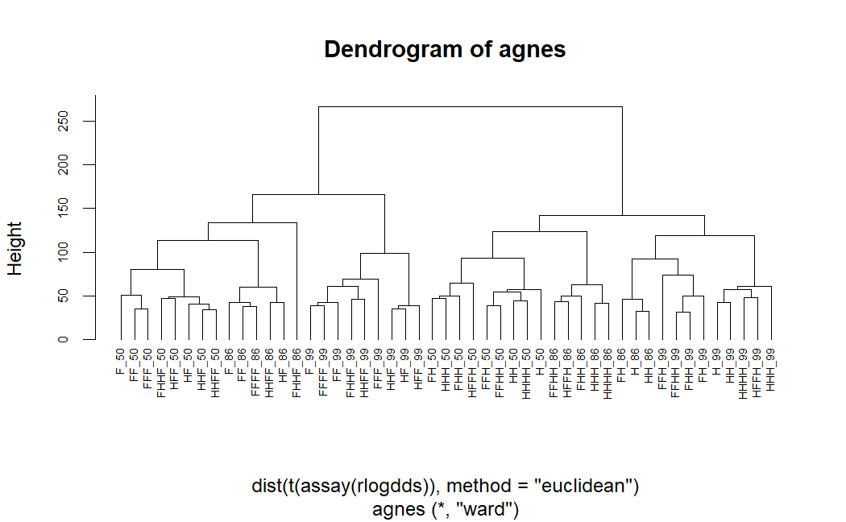
Supplementary Figure 1 – Hierarchical clustering dendrogram (agnes, Ward's method) based on Euclidean distance, illustrating transcriptional differences across culture conditions and donors. The clustering shows that transcriptional variation between donors (denoted by "50", "86", and "99") is lower than the variation introduced by the culture medium. Labels indicate passage history: F = one passage in FBS, H = one passage in hPL. For example, FF represents cells directly cultured in FBS, HF represents cells adapted to hPL, and HFFH represents cells re-adapted to hPL.

Slide 4
(A)
(B)
Re-adapted FBS
Adapted FBS
54 DEG
104 DEG
Direct
FBS
1 106DEG
4 DEG
Direct
hPL
65 DEG
Re-adapted hPL
Adapted hPL
Supplementary Figure 2 – Impact of adaptation between human platelet lysate (hPL) and fetal bovine serum (FBS) on the transcriptome of bone-marrow derived mesenchymal stromal cells (MSC(M)). (A) Transcriptional distances (Differentially expressed genes (DEG) number) between MSC derived from each adaptation regimen. DEG were defined as genes with |FC|>4 and padj<0.01. Distance between conditions is proportional to the number of DEG. Blue circles represent FBS-MSC and red circles hPL-MSC. (B) Percentage of DEG between Direct conditions and Adapted or Re-adapted conditions. Percentages of DEG were obtained by dividing the number of DEG by the number of expressed genes.

Slide 5
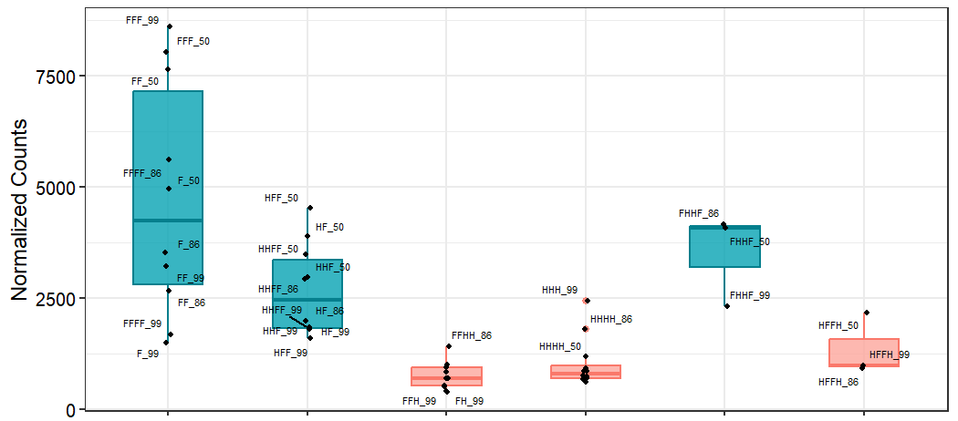
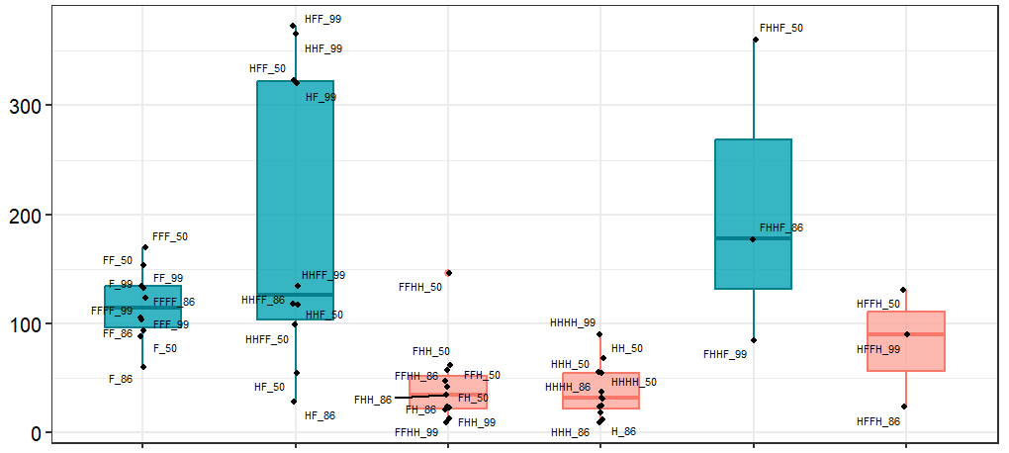
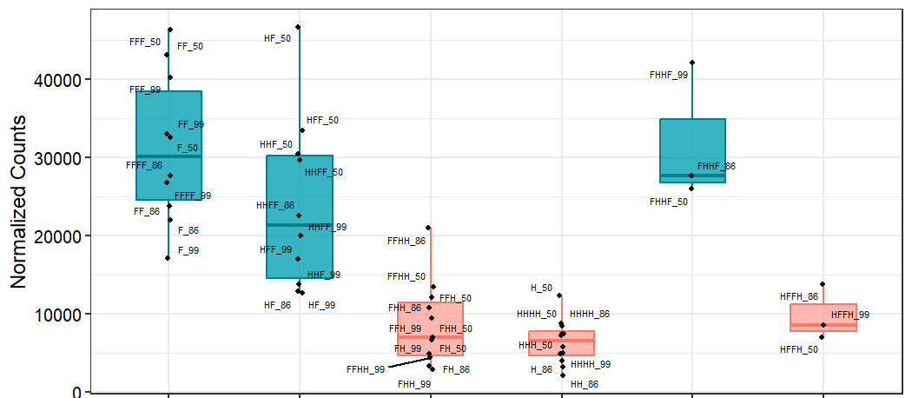
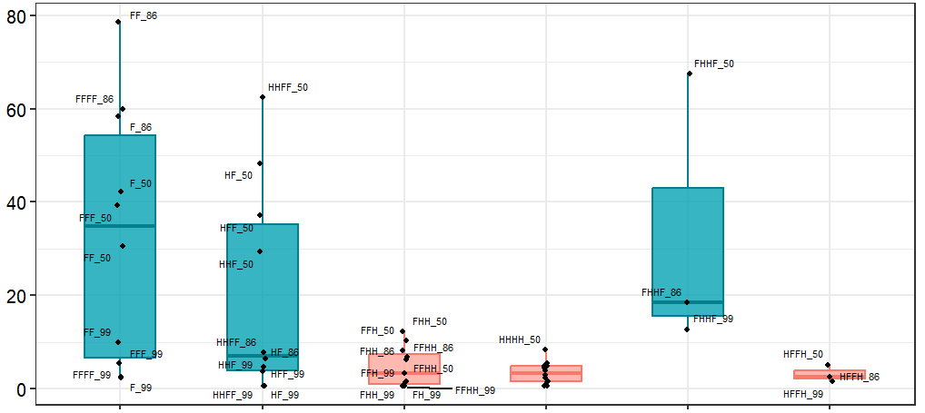
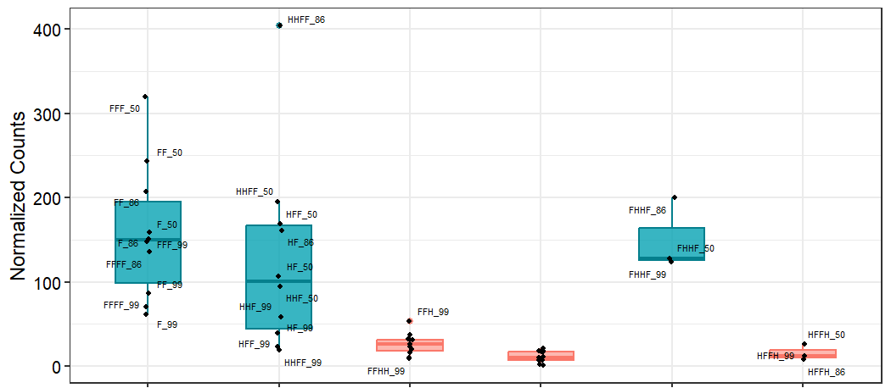
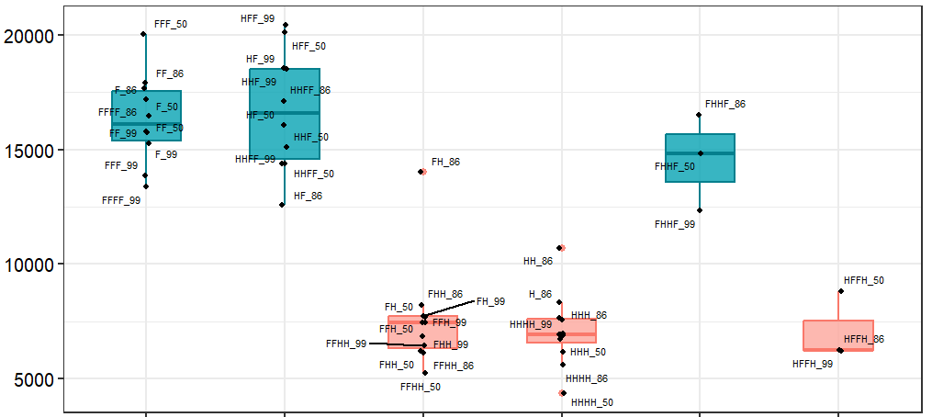
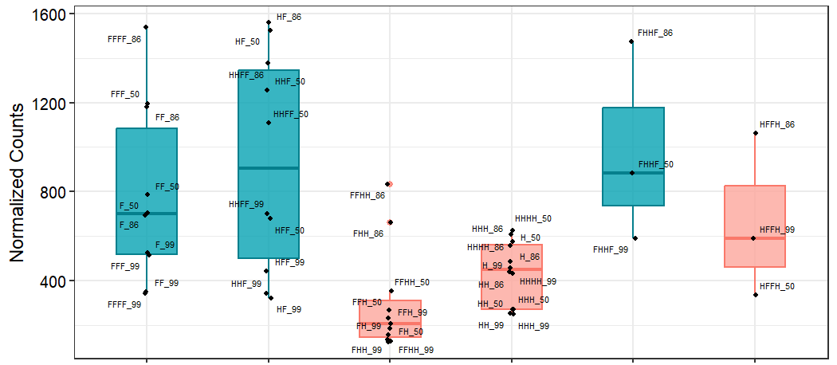
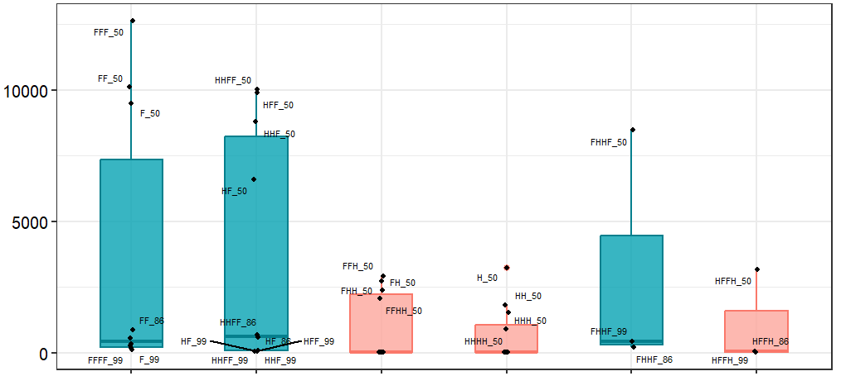
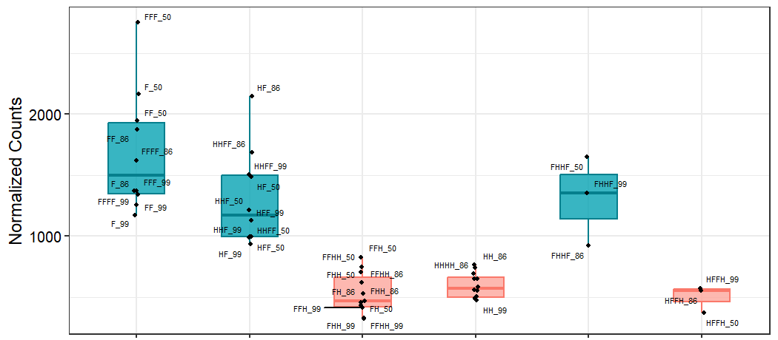
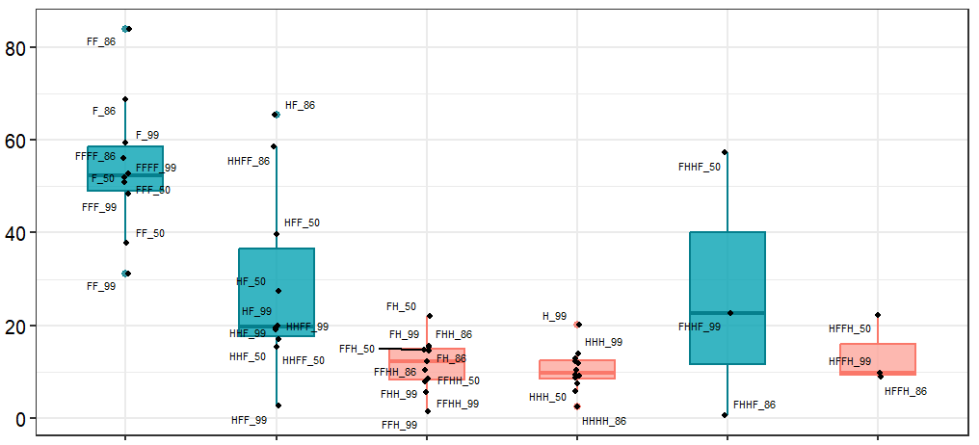
JAG1
BMP6
DCN
CDH3
CDH15
ALCAM
JAM2
ITGA8
ITGA1
ITGA9
Direct FBS
Adapted FBS
Adapted hPL
Direct hPL
Re-adapted FBS
Re-adapted hPL
Direct FBS
Adapted FBS
Adapted hPL
Direct hPL
Re-adapted FBS
Re-adapted hPL
Supplementary Figure 3 – Boxplots showing normalized gene expression counts for the final set of genes overexpressed in FBS-MSC which may influence HSPC function. Each box represents the distribution of expression levels across samples, with blue indicating FBS-MSC and red indicating hPL-MSC.

Slide 6
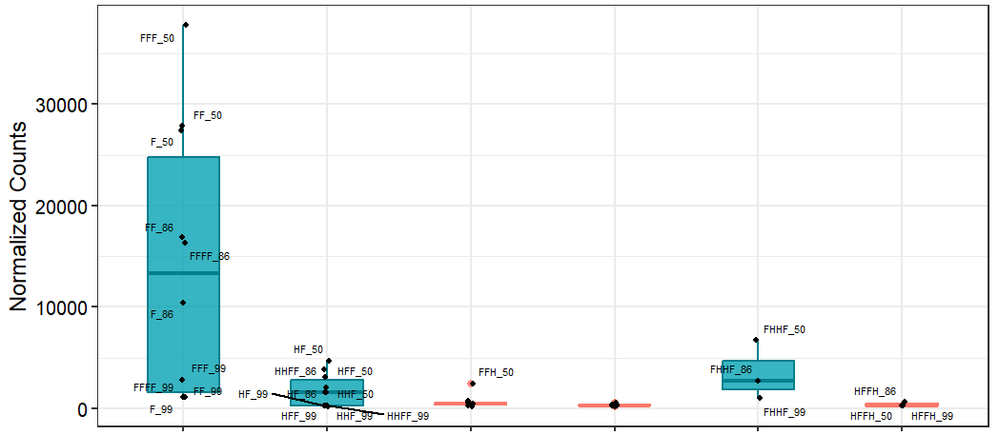
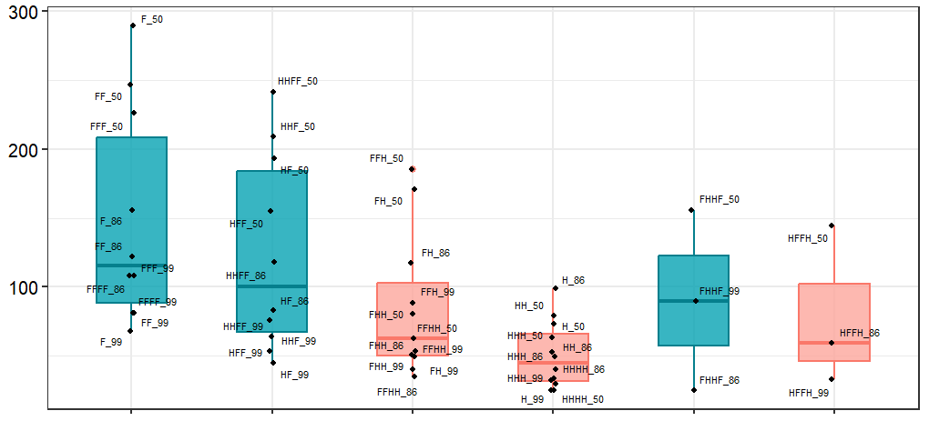
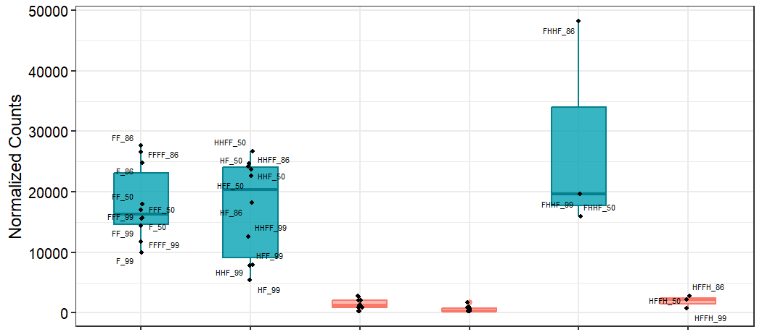
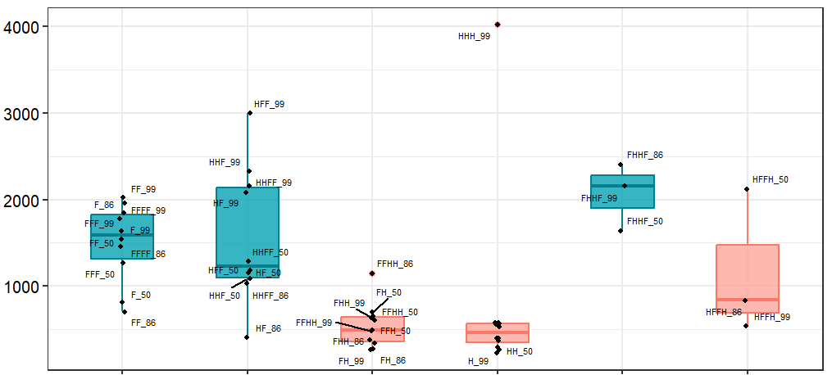
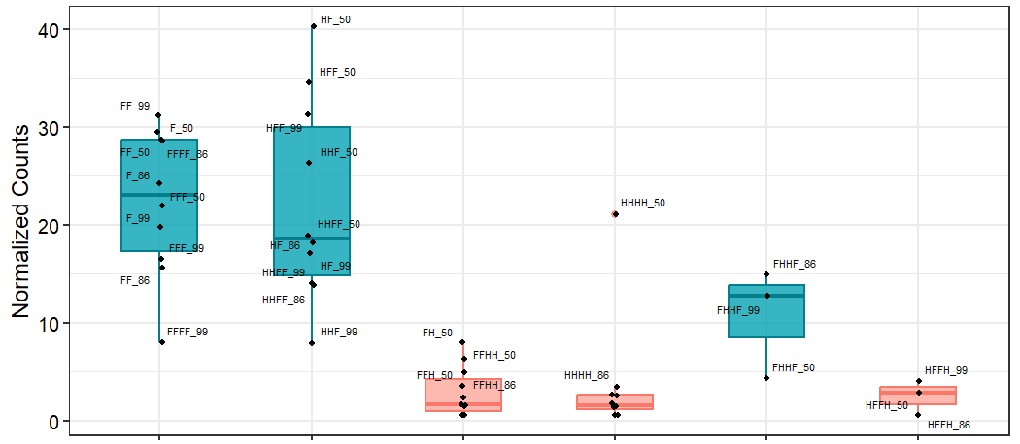
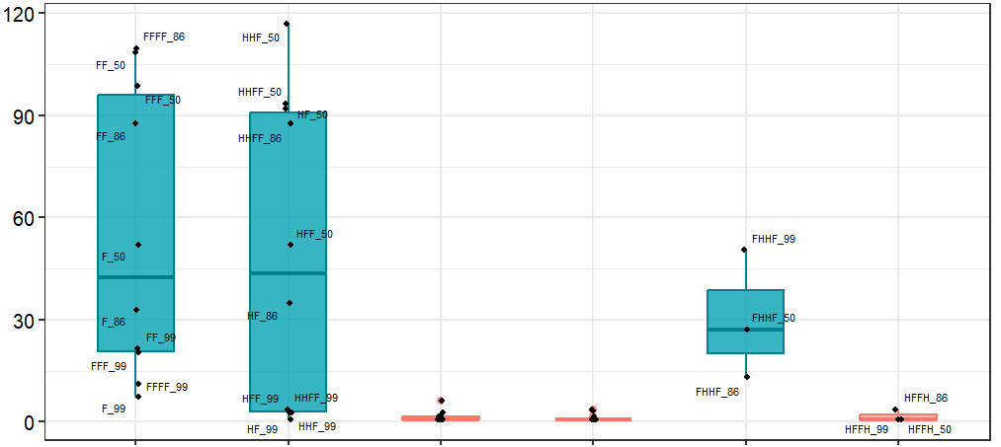
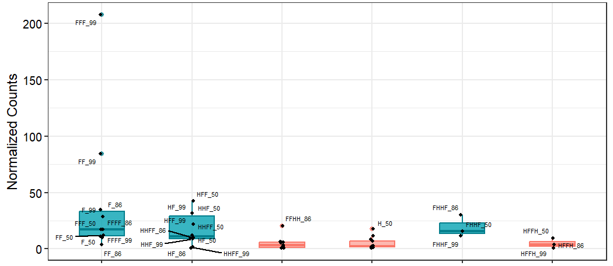
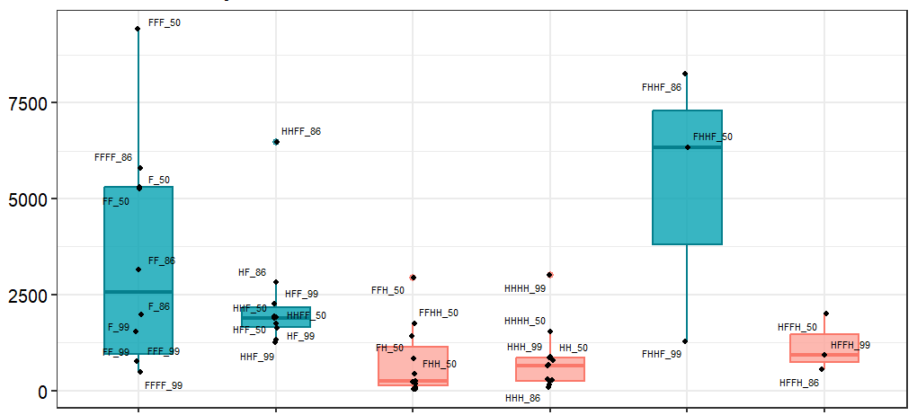
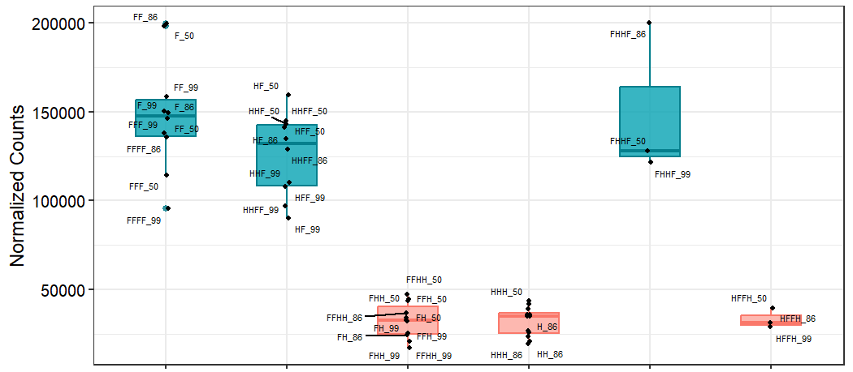
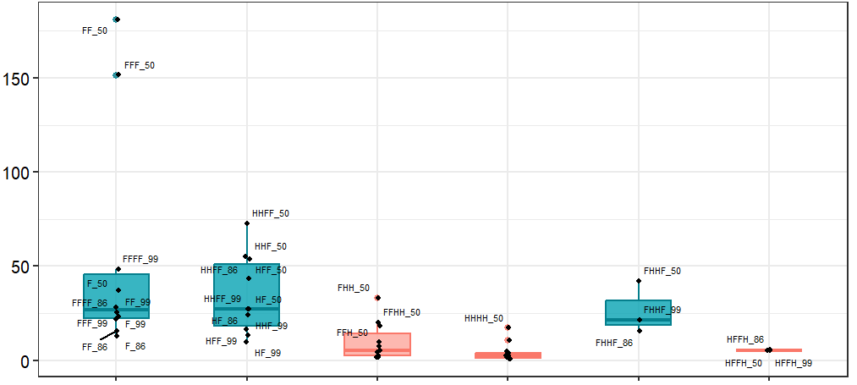
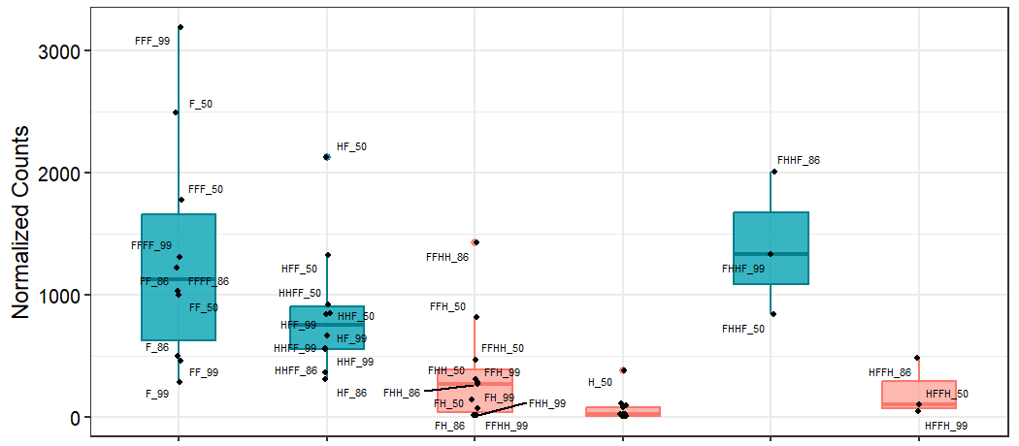
LEPR
WNT2B
FGF7
IL6
IGF1
IGF2
IGFBP1
IGFBP2
IGFBP4
SFRP2
SFRP4
Direct FBS
Adapted FBS
Adapted hPL
Direct hPL
Re-adapted FBS
Re-adapted hPL
Direct FBS
Adapted FBS
Adapted hPL
Direct hPL
Re-adapted FBS
Re-adapted hPL
Supplementary Figure 3 (cont)

Slide 7
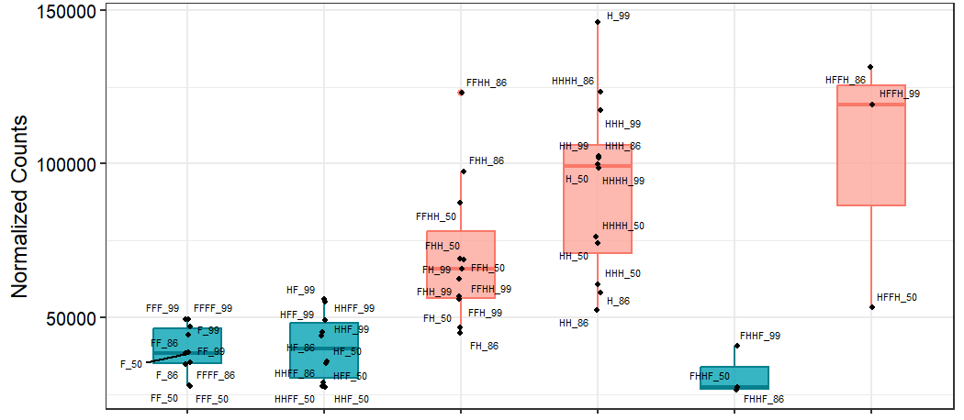
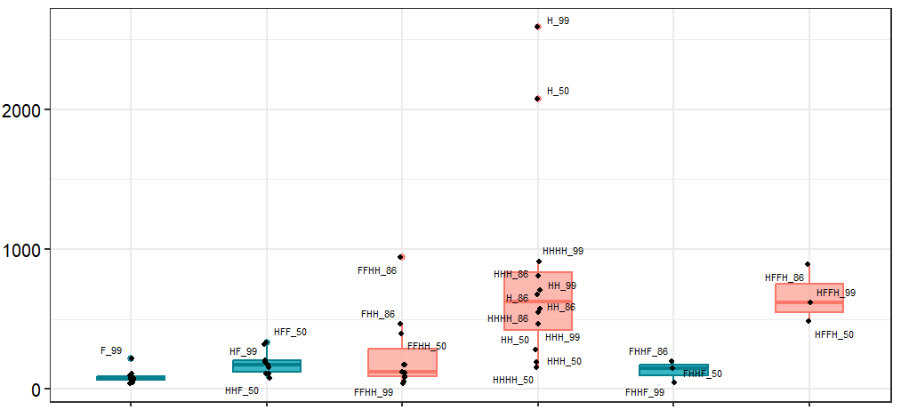
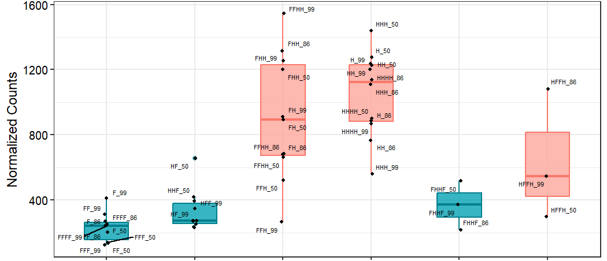
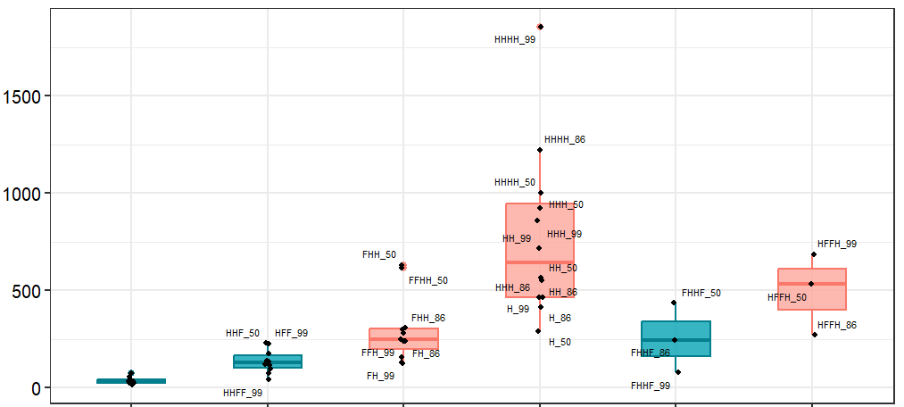
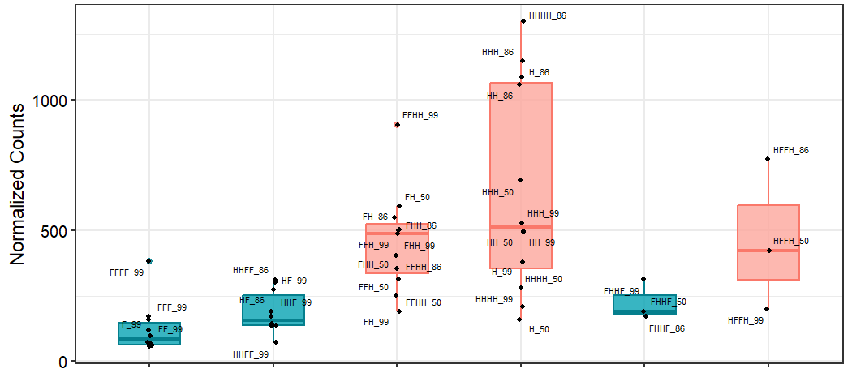
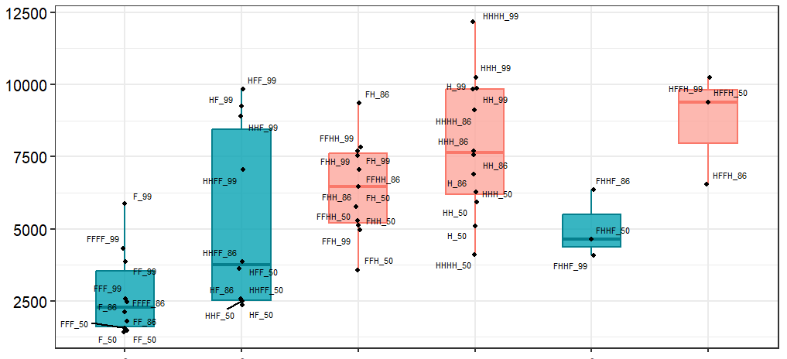
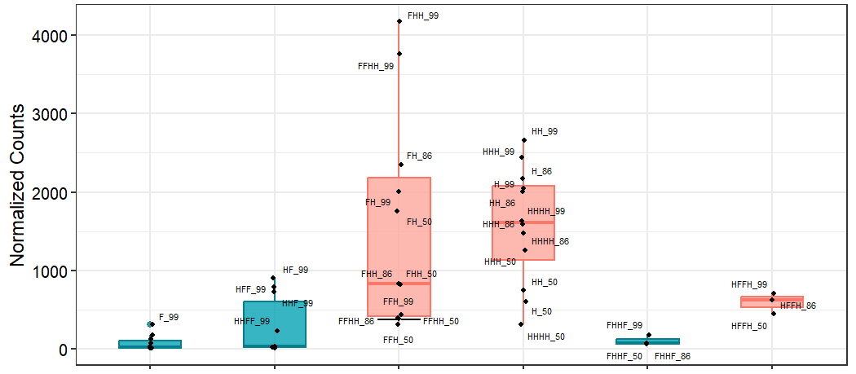
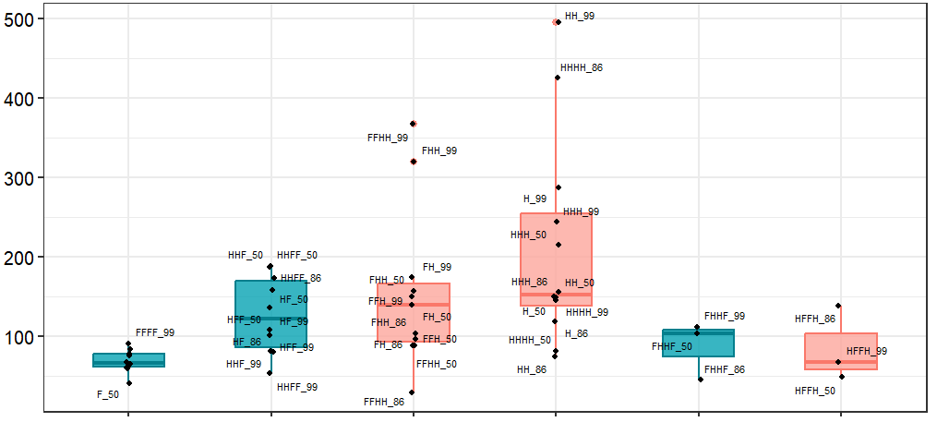
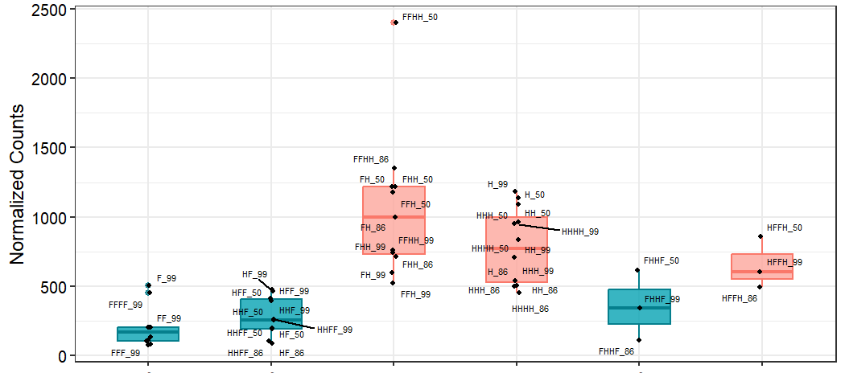
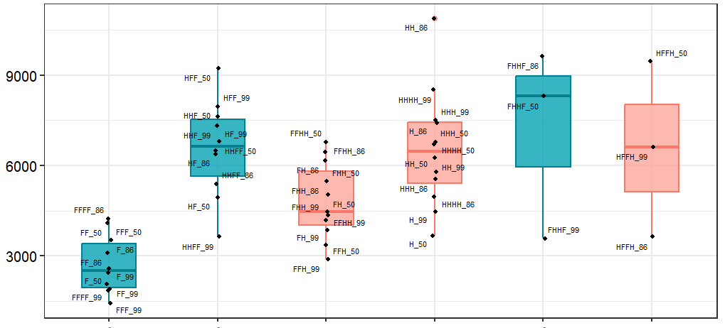
MMP14
SPP1
BMP4
DKK2
EBF2
WNT5B
WNT7B
WNT9A
ITGA2
CDH2
Direct FBS
Adapted FBS
Adapted hPL
Direct hPL
Re-adapted FBS
Re-adapted hPL
Direct FBS
Adapted FBS
Adapted hPL
Direct hPL
Re-adapted FBS
Re-adapted hPL
Supplementary Figure 4 – Boxplots showing normalized gene expression counts for the final set of genes overexpressed in hPL-MSC which may influence HSPC function. Each box represents the distribution of expression levels across samples, with blue indicating FBS-MSC and red indicating hPL-MSC.

