Slide 1
Tutorial for LA-iMageS
Summary
Software panel…………………….……………………………….....……………….………………..
Ablation parameters……………………………………………………………………………………
Loading data……………………………………………………………....……….....……….…
Adjusting element intensity………………………………………....………………….….
Smooth the image…………………………………..……………..……..………………..
Export as image...................................................................................
Export as data file................................................................................
Save and reloading the image.............................................................
Image rotation……………………………………………………………..………..………..
3-D View………………………………………………………..………………....…………....
Deleting the axis..................................................................................
Coming back to the start…………………………..………….....…….……….………
Select other element…………………………………………………………....………...
Delete color bar....................................................................................
Insert color bar.....................................................................................
Show tick lines.....................................................................................
2
3
4 to 6
7 to 9
10 to 11
12 to 15
16 to 20
21 to 30
32 to 34
35 to 37
38 to 39
40 to 41
42 to 47
48 to 49
50 to 51
52 to 55

Slide 2
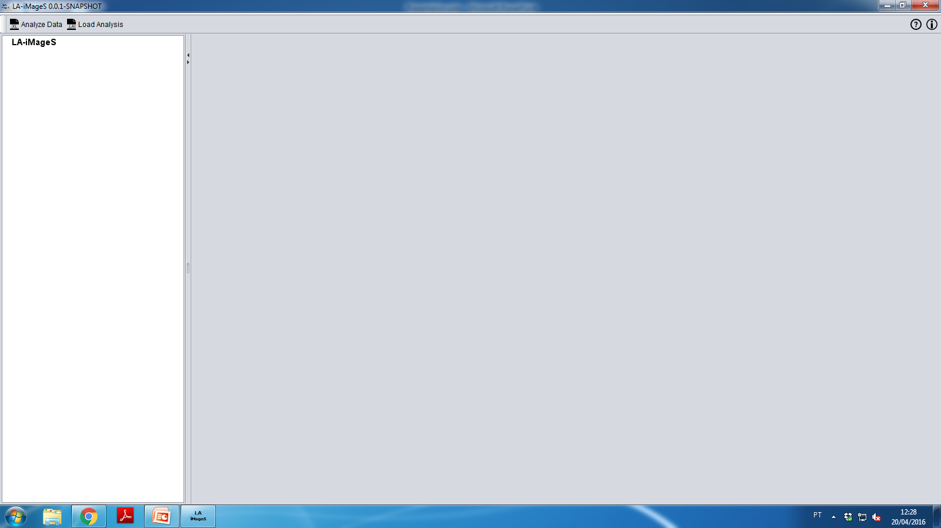
Click here
to start the image building
Software panel

Slide 3
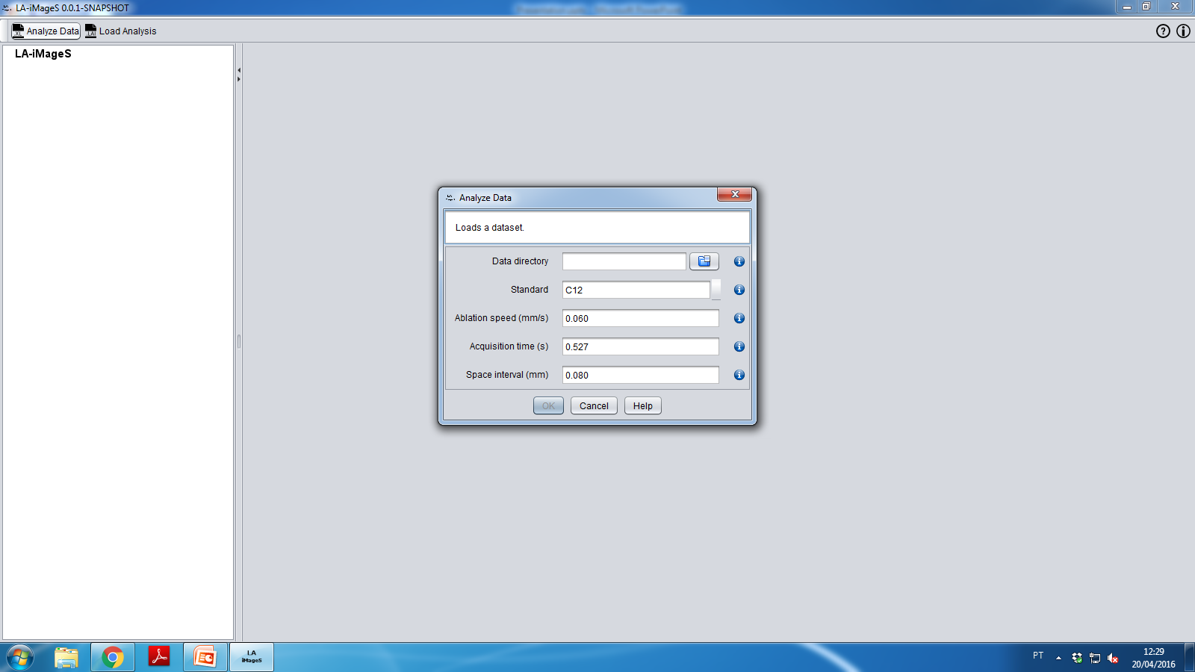
2nd: Insert XL data files
1st: Insert the parameters
for building the image
Ablation parameters

Slide 4
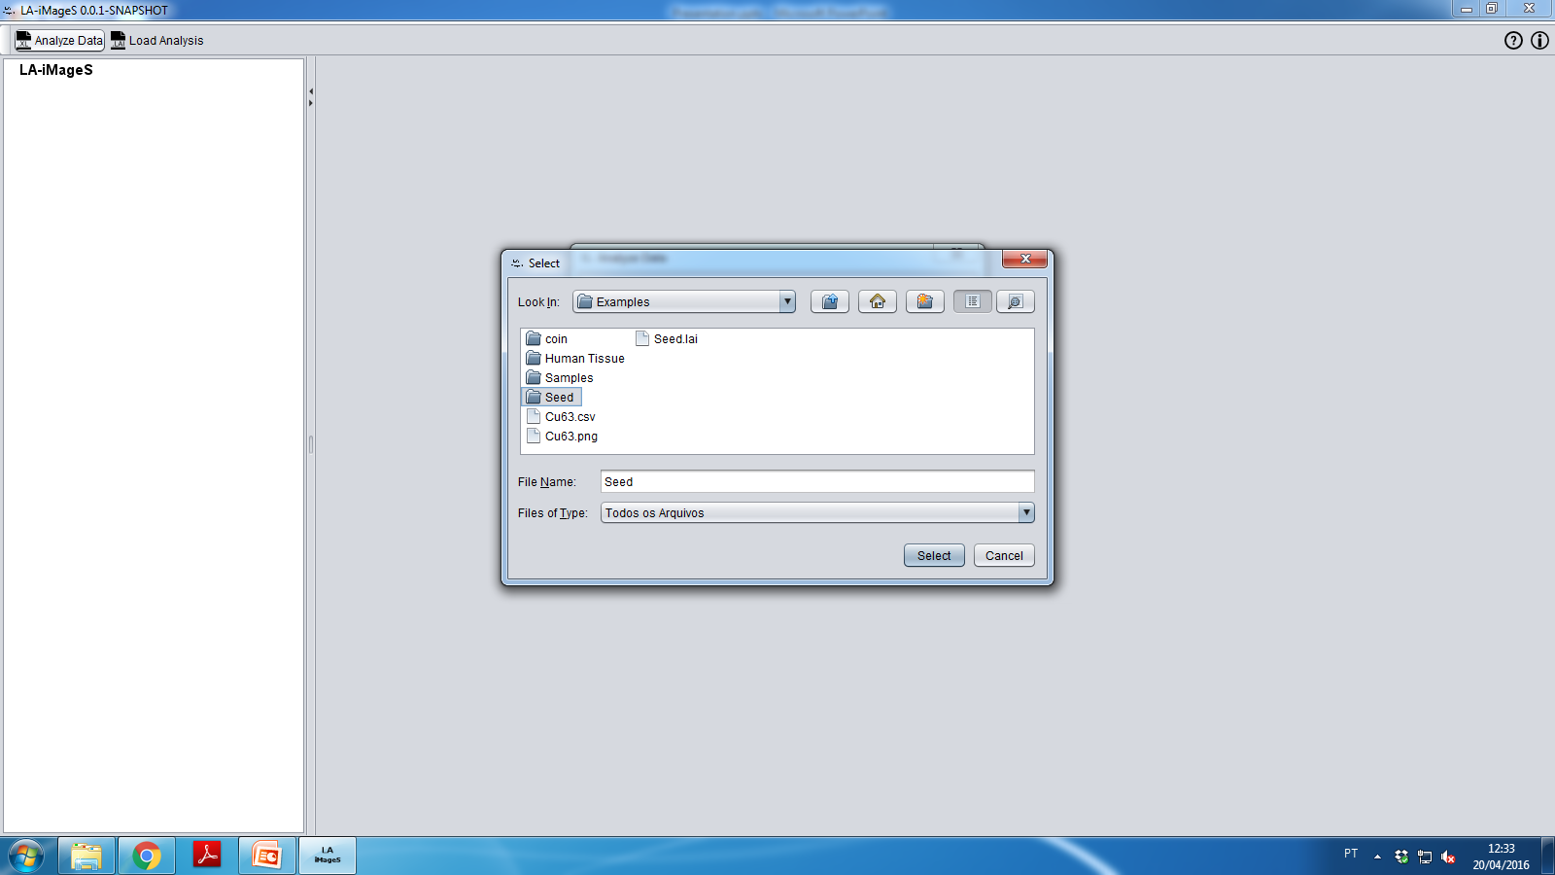
1st:
Select the result folder
2nd:
Click Select
Loading data

Slide 5
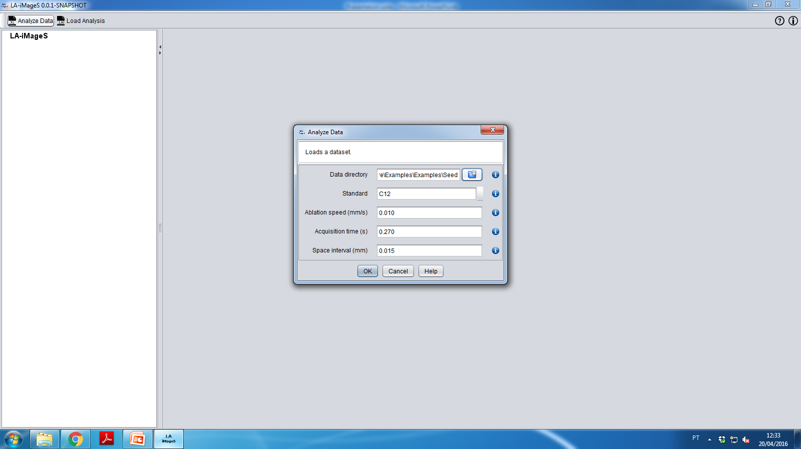
Click Ok
Loading data

Slide 6
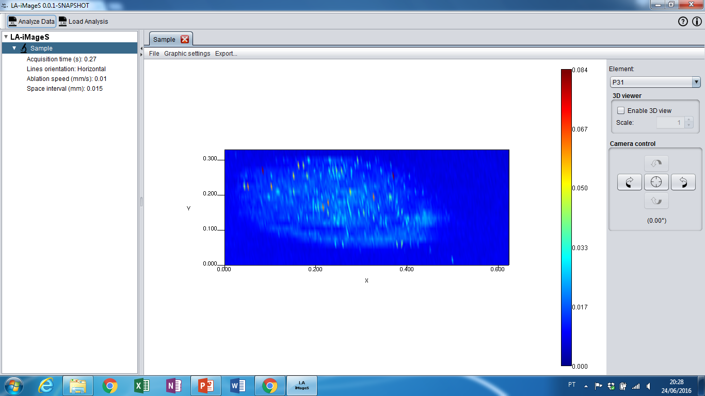
Loading data

Slide 7
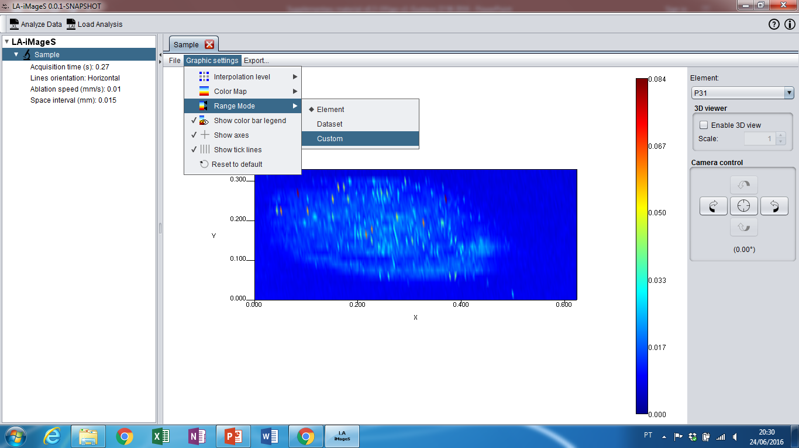
1st: Click Graphic Settings
2nd: Click in Range mode
3rd: Select the option
Custom
Adjusting element intensity

Slide 8
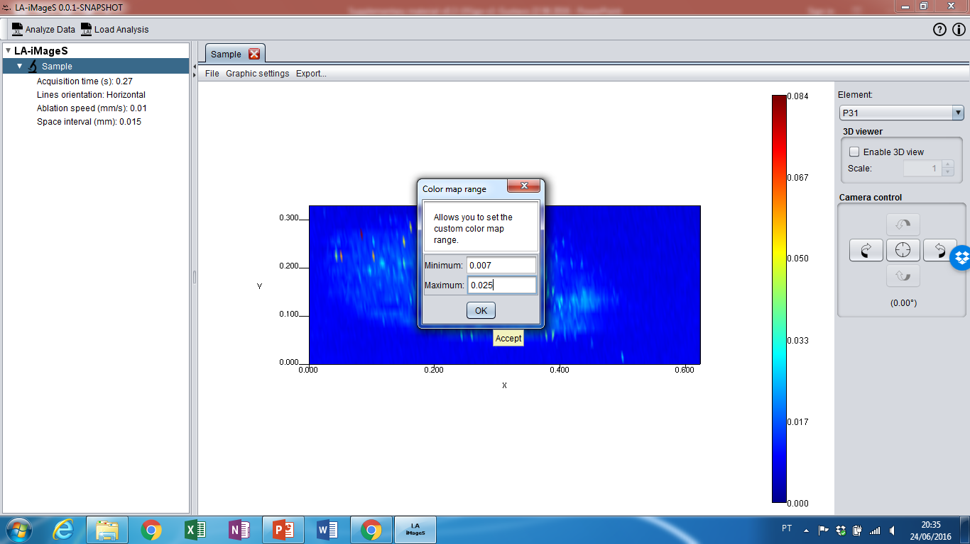
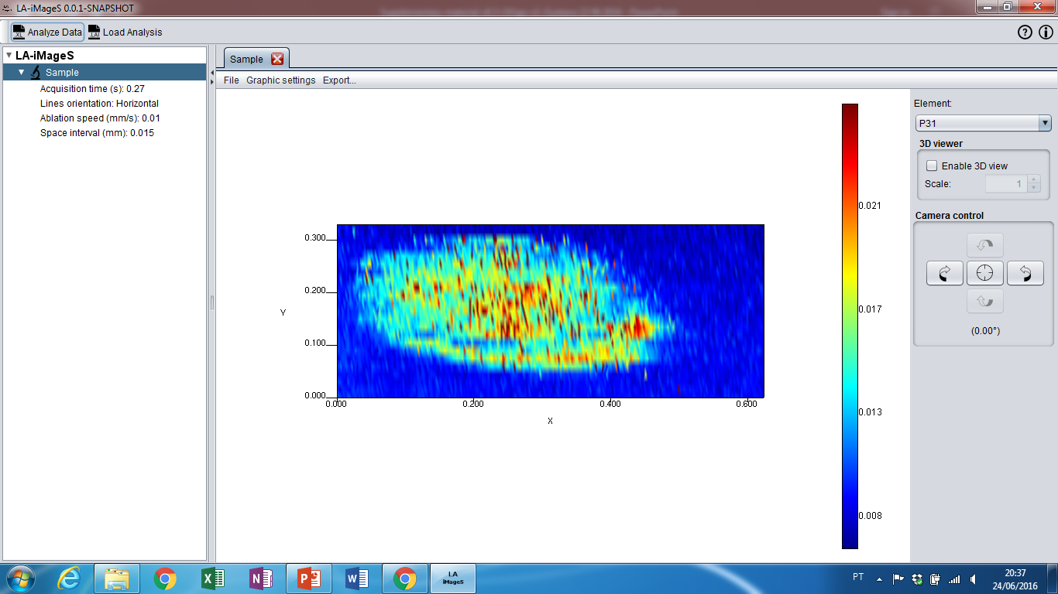
1st: Select data interval
2nd: Click Ok
Adjusting element intensity

Slide 9
Adjusting element intensity

Slide 10
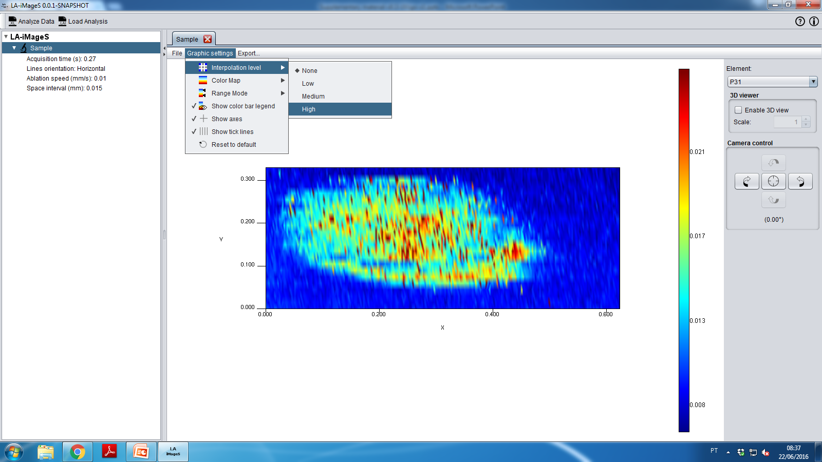
1st: Click Graphic Settings
2nd: Select Interpolation Level
3rd: Chose the best interpolation for your data set
Smooth the image

Slide 11
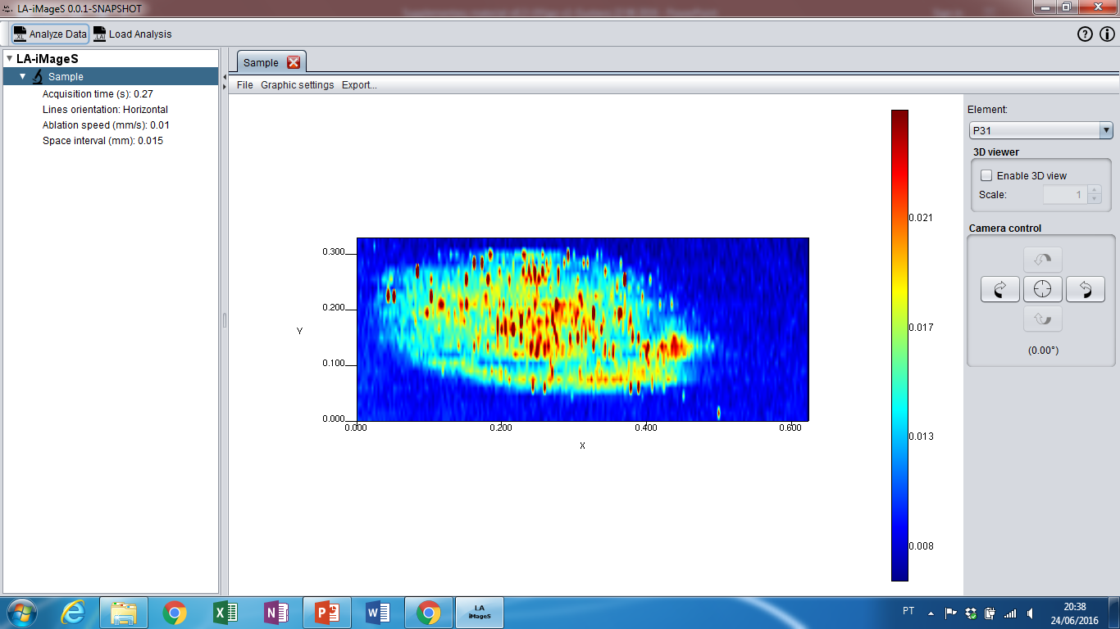
Smooth the image

Slide 12
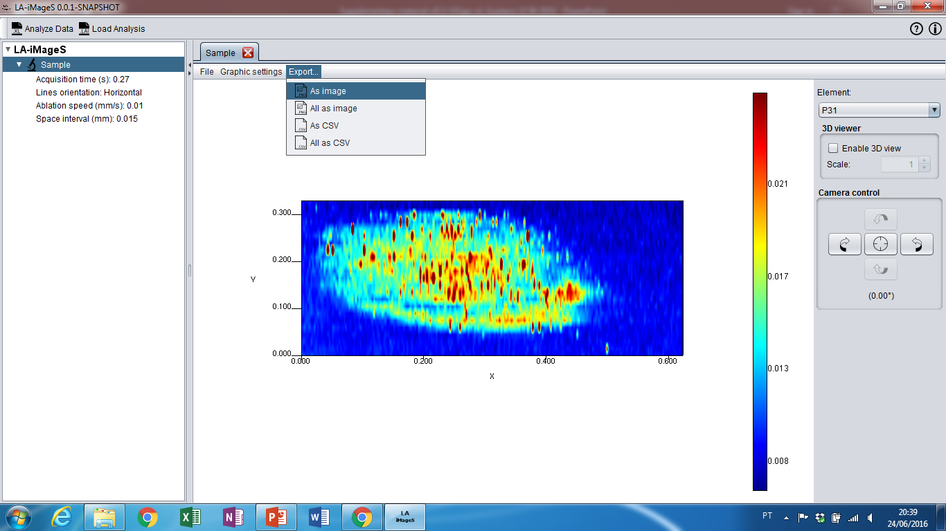
1st: Click Export
2nd: Click As image, for example
Export as image

Slide 13
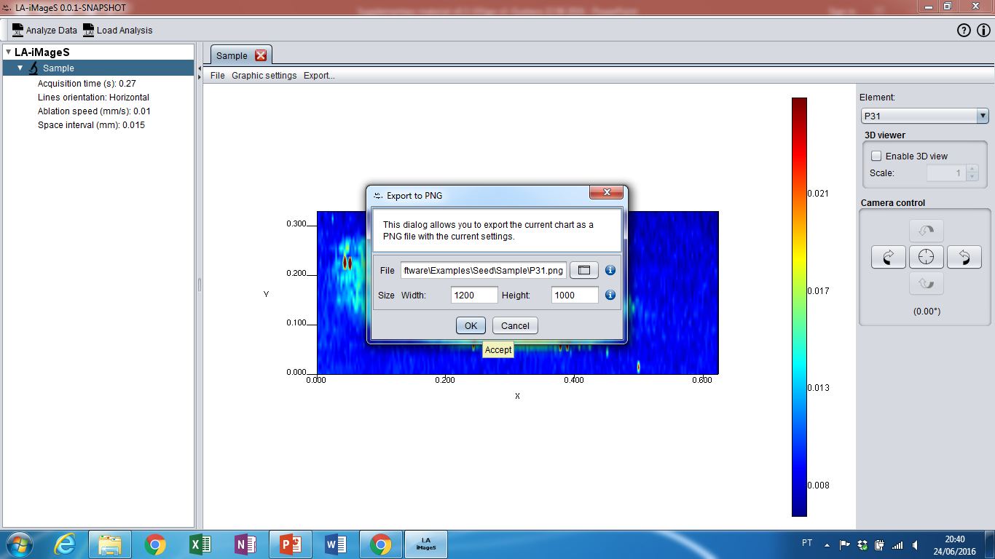
1st: Choose the local path where the file will be saved
2nd: Click Ok
Export as image

Slide 14
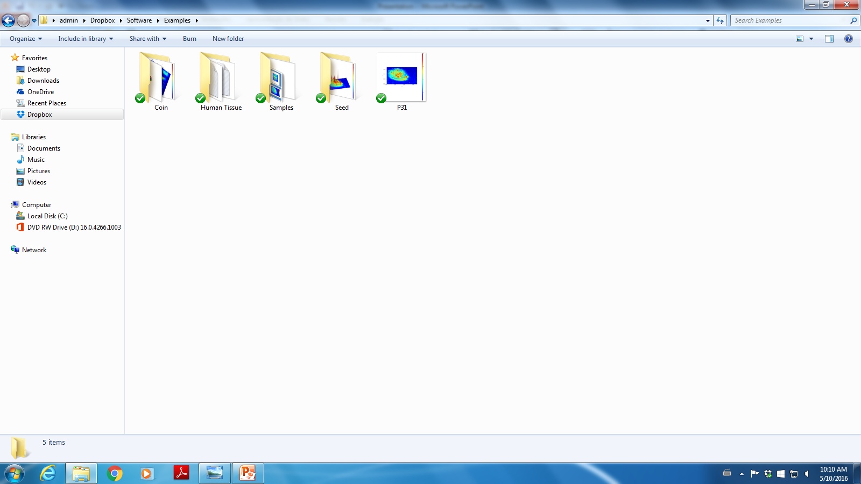
The file will be saved in selected directory
Export as image

Slide 15
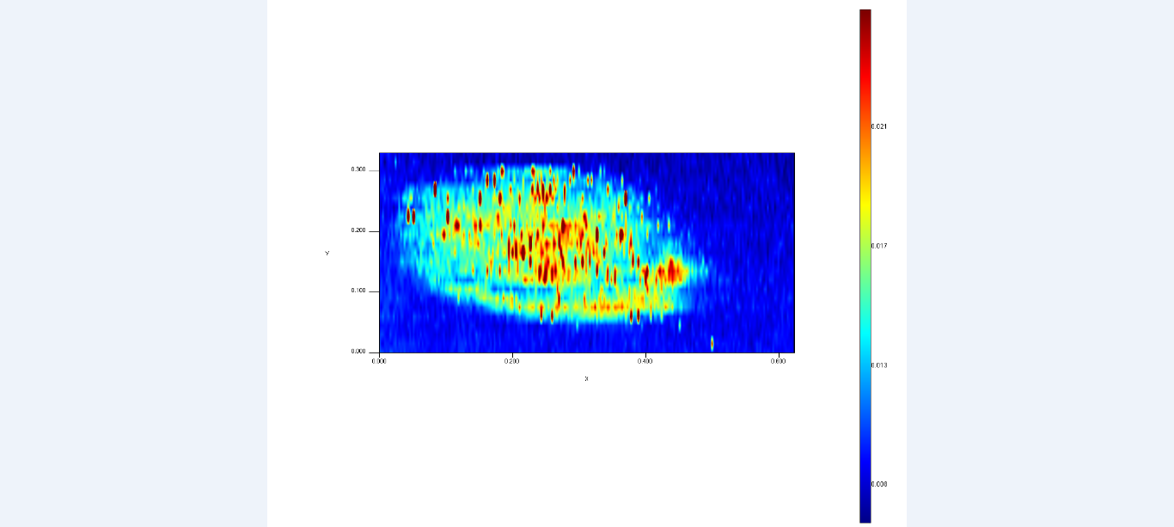
Export as image

Slide 16
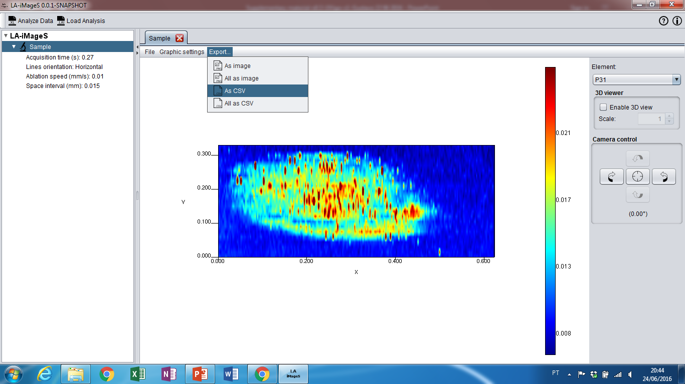
1st: Click Export
2nd: Click As CSV, for example
Export as data file

Slide 17
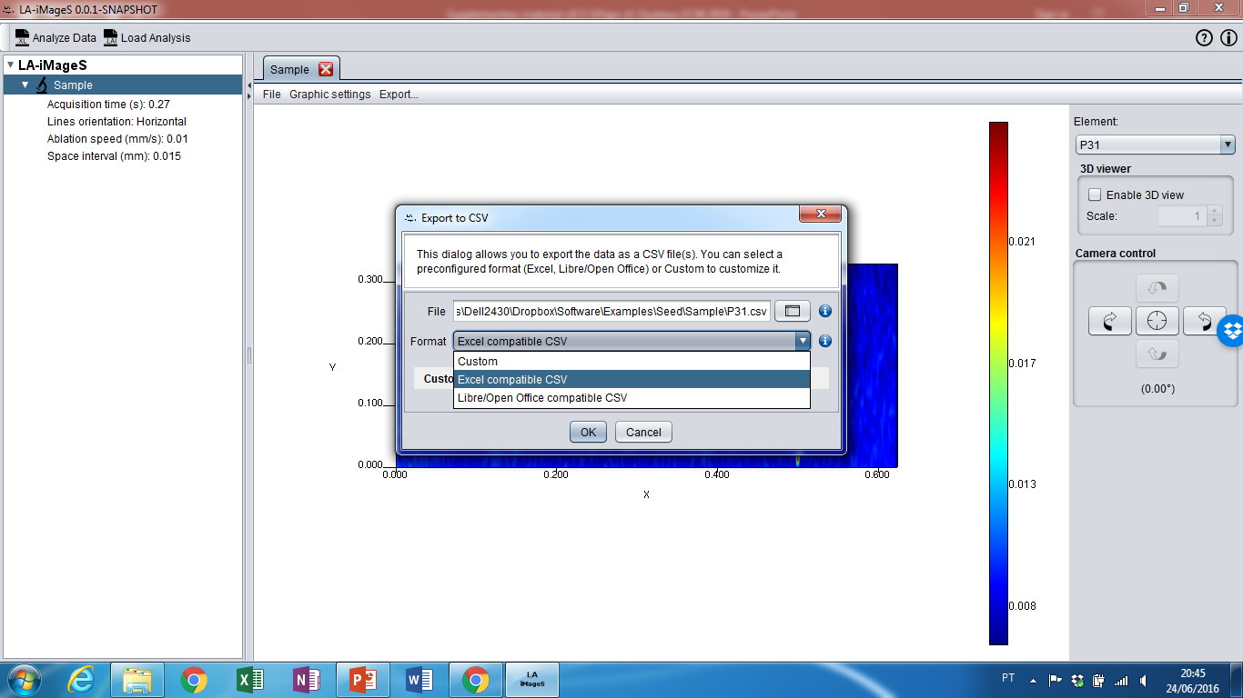
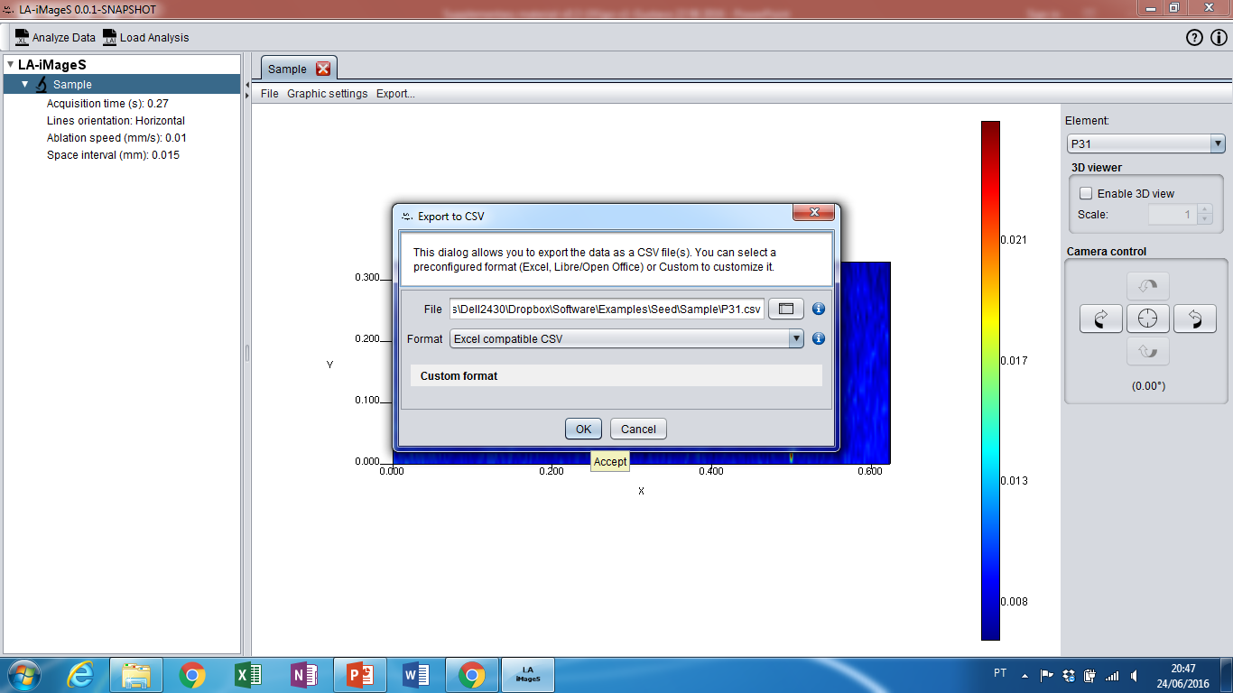
Choose the adequate file format to save data
Export as data file

Slide 18
1st: Choose the local path where the file will be saved
2nd: Click Ok
Export as data file

Slide 19
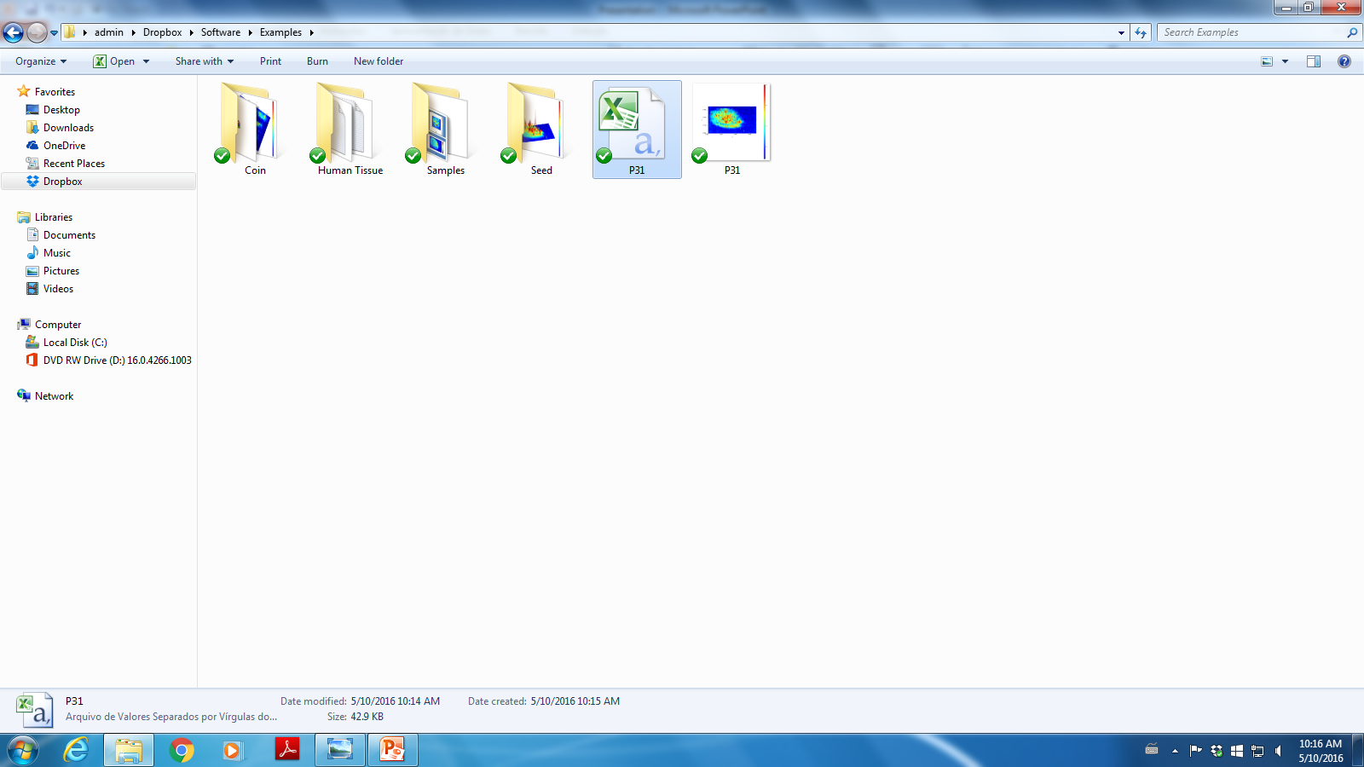
The file will be saved in selected directory
Export as data file

Slide 20
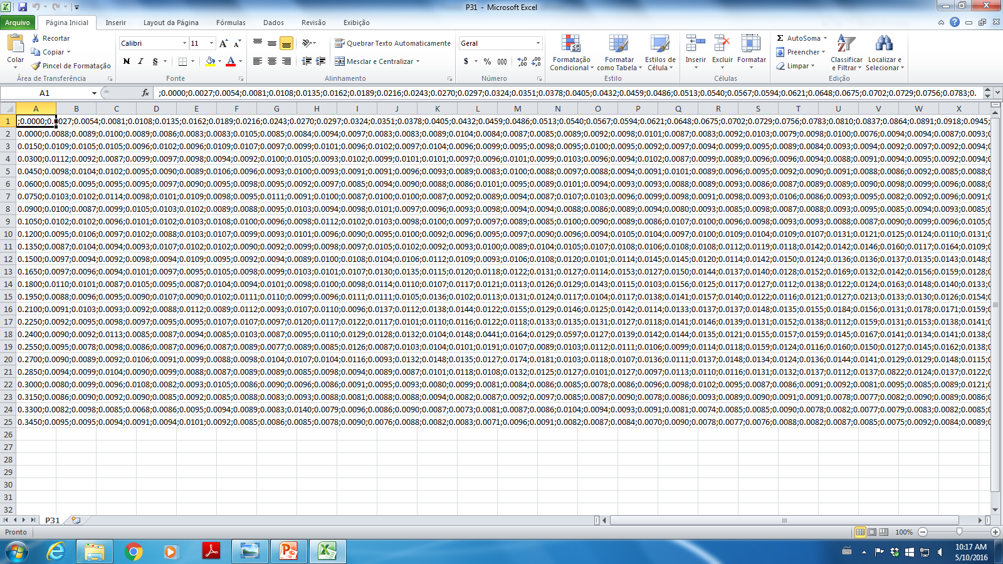
To this format, you can recovery your data used to image building
Export as data file

Slide 21
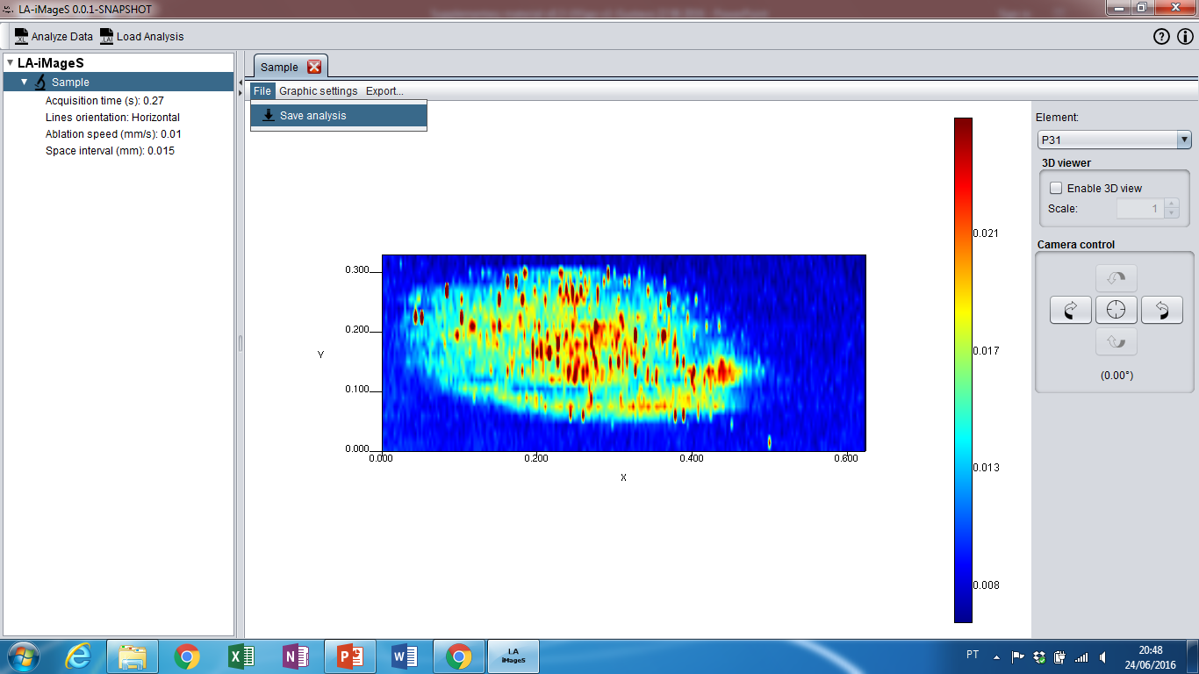
1st: To save the image, Click File
2nd: and Save analysis
Save and reloading the image

Slide 22
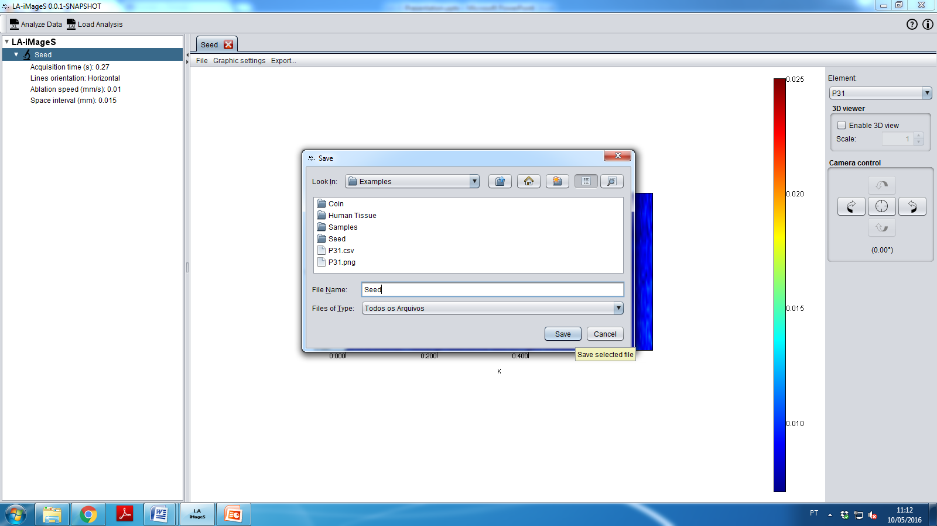
1st: Give a name to the file
2nd: …and click Save
Save and reloading the image

Slide 23
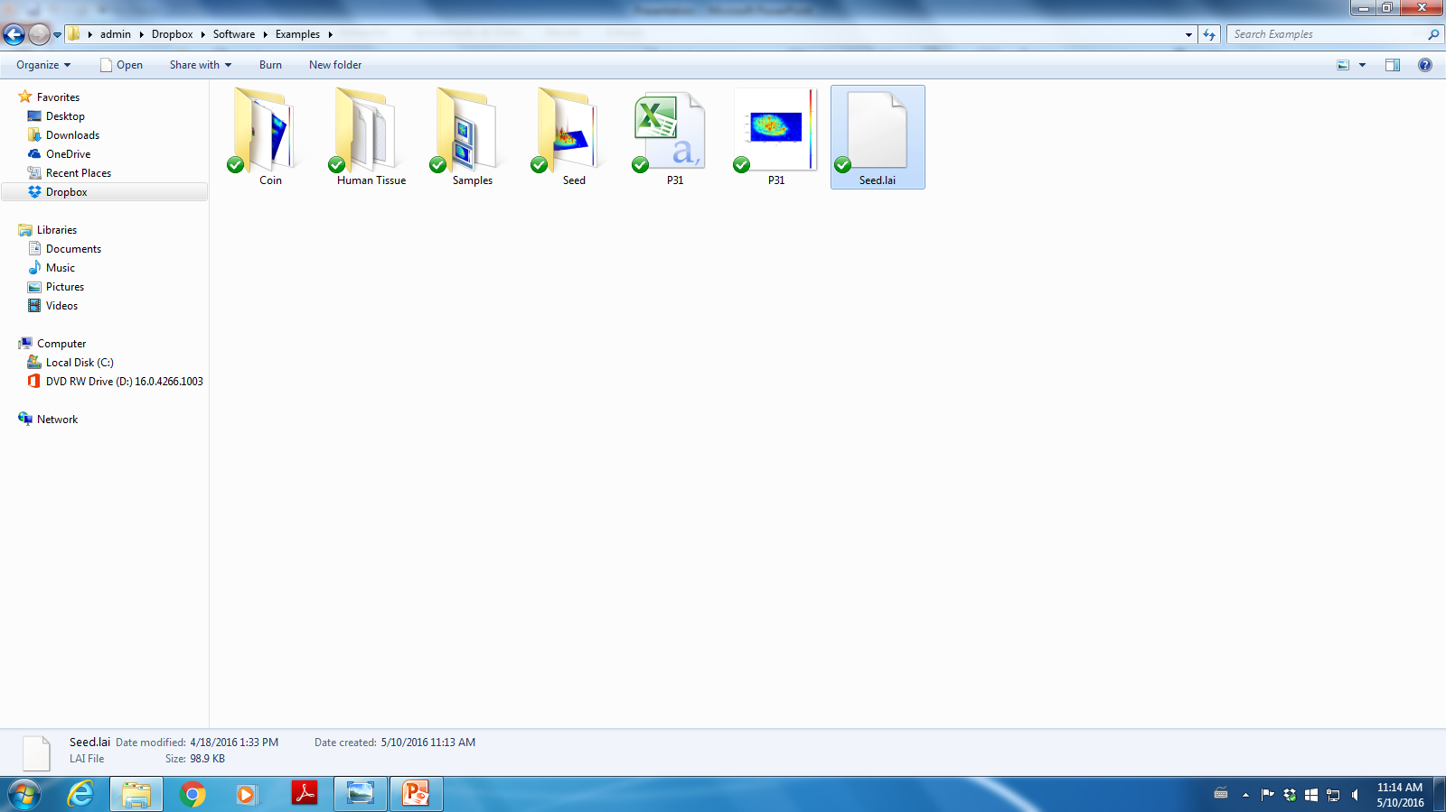
The file will be saved in selected directory
Save and reloading the image

Slide 24
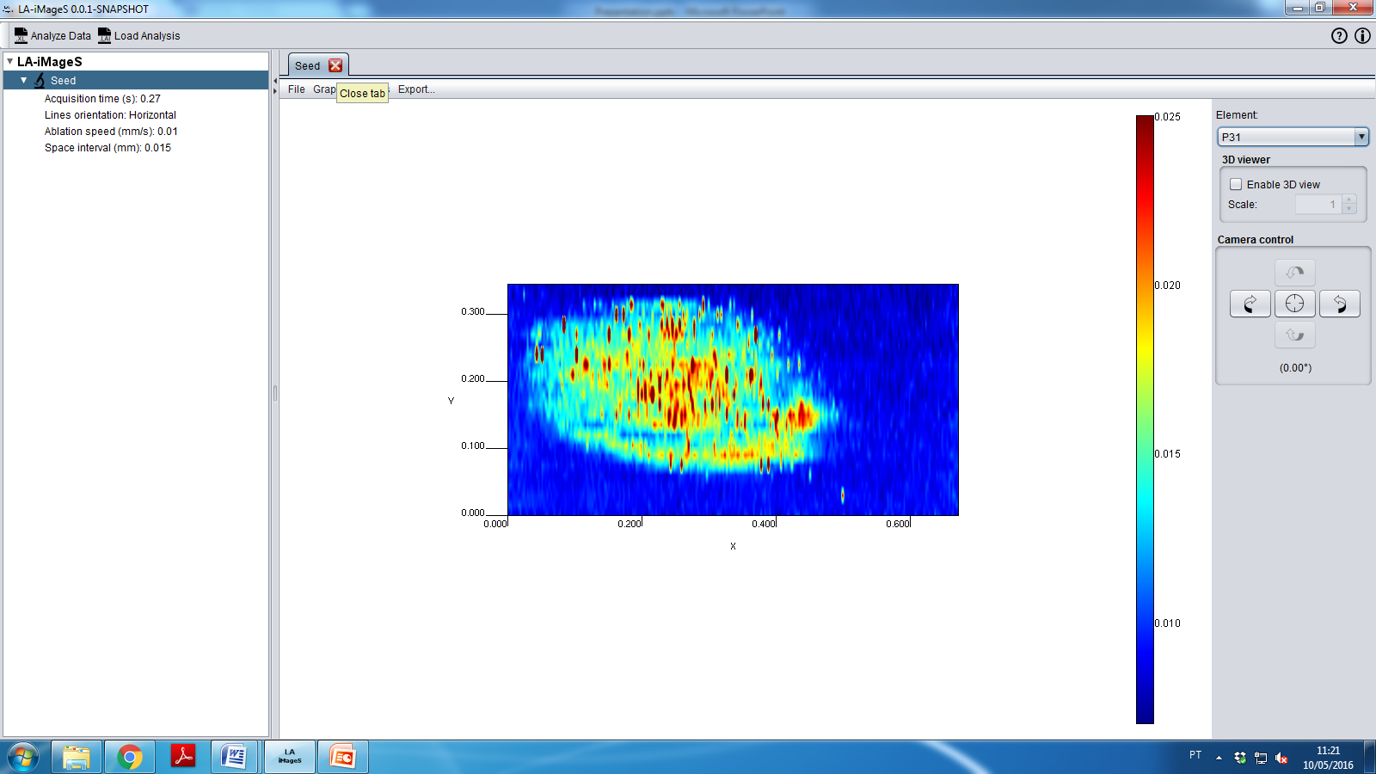
You can close the tab or the software
Save and reloading the image

Slide 25
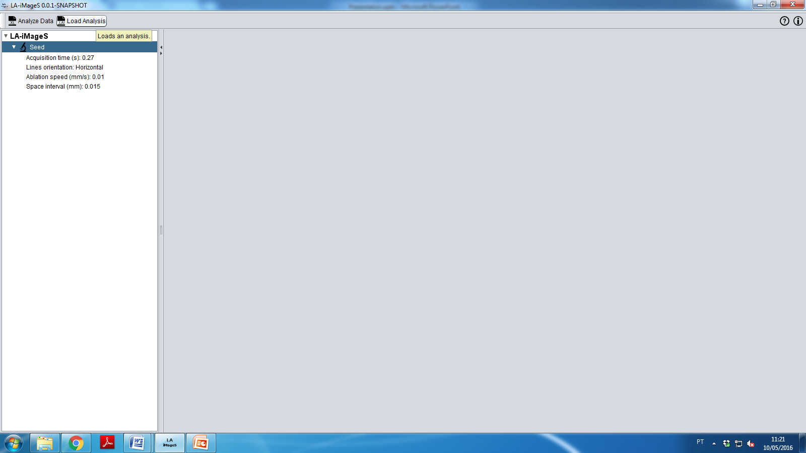
For recovering the image, click Load analysis
Save and reloading the image

Slide 26
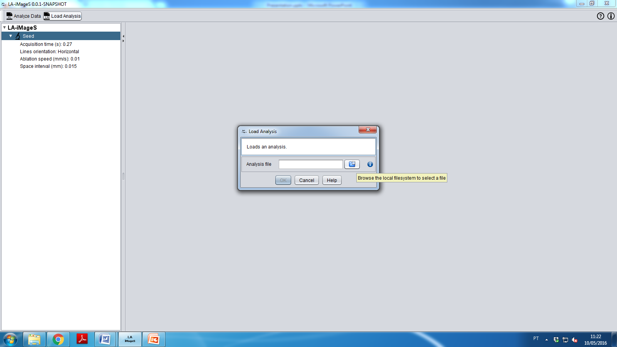
Click the button to show the Data directory
Save and reloading the image

Slide 27
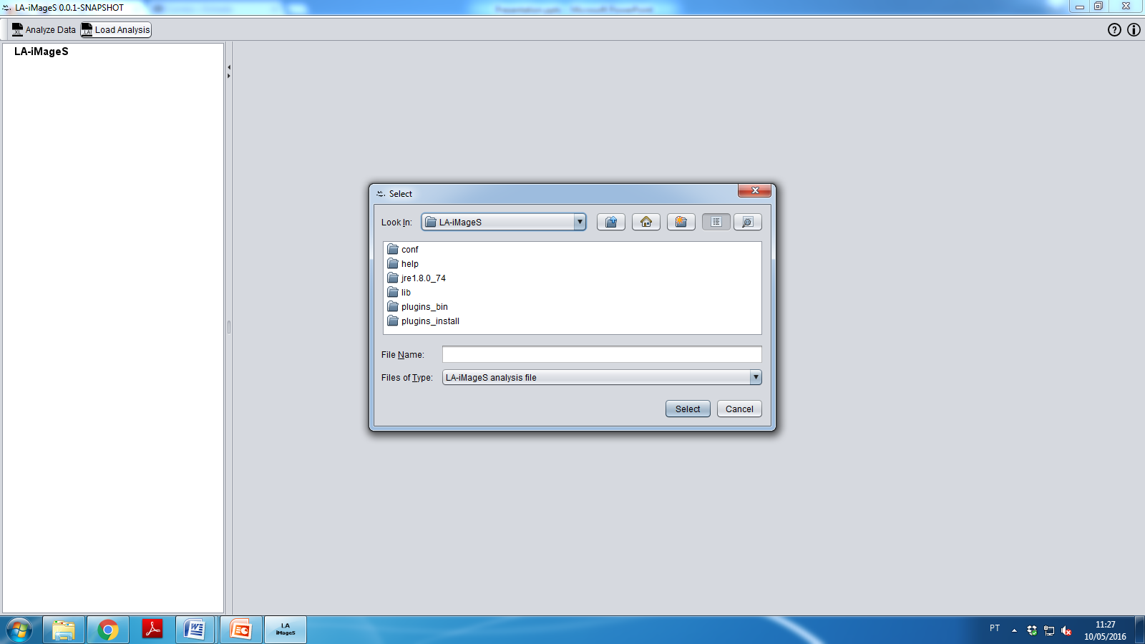
Click the button to show the Data directory
You must load the file with extension “.lai”
Save and reloading the image

Slide 28
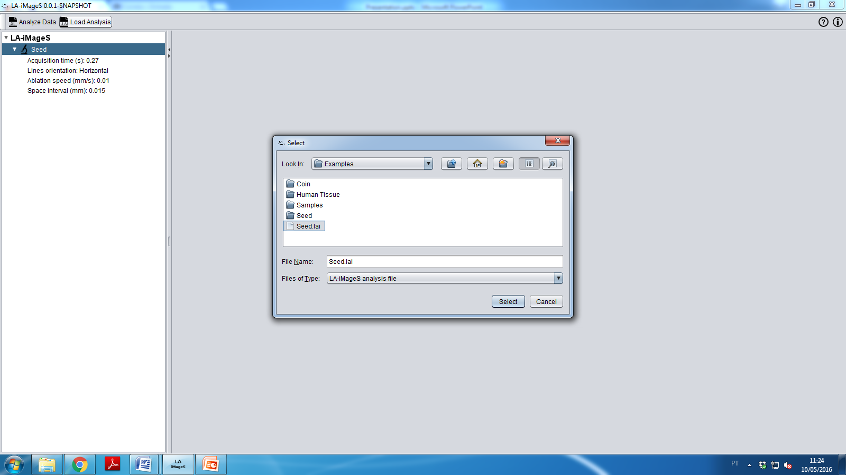
1st: Find the file
2nd: …and click Select
Save and reloading the image

Slide 29
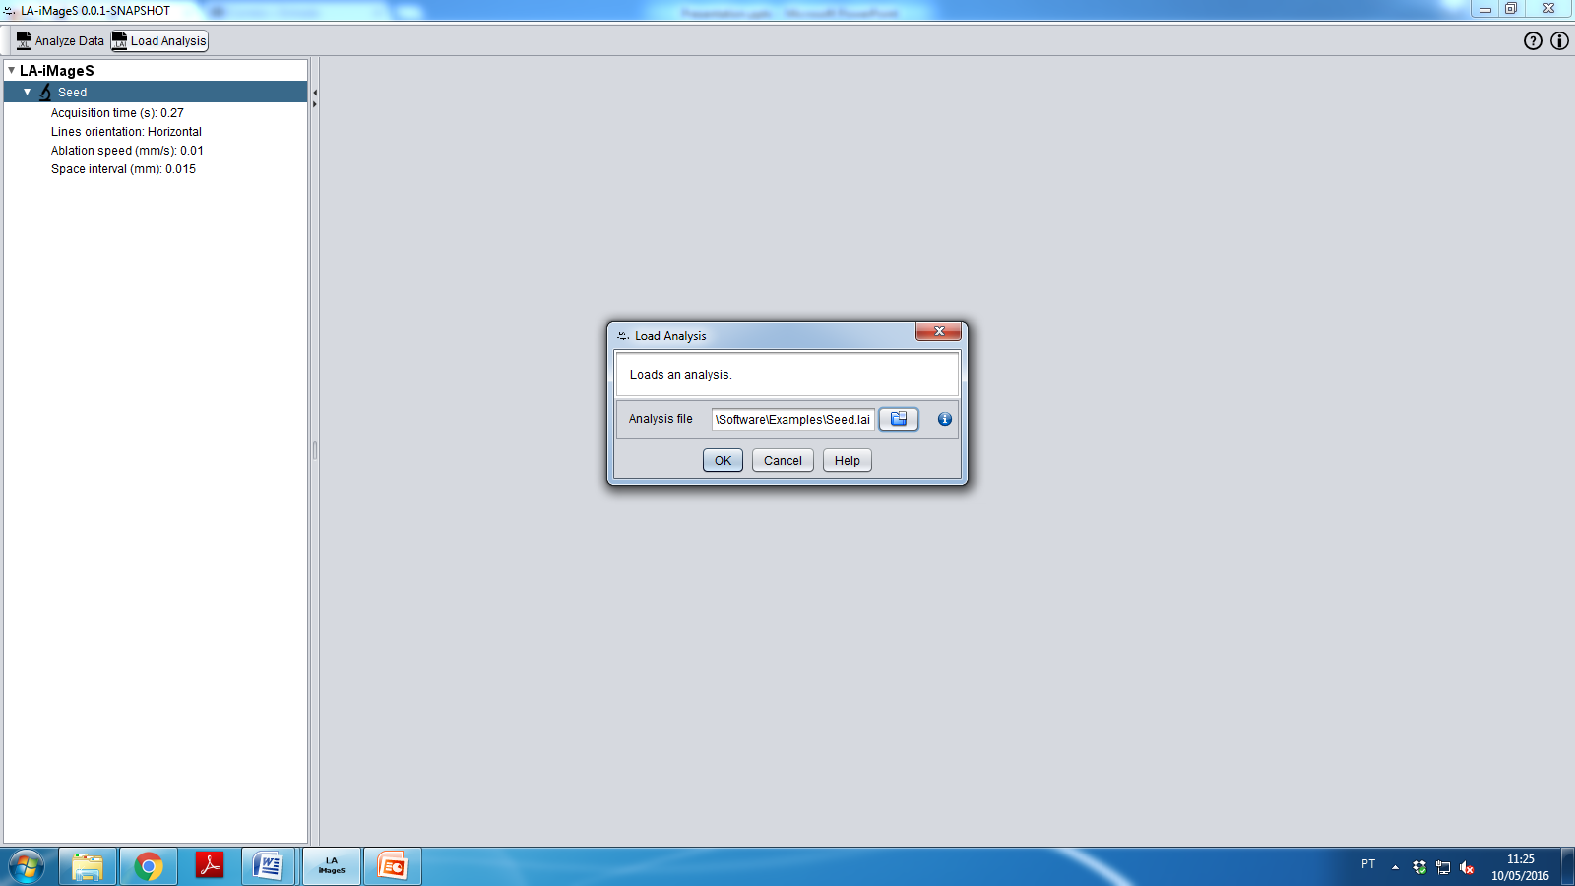
Click Ok
Save and reloading the image

Slide 30
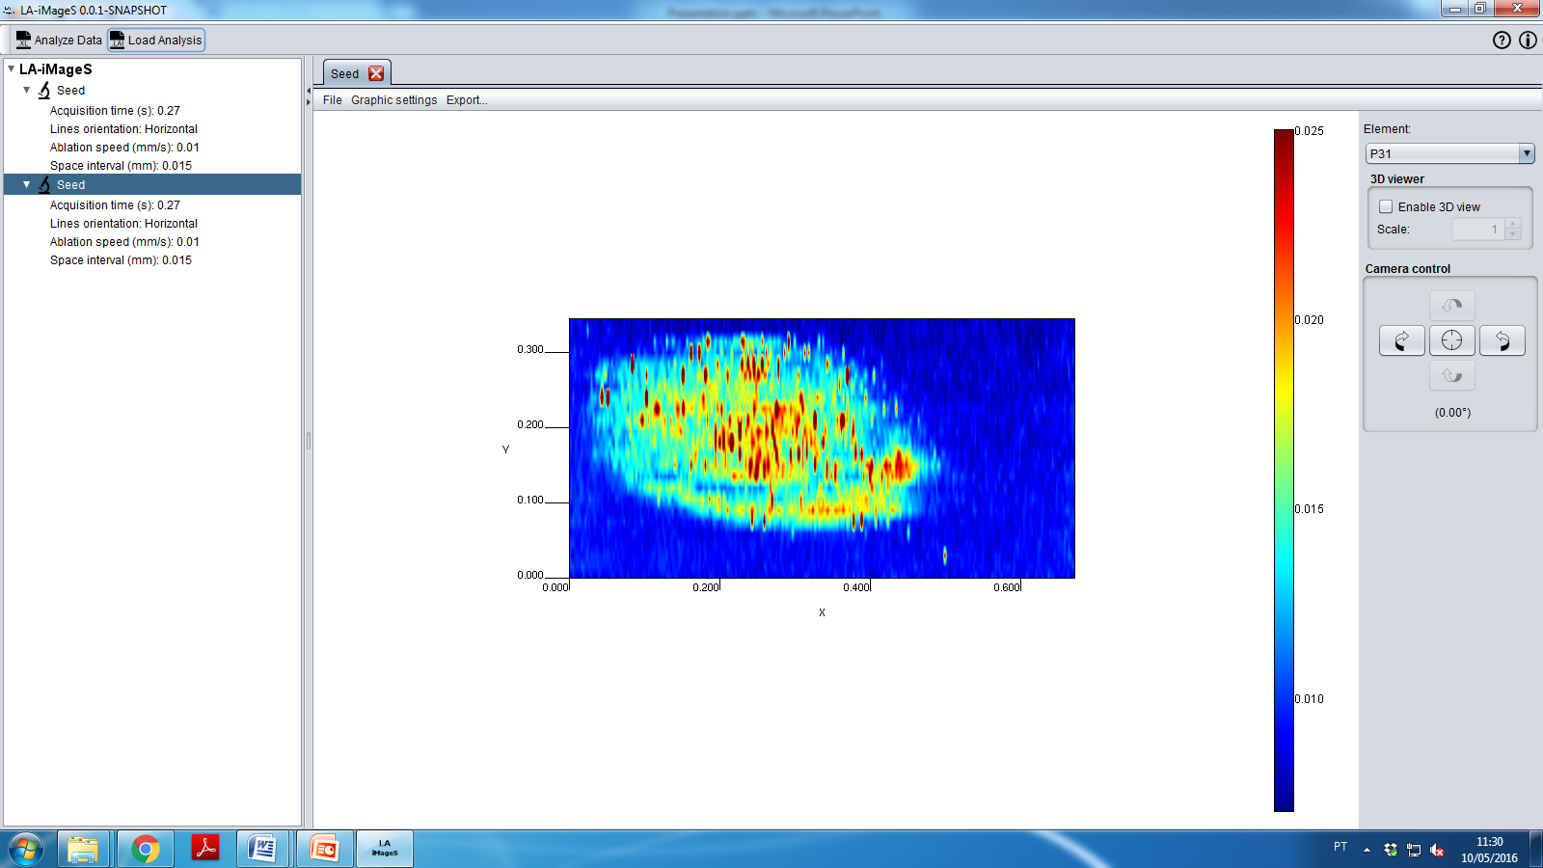
Save and reloading the image

Slide 31
Other features of
LA-iMageS

Slide 32

Click to rotate the image
Image rotation

Slide 33
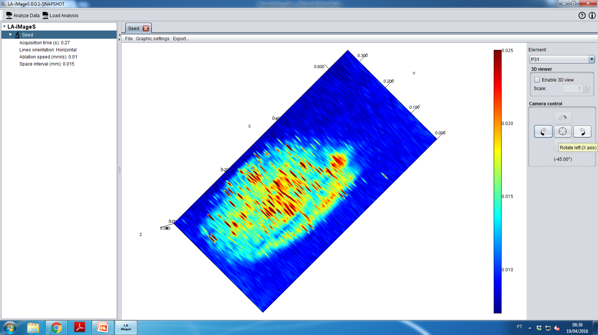
Click to rotate the image
Image rotation

Slide 34
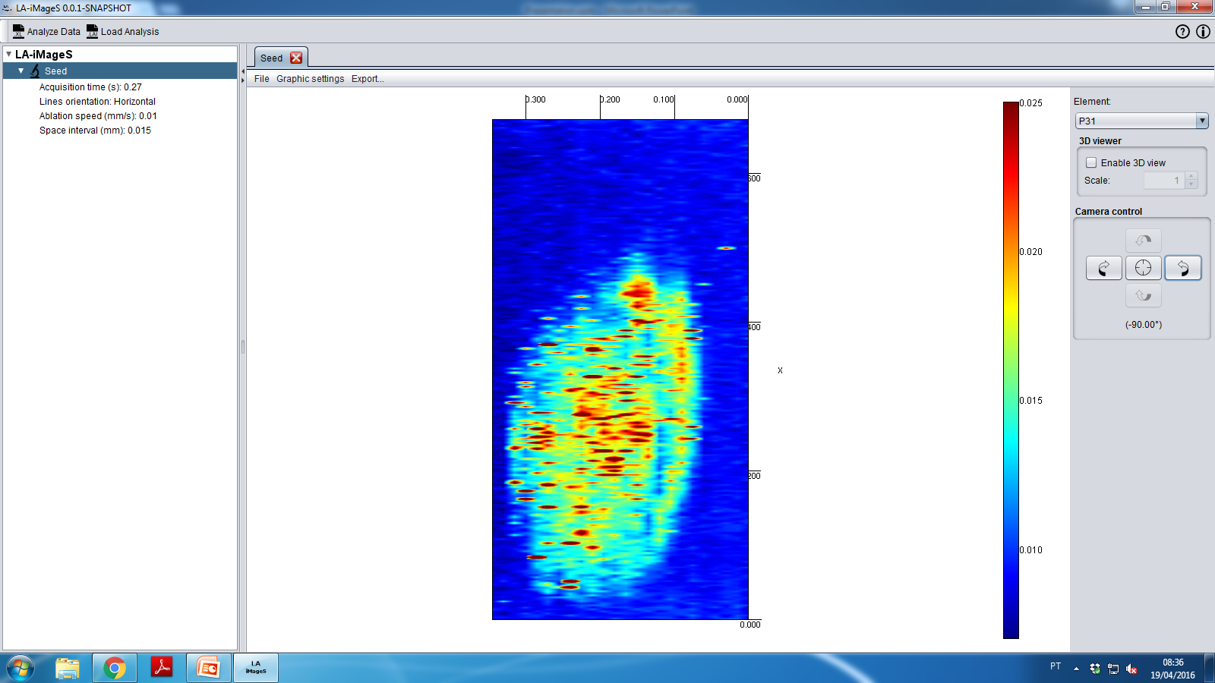
Click to rotate the image
Image rotation

Slide 35
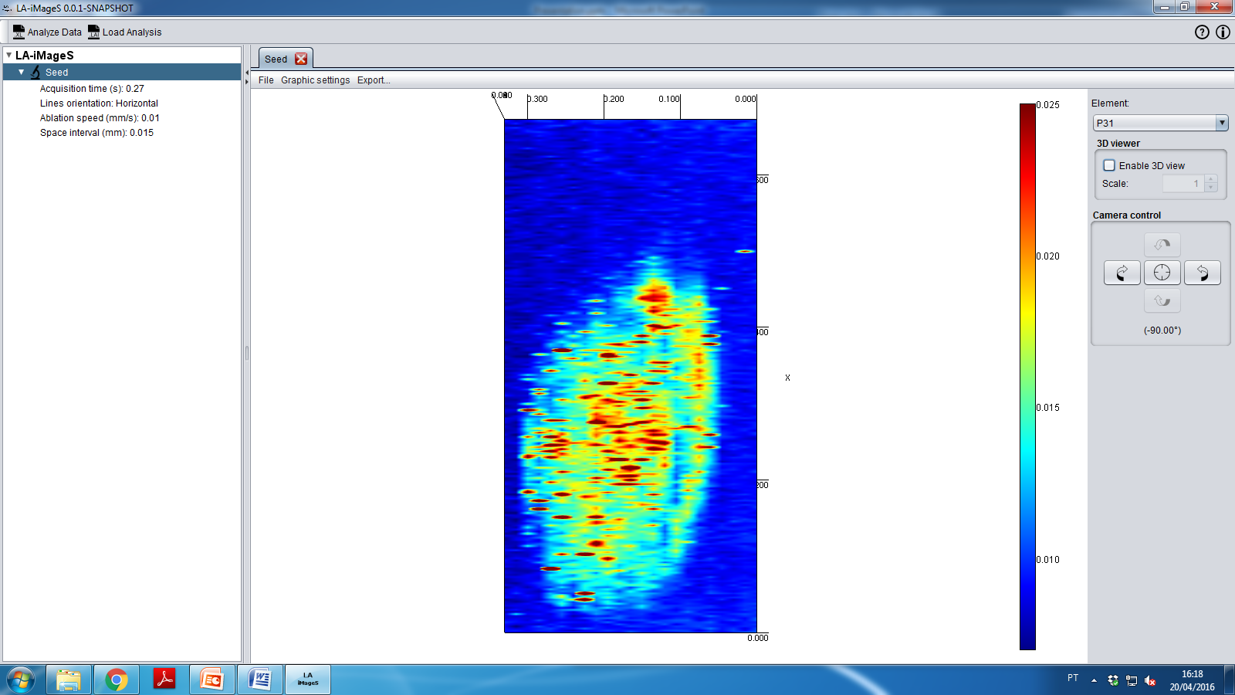
Click here to generate 3D view
3-D view

Slide 36
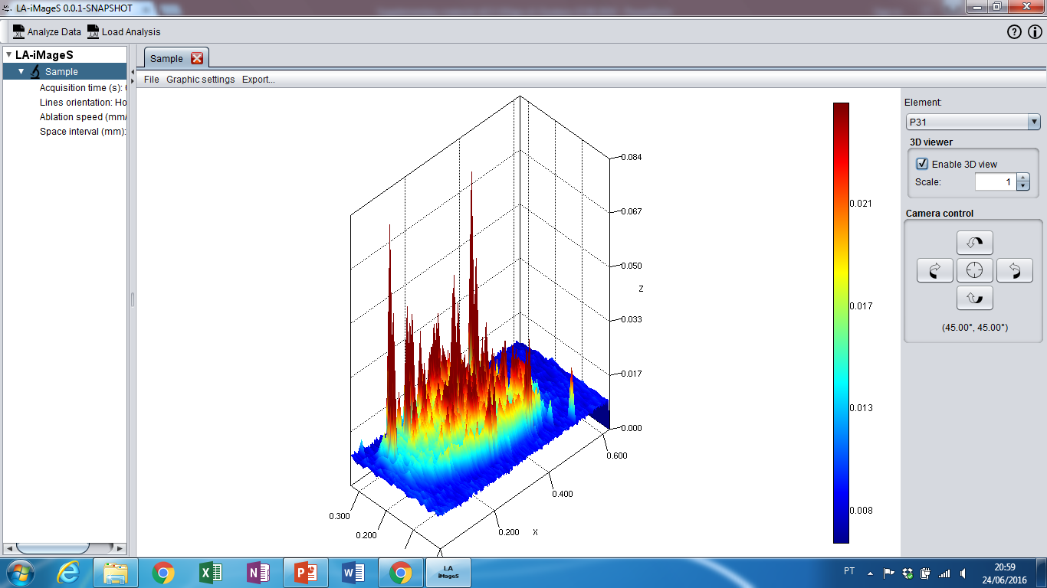
Click here to generate 3D view
3-D view

Slide 37
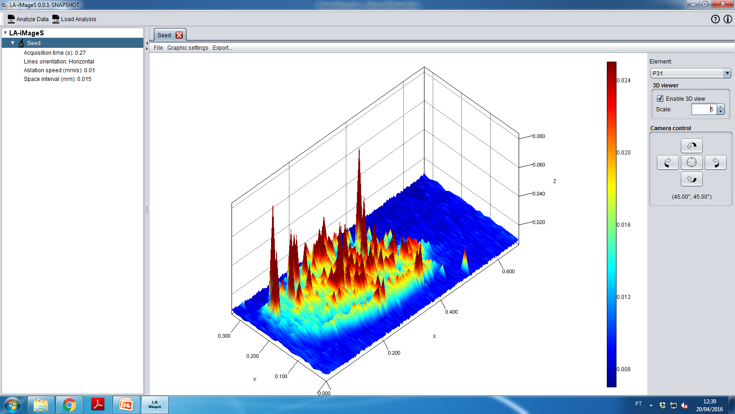
You can change
z-scale
3-D view

Slide 38
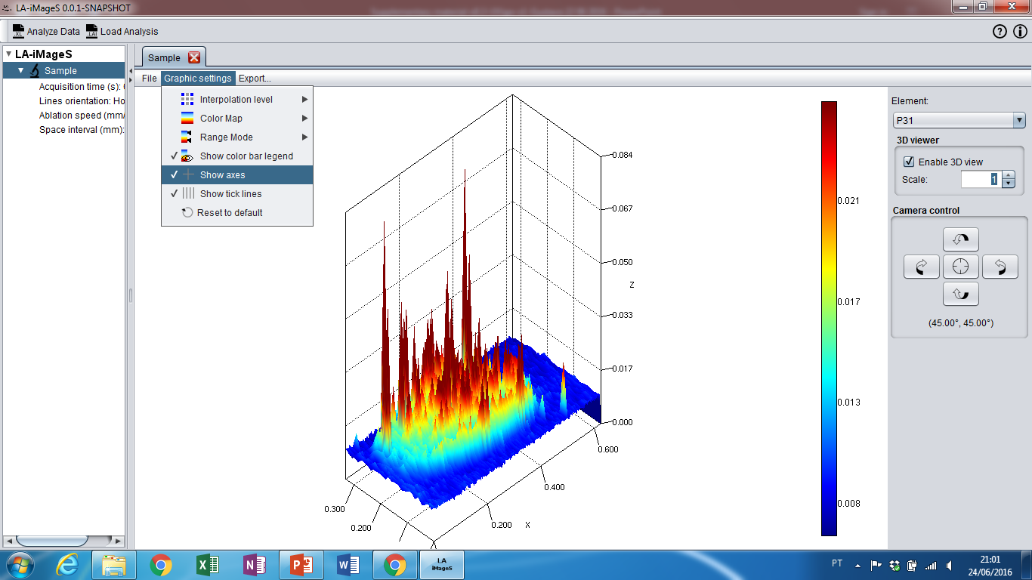
This tool removes all axis
Deleting the axis

Slide 39

Deleting the axis

Slide 40

Cilck here, if you want to restart image bulding
Coming back to the start

Slide 41
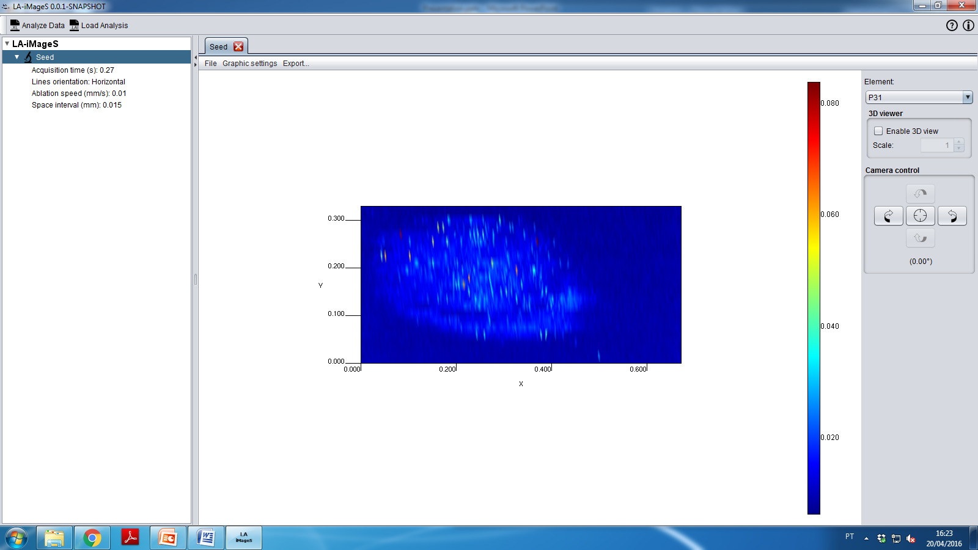
Coming back to the start

Slide 42
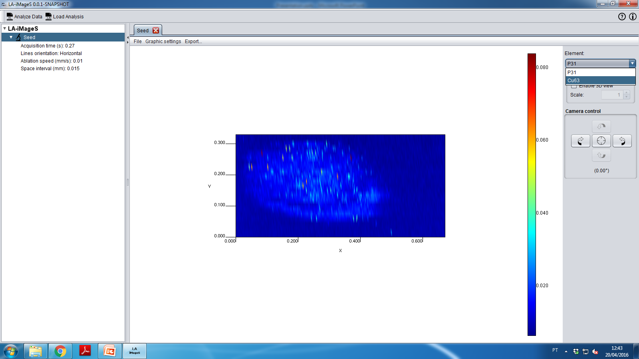
1st: For changing the element, click here
2nd: and select other element
Select other element

Slide 43
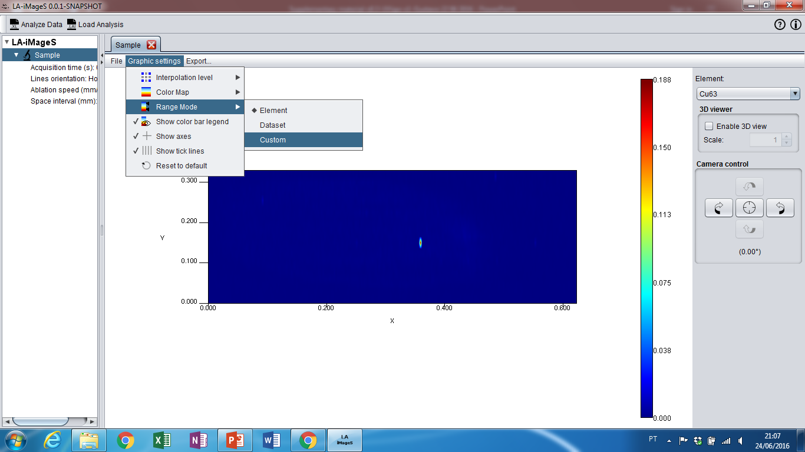
1st: Click Graphic Settings
2nd: Click in Range mode
3rd: Select the option
Custom
Select other element

Slide 44
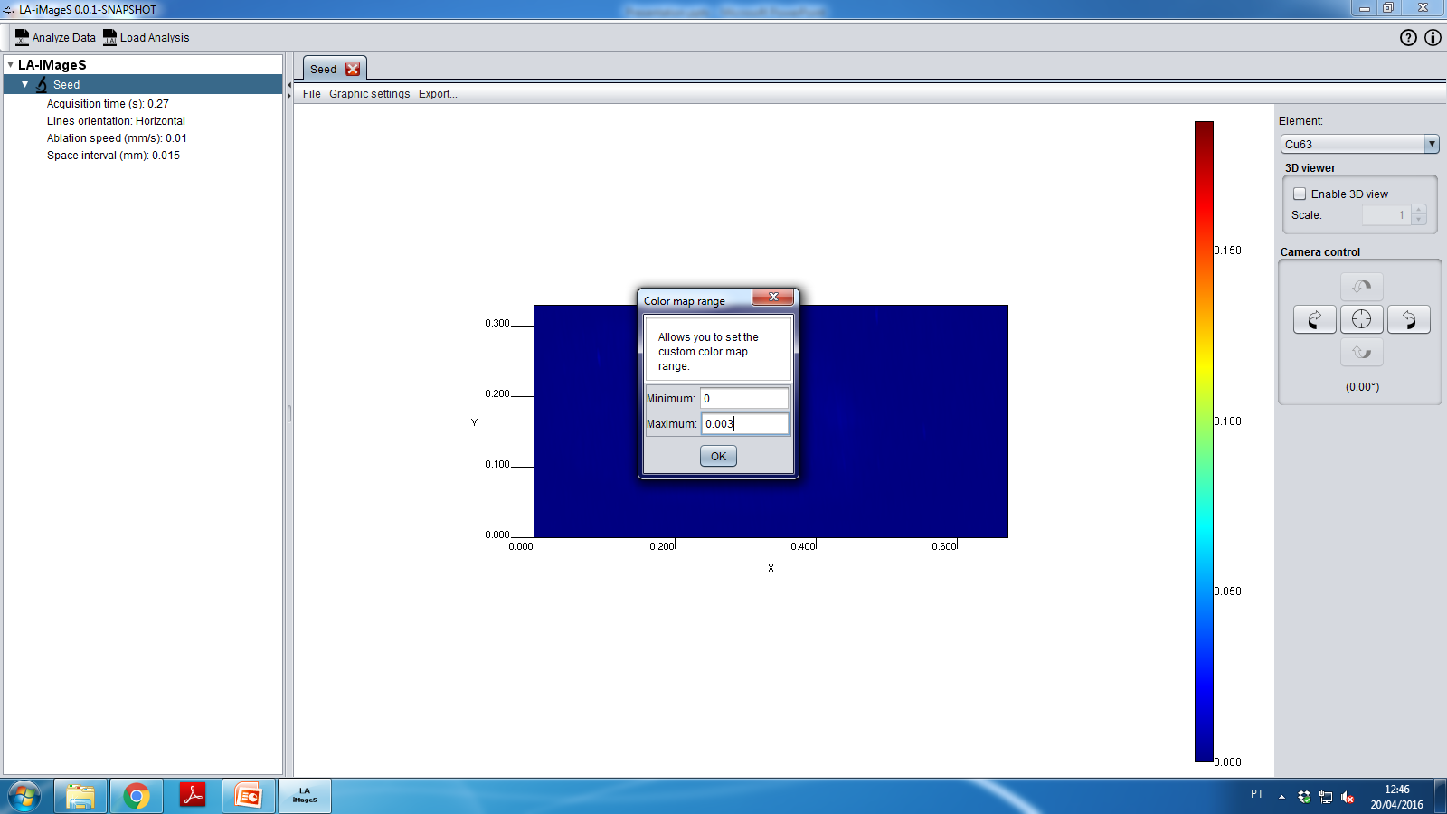
1st: Select the interval of Data
2nd: Click Ok
Select other element

Slide 45
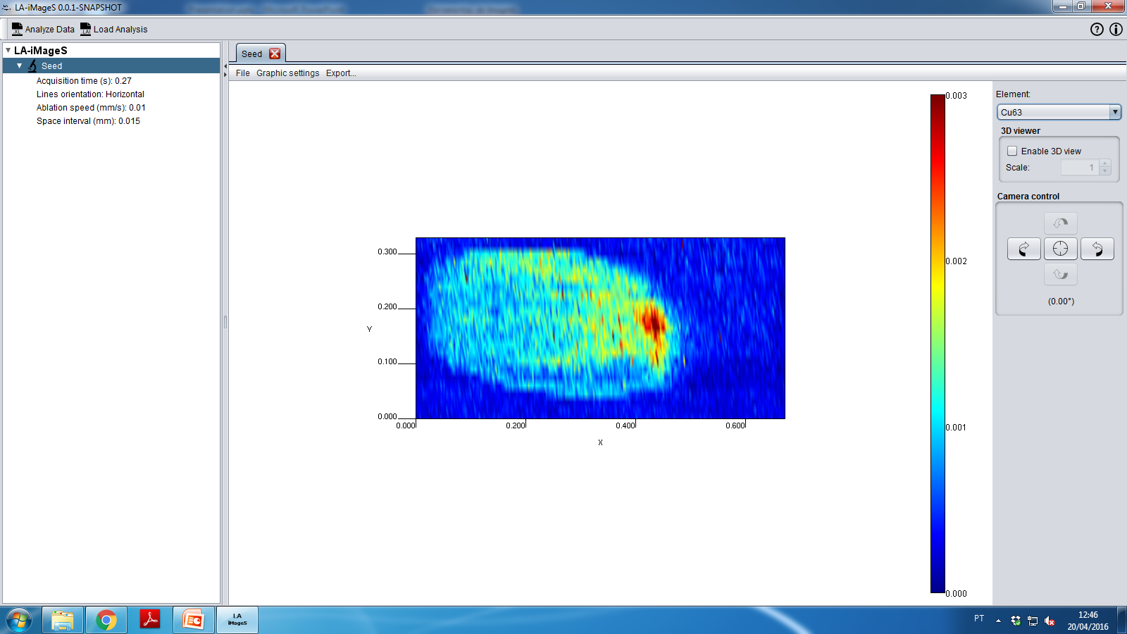
Select other element

Slide 46
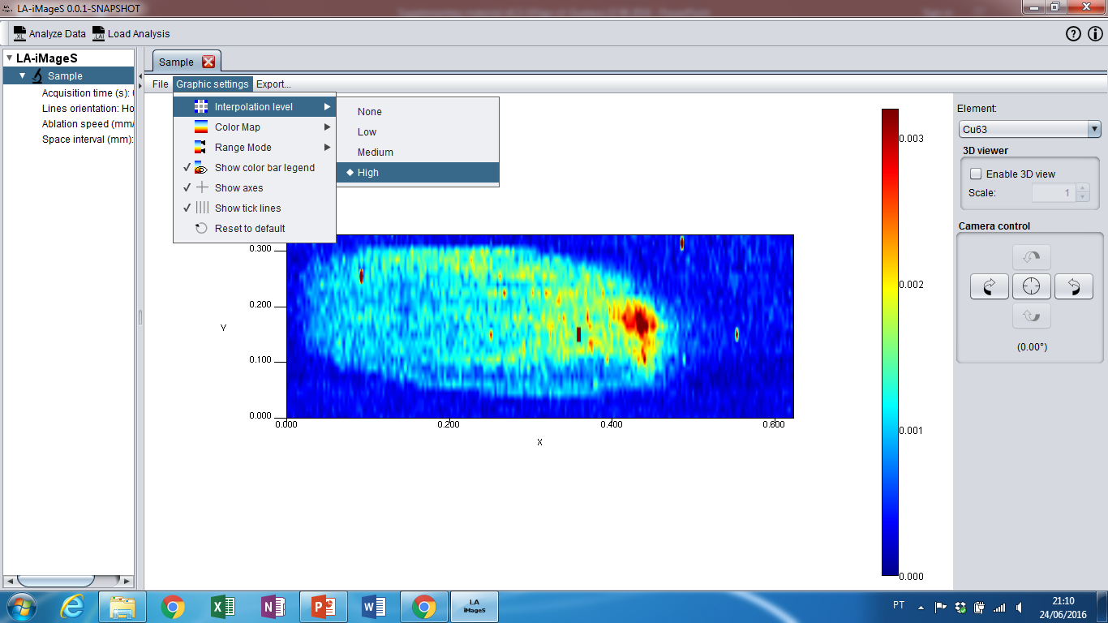
1st: Click Graphic Settings
2nd: Select Interpolation Level
3rd: Chose the best interpolation for your data set
Select other element

Slide 47

Select other element

Slide 48
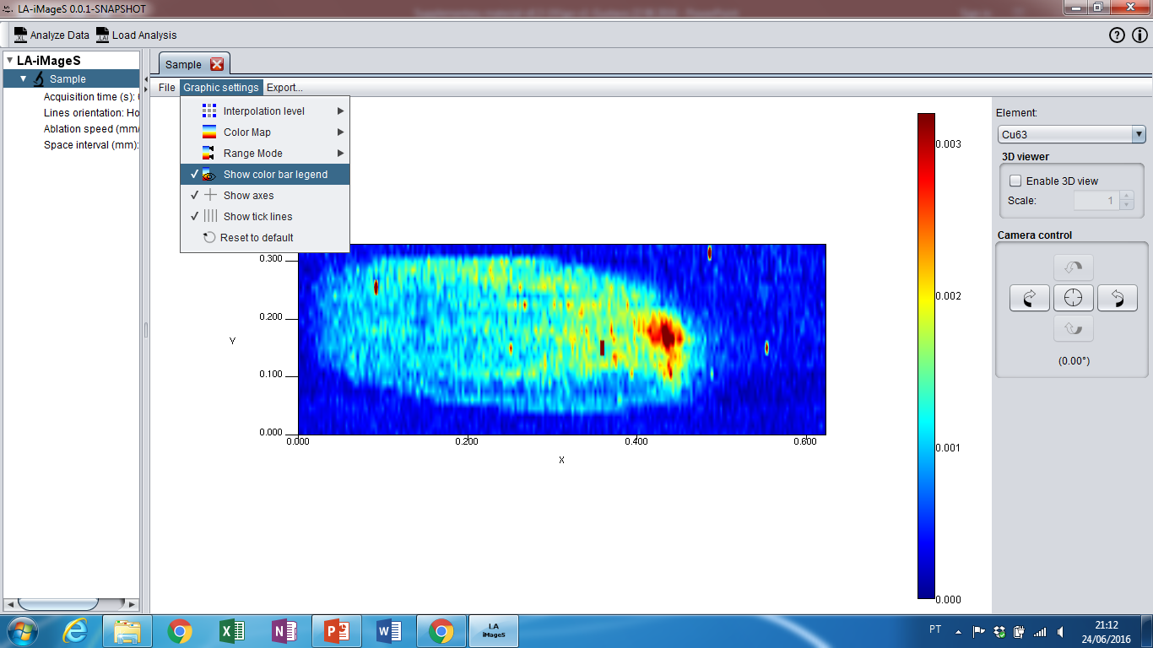
1st: Click Graphic Settings
2nd: Click to remove color bar
Delete color bar

Slide 49
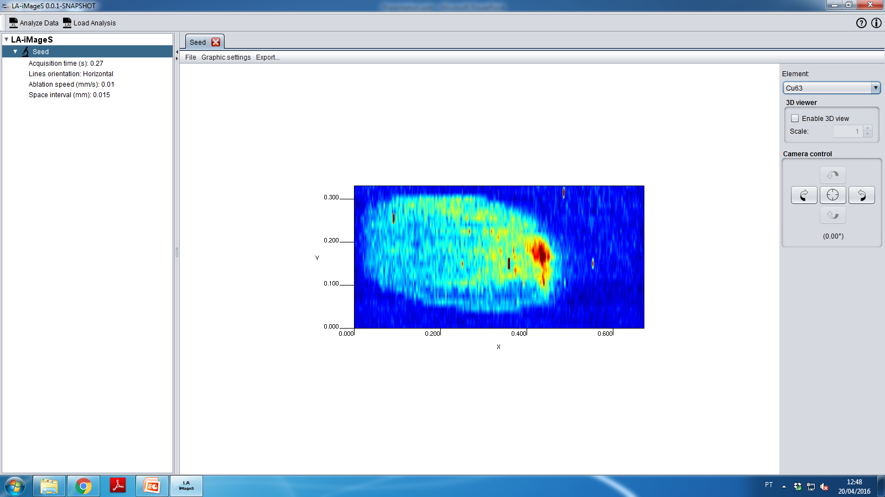
Delete color bar

Slide 50
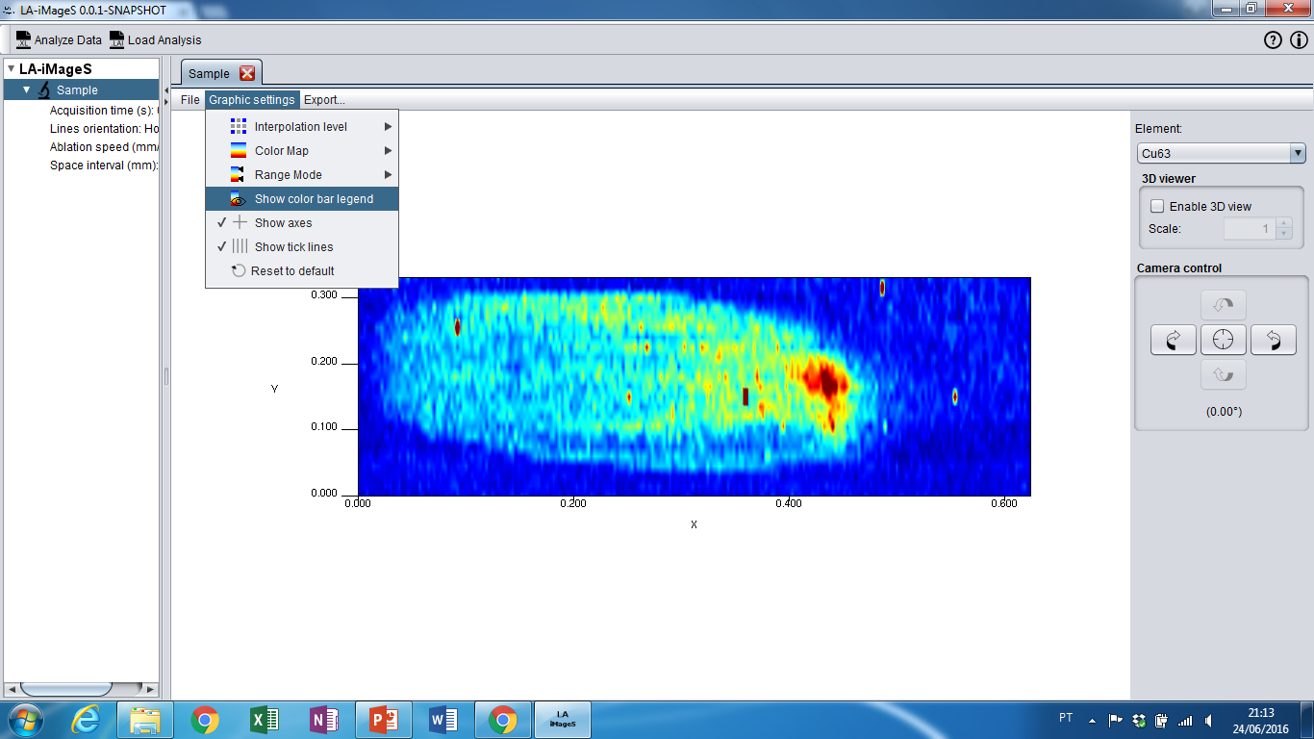
1st: Click Graphic Settings
2nd: Click to show the color bar
Insert color bar

Slide 51
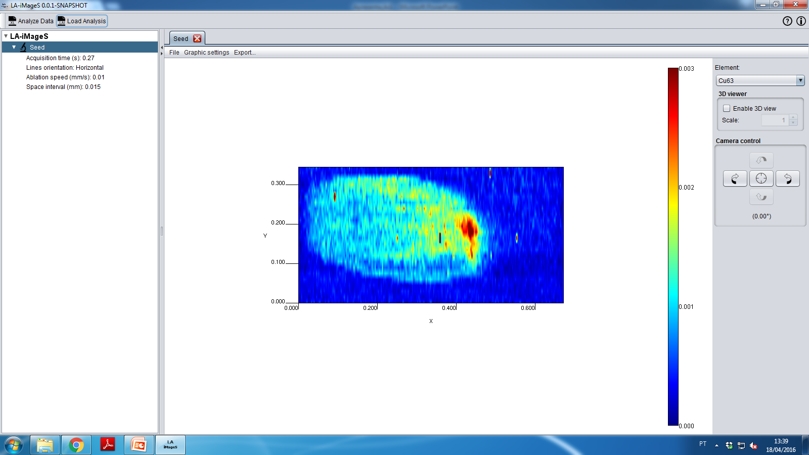
Insert color bar

Slide 52
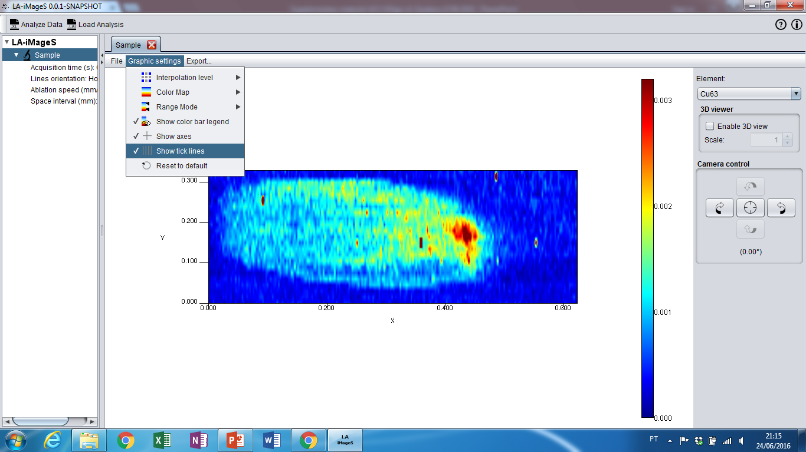
1st: Click Graphic Settings
2nd: Click to remove tick lines
Show tick lines

Slide 53
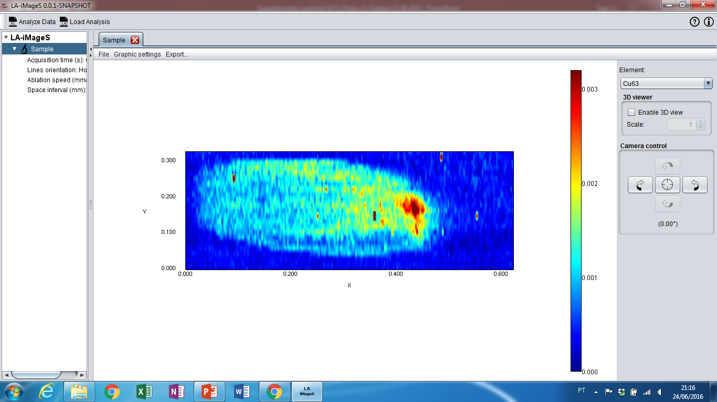
Show tick lines

Slide 54
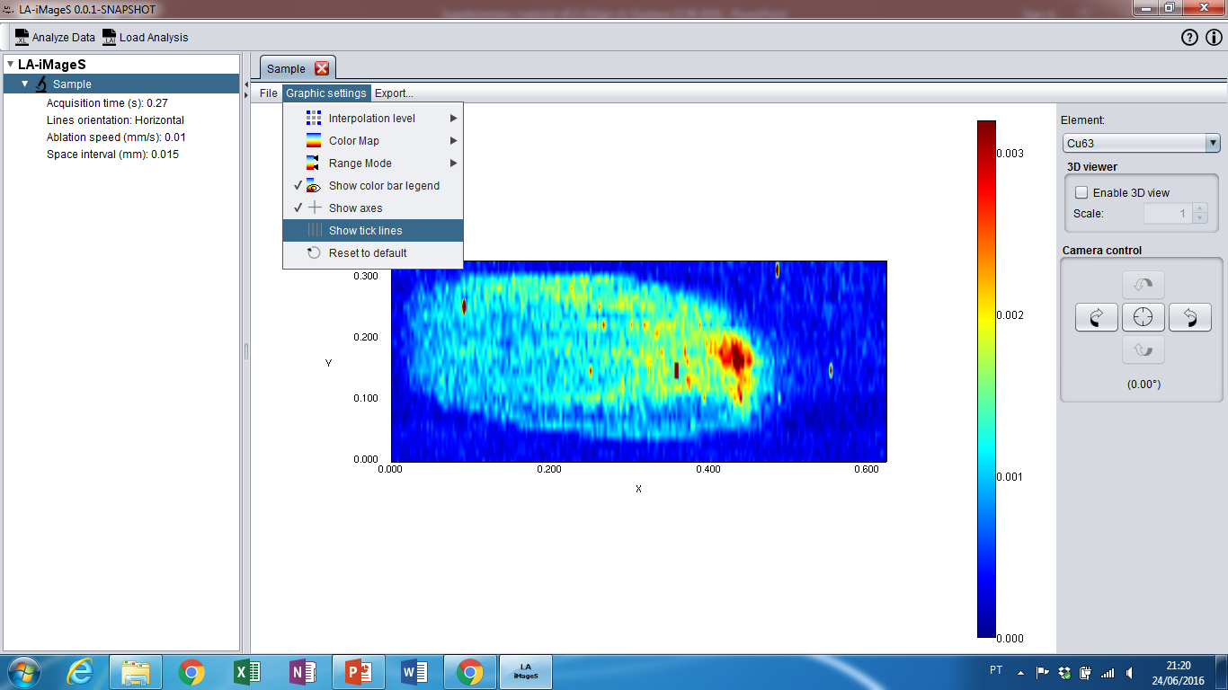
1st: Click Graphic Settings
2nd: Click to show tick lines
Show tick lines

Slide 55

Show tick lines

