Slide 1
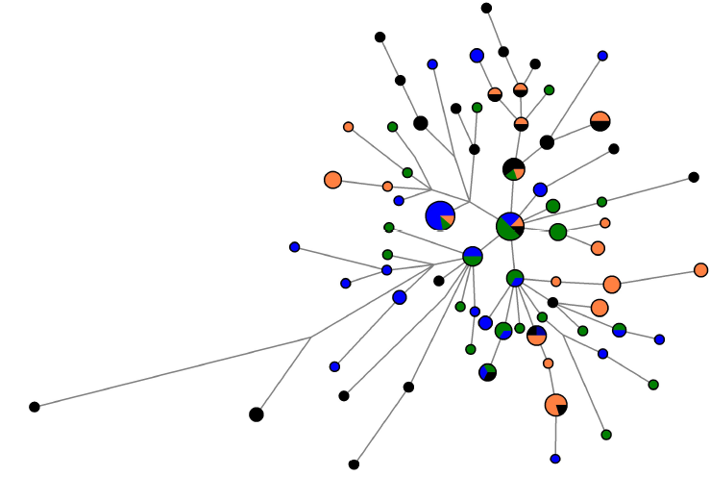
Lebanon
Ireland
West Armenia
Italy

