Slide 1
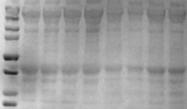
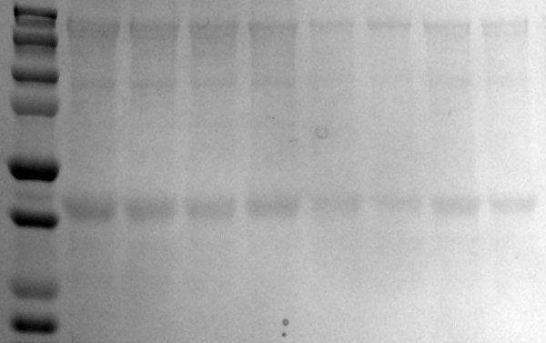
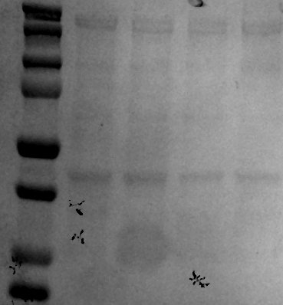
A
wild-type
SOD1^{G93A}
TA
B
GAS
C
wild-type
SOD1^{G93A}
FDB
Beqollari_Supplemental Fig. 2

