Slide 1

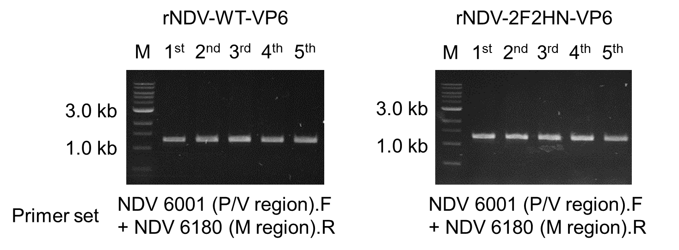
A
MDBK cells
B

