Slide 1

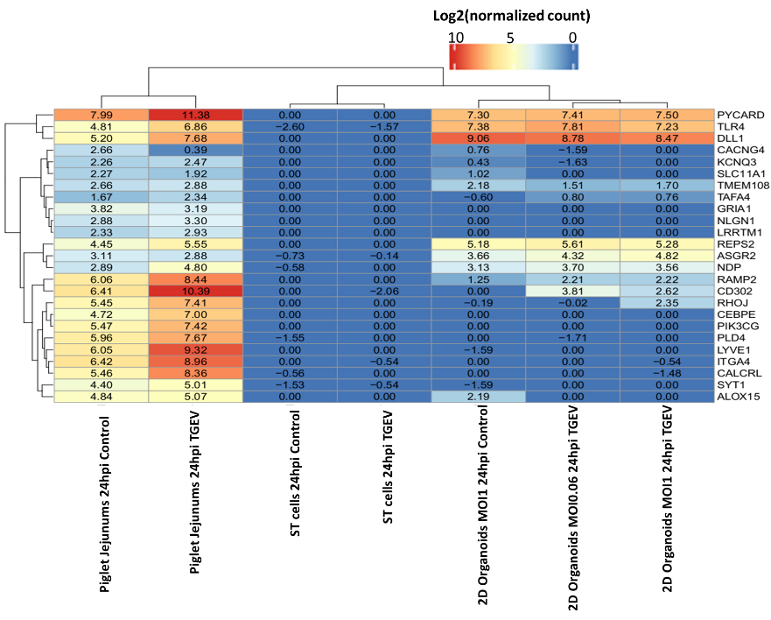
A
B
Log₂(normalized counts)
Log₂(normalized counts)

