Slide 1
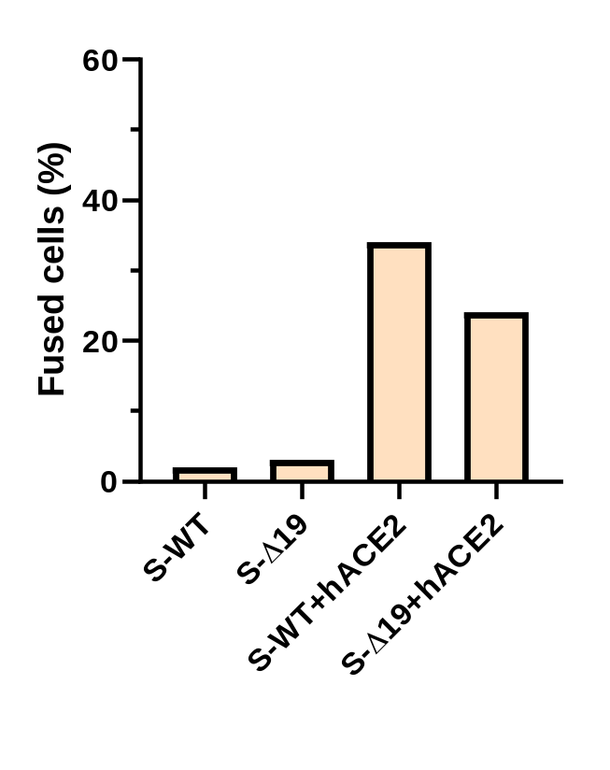
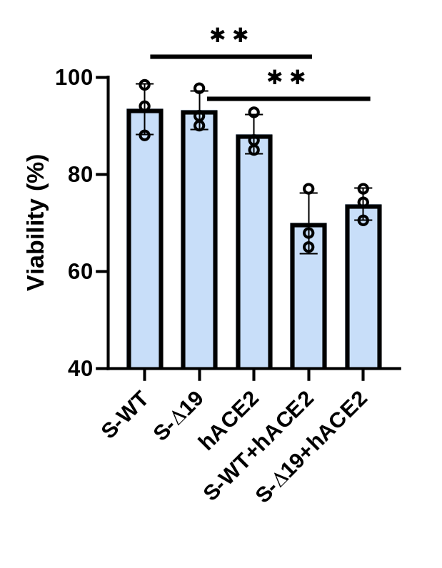
A.
Cell fusion in 293T co-culture
B.
Cell viability in co-culture of 293T
Figure S1.

Slide 2
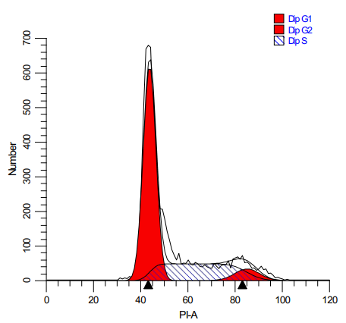
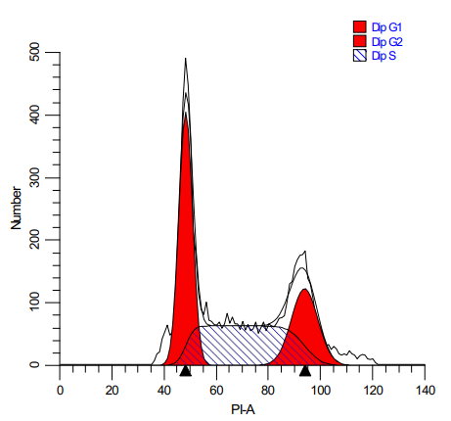
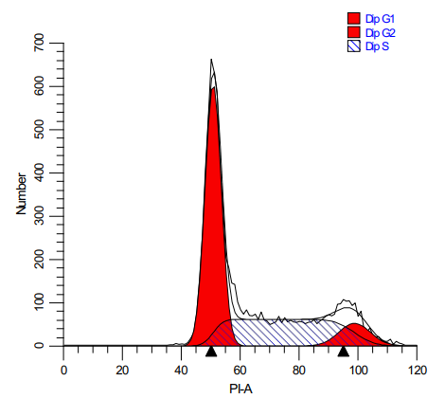



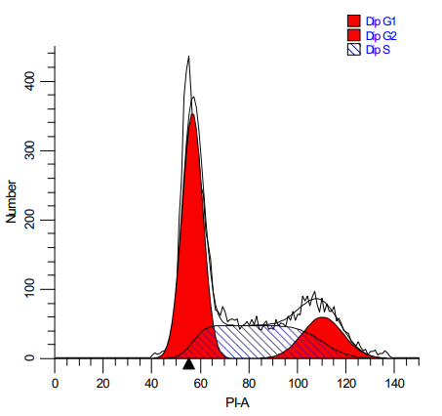
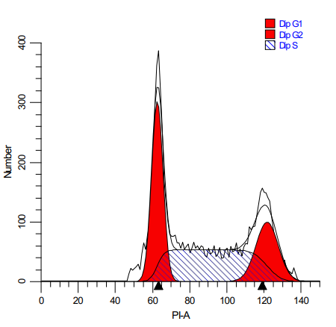


293T-S-WT-EGFP
293T-S-∆19-EGFP
293T-hACE2-mCherry
293T-S-WT-EGFP +
293T-hACE2-mCherry
293T-S-∆19-EGFP +
293T-hACE2-mCherry
Figure S2.

Slide 3
S-WT-GFP-Sk-Hep1 +
ACE2-mCherry-Sk-Hep1
S-WT-GFP-Sk-Hep1
DIC
merged
Figure S3.

Slide 4
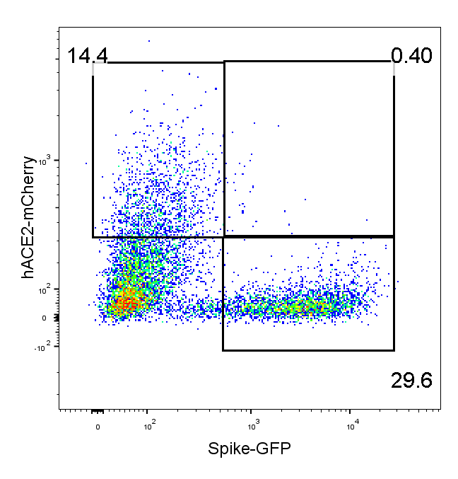
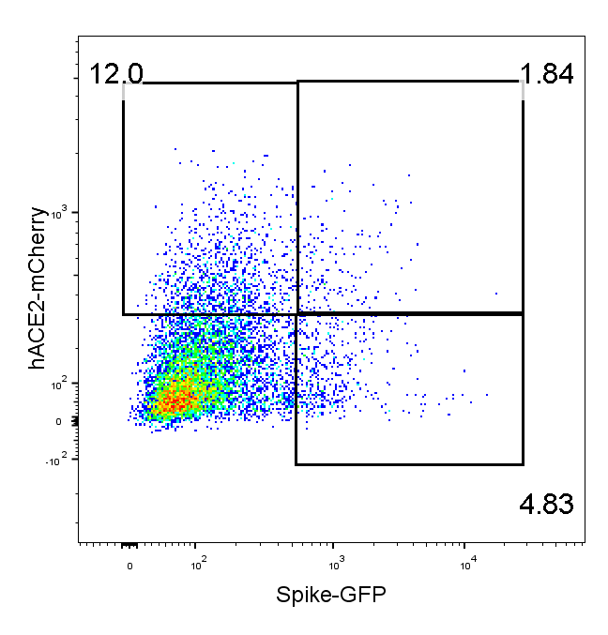
S-WT-GFP-A549 +
ACE2-mCherry-A549-0 hr
S-WT-GFP-A549 +
ACE2-mCherry-A549-24 hr
Figure S4.

