Slide 1
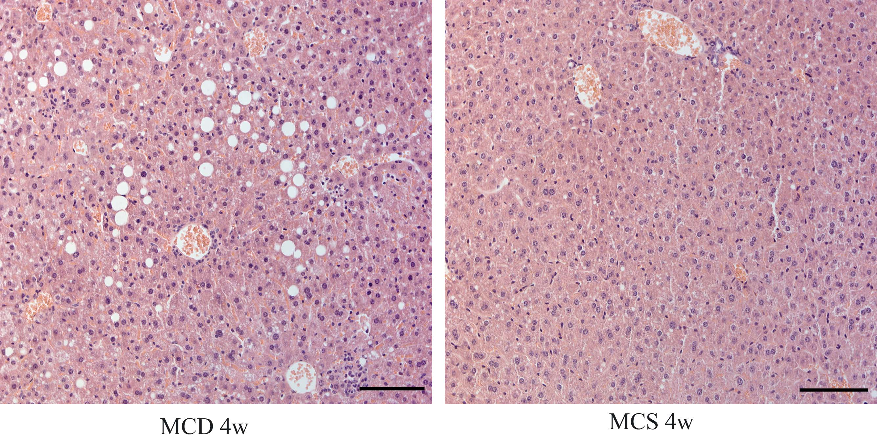
Fig. S2. Histological assessment of liver between MCD and MCS groups.
¹MCD, methionine choline deficiency diet (4 weeks); MCS, methionine choline sufficient diet (4 weeks). Scale bars = 100 μm.

