Slide 1

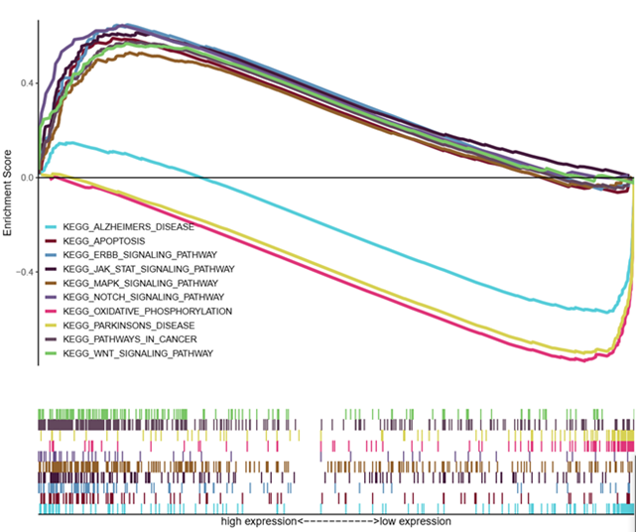
A
B
Wang et al., Figure S2

