Slide 1
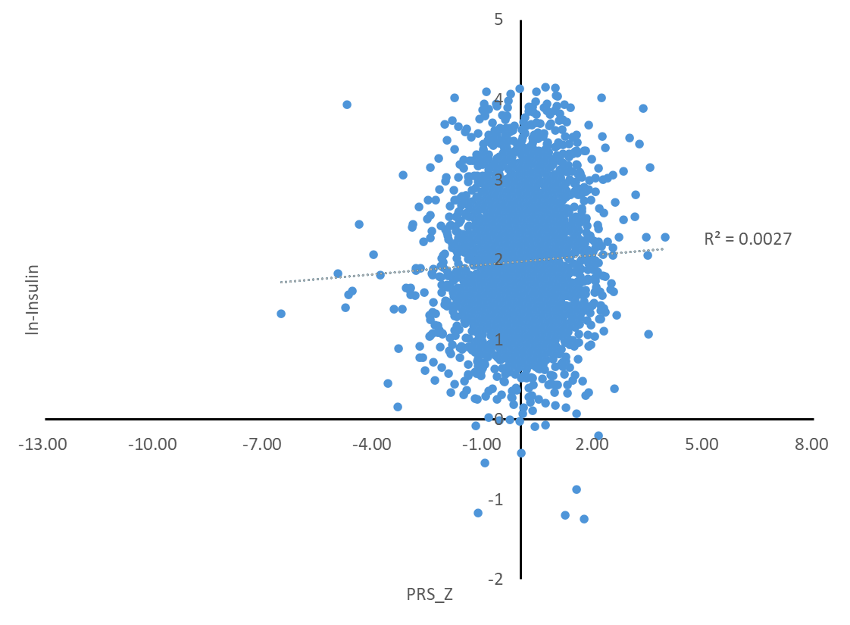
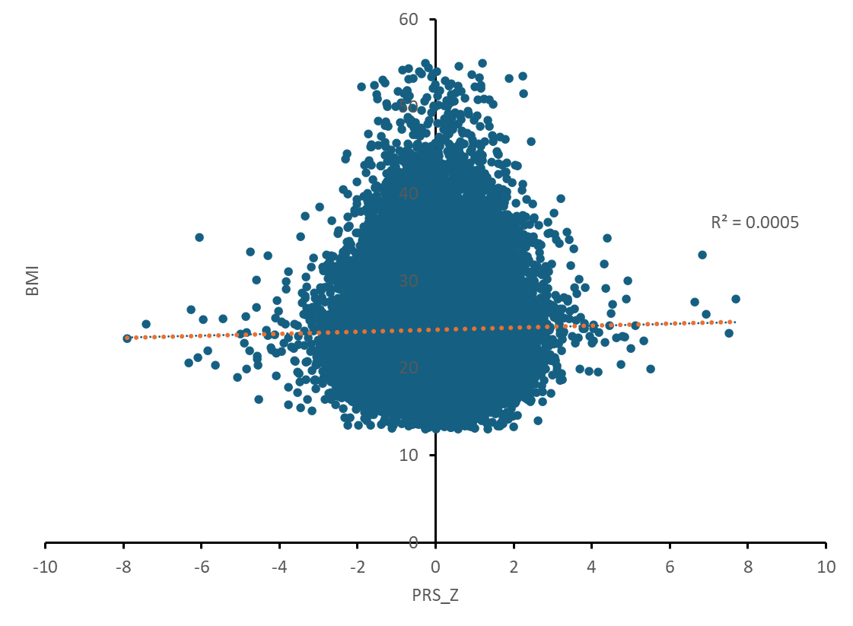
(A)
(B)
Supplementary Figure S4. Scatter plots showing the relationship between z-score normalization of polygenic risk score (PRS_Z) and (A) natural log-transformed fasting insulin levels (ln-insulin) and (B) body mass index (BMI) in the replication group. The linear regression result of the (A) p-value = 0.003, Beta = 0.052, R² = 0.0027, (B) p-value = 8.69 × 10⁻¹¹ , Beta = 0.023, R² = 0.0005.

