Slide 1
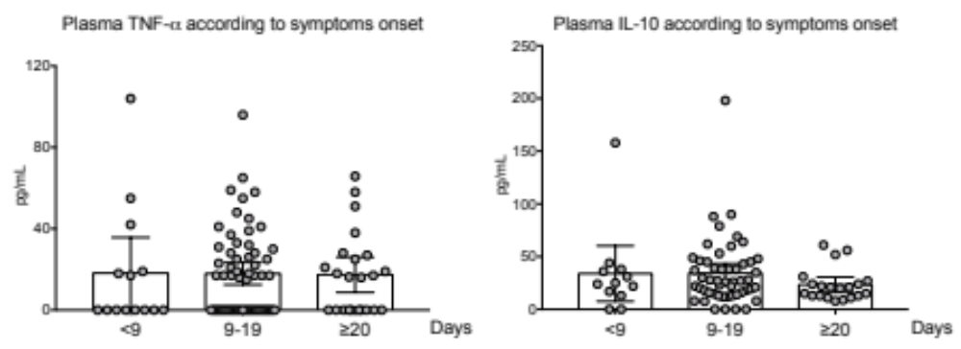
Additional file 4. Plasma levels of TNF-α and IL-10 according to time between symptom onset and cytokine dosage. Data are expressed as median with 95% CI

