Slide 1
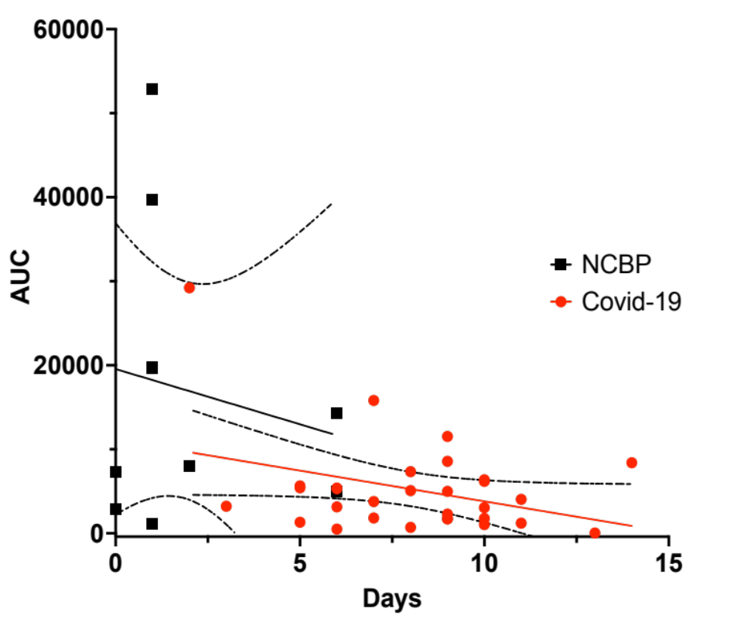
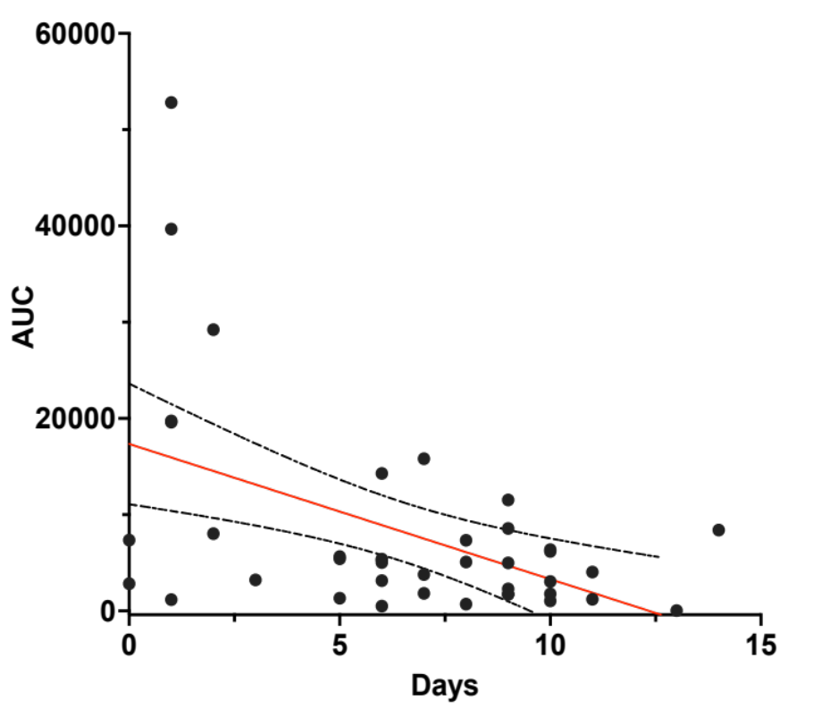
A
B
Supplemental figure 1. Correlation between the AUC of the microvascular blood flow following Acetylcholine iontophoresis and duration of symptoms before ICU admission in NCBP (Black, P=0.63) and Covid-19 (Red, P=0.061) (A) and in pooled NCBP/Covid-19 included patients (Black, R=-0.51, P=0.002)

