Slide 1
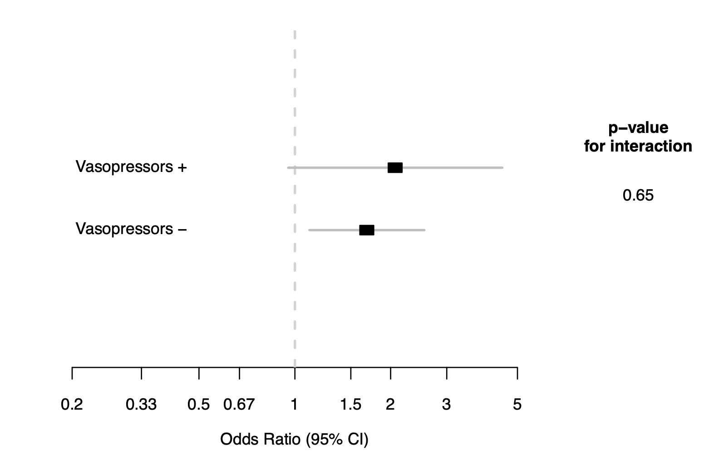
Additional file 4
Additional file 4. Mottling score effect on post-tracheal intubation hypotension according to vasopressor use before tracheal intubation

