Slide 1



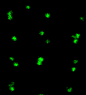
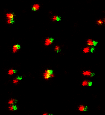
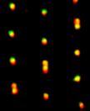
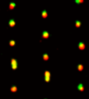

Basal body
GFP
Merge
Merge
GFP-Centrin2; OFD1 RNAi
GFP-Centrin2; Control RNAi
2 µm
GFP-OFD1; Centrin2 RNAi
GFP-OFD1; Control RNAi
GFP-OFD1; FOR20 RNAi
GFP-OFD1; Control RNAi
GFP-FOR20; OFD1 RNAi
GFP-FOR20; Control RNAi

