Slide 1
Supplementary Table S1. Extraction yield of various C. asiatica extracts
Postharvest drying | Parts | Extraction solvent | Extract | Yield (% w/w)¹⁾
Heated-air drying | Leaf | Cold-water | HD-L-CW | 28.8
 |  | Hot-water | HD-L-HW | 30.2
 |  | 50% EtOH | HD-L-50E | 37.3
 |  | 70% ethanol | HD-L-70E | 30.1
 | Whole | Cold-water | HD-W-CW | 29.7
 |  | Hot-water | HD-W-HW | 29.3
 |  | 50% EtOH | HD-W-50E | 30.1
 |  | 70% EtOH | HD-W-70E | 25.5
Freeze drying | Leaf | Cold-water | FD-L-CW | 23.3
 |  | Hot-water | FD-L-HW | 32.6
 |  | 50% EtOH | FD-L-50E | 32.8
 |  | 70% EtOH | FD-L-70E | 31.0
 | Whole | Cold-water | FD-W-CW | 22.7
 |  | Hot-water | FD-W-HW | 28.6
 |  | 50% EtOH | FD-W-50E | 29.2
 |  | 70% EtOH | FD-W-70E | 29.8
¹⁾ Yield (% w/w) was calculated against the dried raw material.

Slide 2
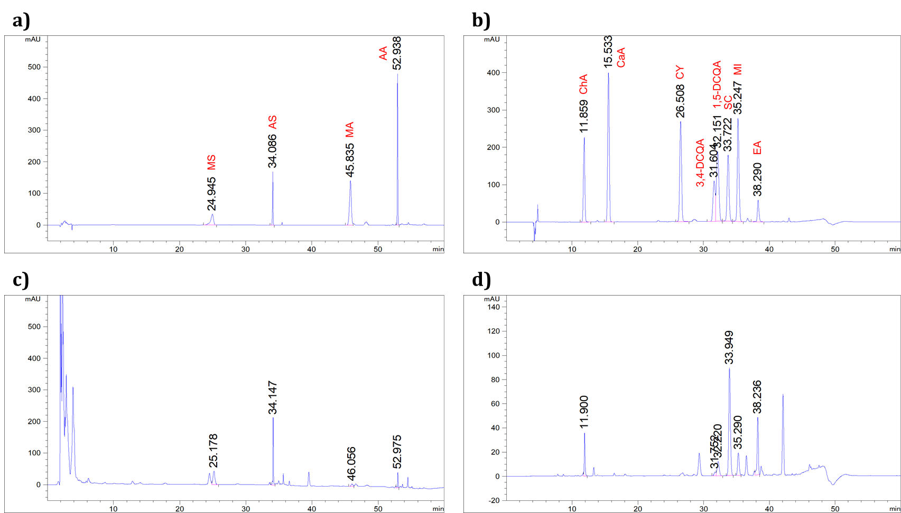
Supplementary Fig. S1. HPLC chromatogram of standard references and secondary metabolites of C. asiatica extracts.
Standard materials and extracts were run in the HPLC system coupled with a PDA detector at 205 nm (A and C) and 325 nm (B and D). (a) Chromatogram of standard references (250 μg/mL, each), including madecassoside (MS), asiaticoside (AS), madecassic acid (MA), and Asiatic acid (AA); (b) Chromatogram of standard references (250 μg/mL, each), including chlorogenic acid (ChA), caffeic acid (CaA), cymaroside (CY), 3,4-dicaffeoylquinic acid (3,4-DCQA), 1,5-dicaffeoylquinic acid (1,5-DCQA), scutellarin (SC), miquelianin (MI), and ellagic acid (EA); (c) Representative chromatogram of extract (HD-L-50E; 5 mg/mL) to determine terpenoids. (d) Representative chromatogram of the extract (HD-L-50E; 5 mg/mL) to determine polyphenolic acids and flavonoids.

