Slide 1
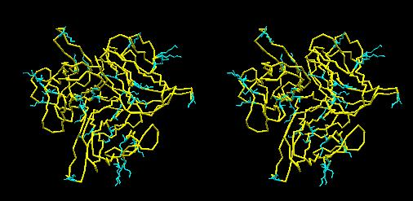
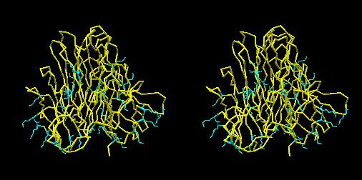
a
Additional File 1: Stereo-view of three-dimensional hFasLECD structure. The atomic coordinate data were obtained from PDB (ID: 4msv). A biological unit composed of single hFasLECD trimer (aa 143 – 281) alone is presented as a wire model. Overall backbone structure and all lysine residues with side-chains are shown in yellow and cyan, respectively. (a) a vertical view, (b) a horizontal view.
b
Additional File 1 (M. Muraki)

