Slide 1
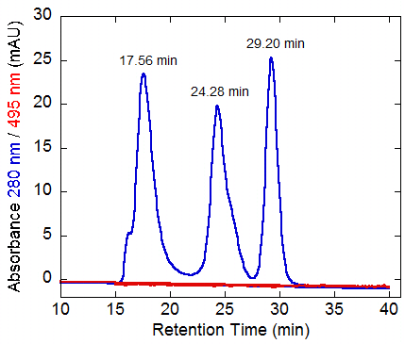
Additional File 2: Analysis of molecular-weight size markers by size-exclusion chromatography.
A mixture of Thyrogloblin (669 kDa), Aldolase (158 kDa) and Ovalbumin (43 kDa) was analyzed, Used column, Superdex 200 10 / 300 GL. Elution buffer, 50 mM Tris-hydrochloride plus 150 mM sodium chloride (pH 7.5). Wavelengths of 280 nm (blue) and 495 nm (red) were used for the detection. Flow rate, 0.5 ml / min. The retention time of each peak position is shown.
Additional File 2 (M. Muraki)

