Slide 1
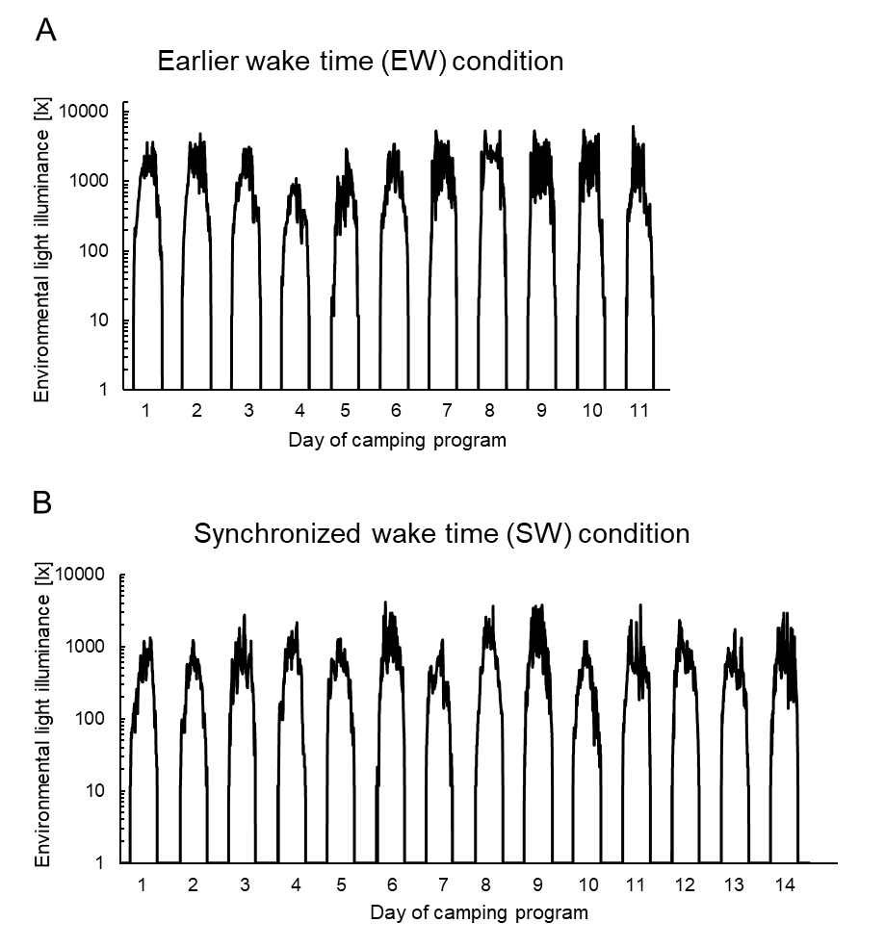
Supplemental figure S1

