Slide 1
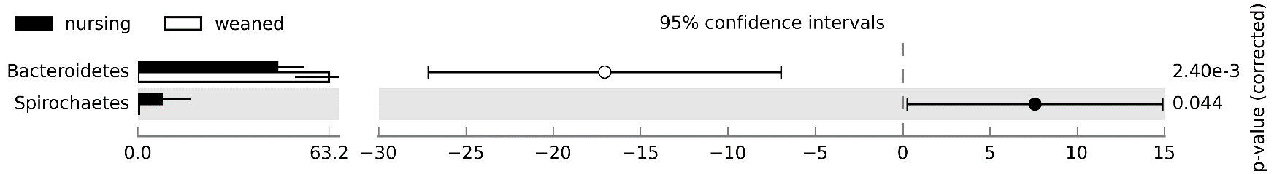
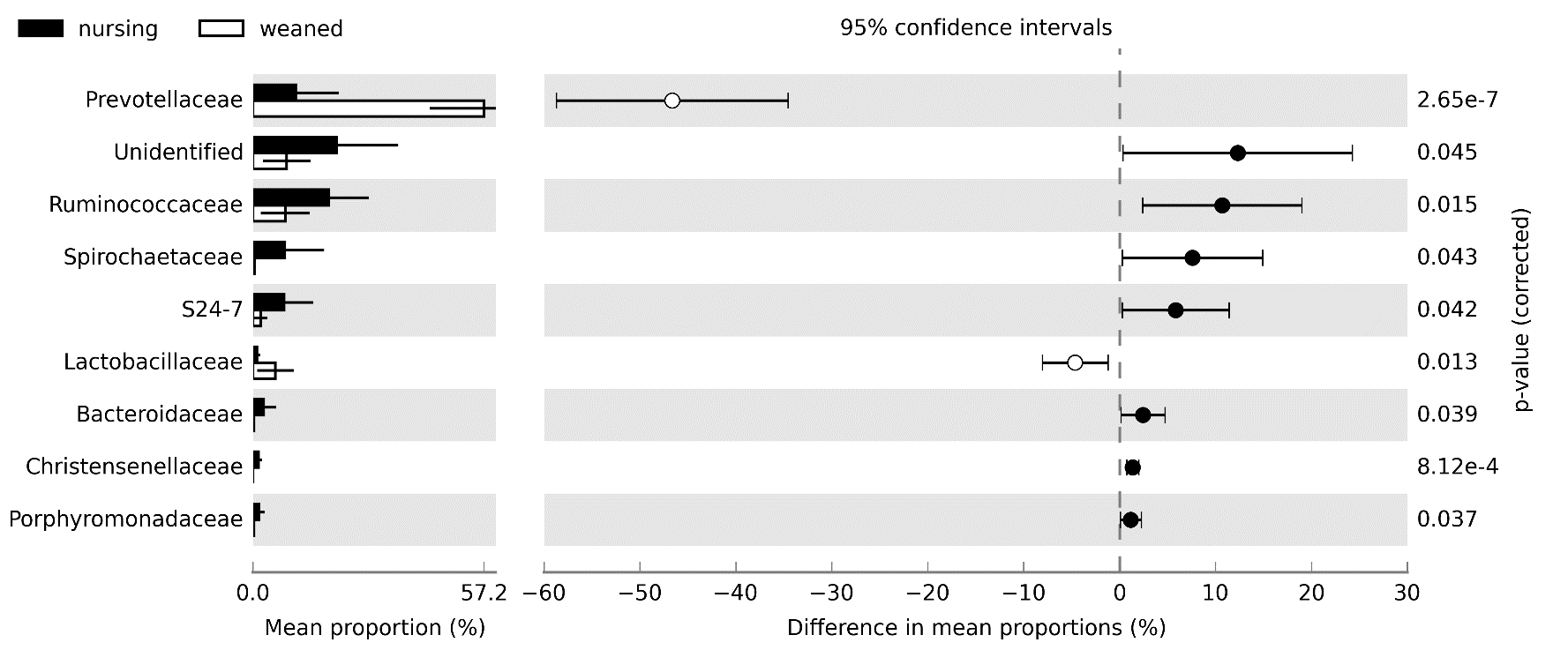
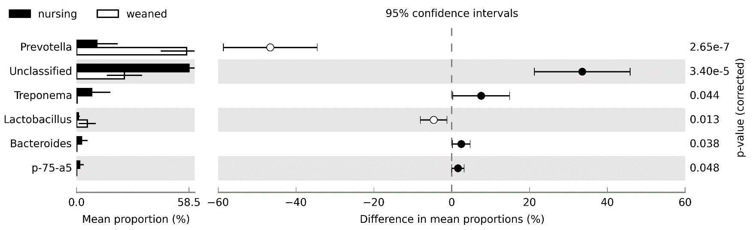
Additional file 2: Fig. S1
a
Mean proportion, %
Difference in mean proportions, %
b
Mean proportion, %
Difference in mean proportions, %
c
Prevotella
Unclassified
Treponema
Lactobacillus
Bacteroides
p-75-a5
Mean proportion, %
Difference in mean proportions, %

Slide 2
Additional file 2:Fig. S2
a
b
c

Slide 3
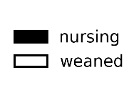

Additional file 2: Fig. S3
abundance, %

Slide 4
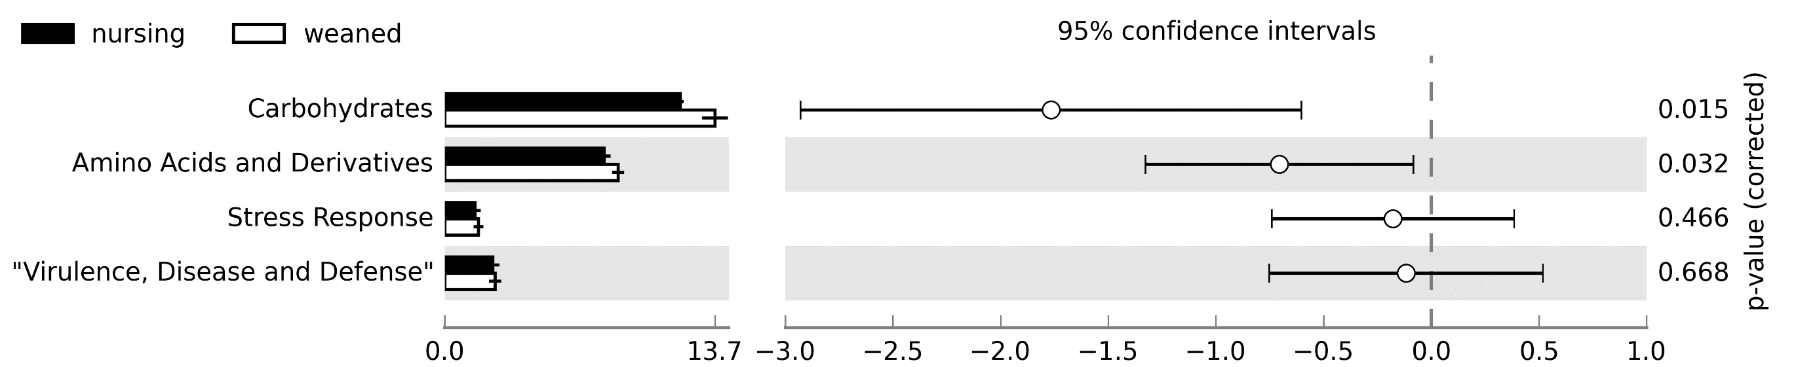
Additional file 2: Fig. S4
Mean proportion, %
Difference in mean proportions, %

Slide 5
Additional file 2: Fig. S5
a
b

