Slide 1
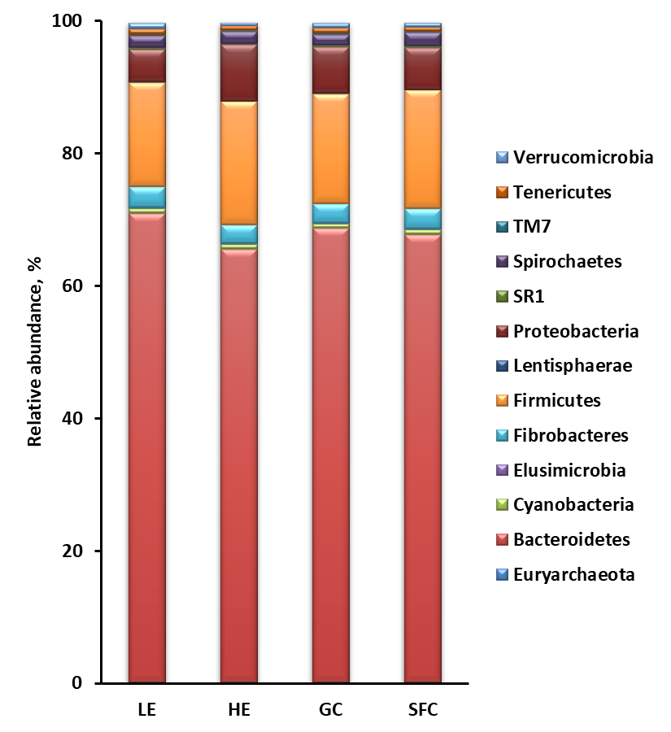
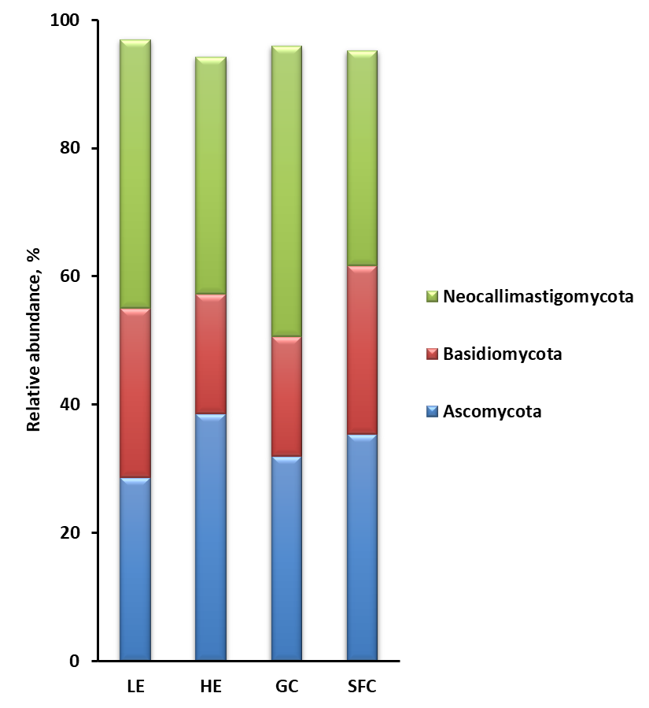
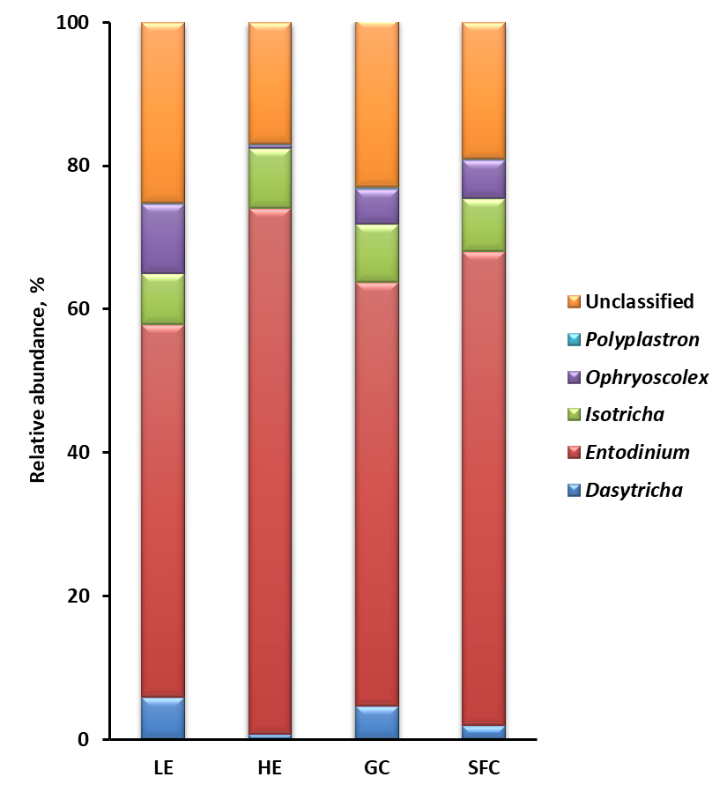
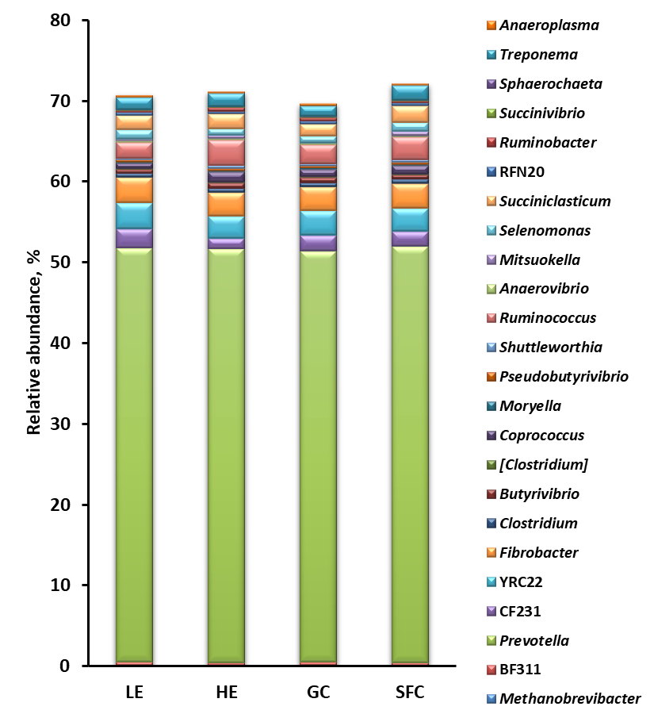
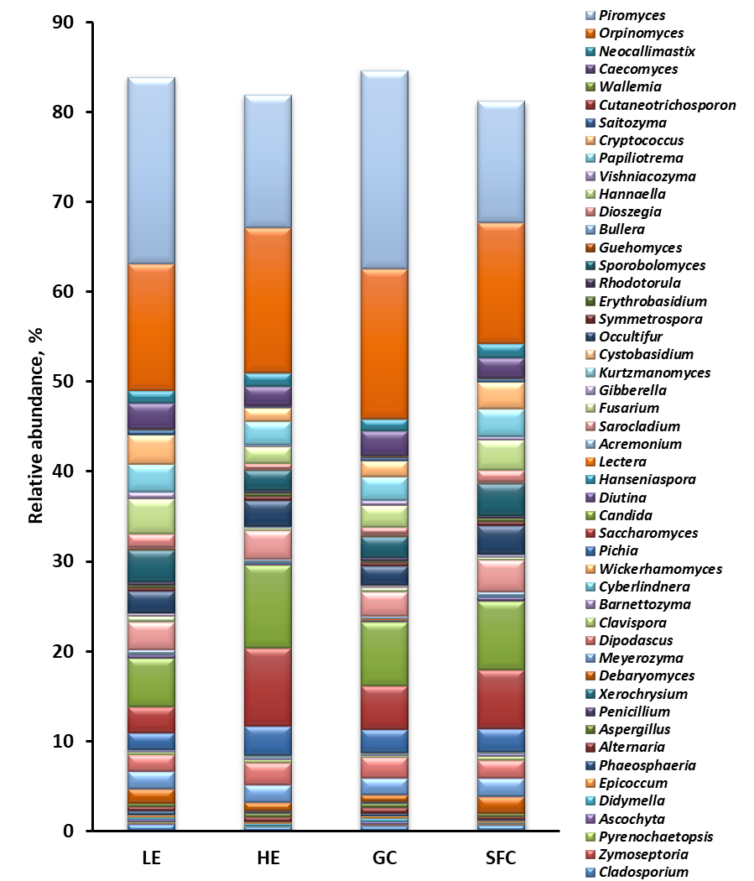
A.
C.
E.
B.
D.
Fig. S1. Relative abundance of the major bacterial and archaeal phyla (A) and genera (B), fungal phyla (C) and genera (D), and protozoal genera (E) (one those each having a relative abundance ≥0.1% in at least one of the dietary treatments are shown).
Notes:
Figure S1. Relative abundance of the major classified multi-kingdom microbiota for bacteria and archaea (A) and fungi (B) at phylum and genus level, and protozoa (C) at genus level only (each representing >0.1% at least one of the dietary conditions).

