Slide 1
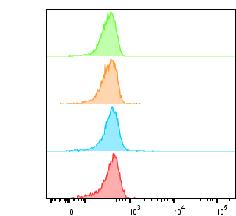
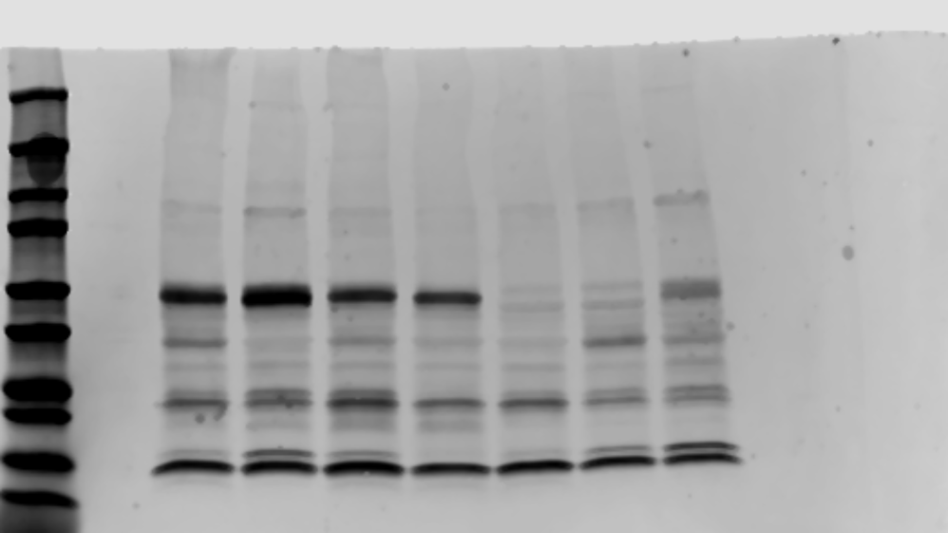
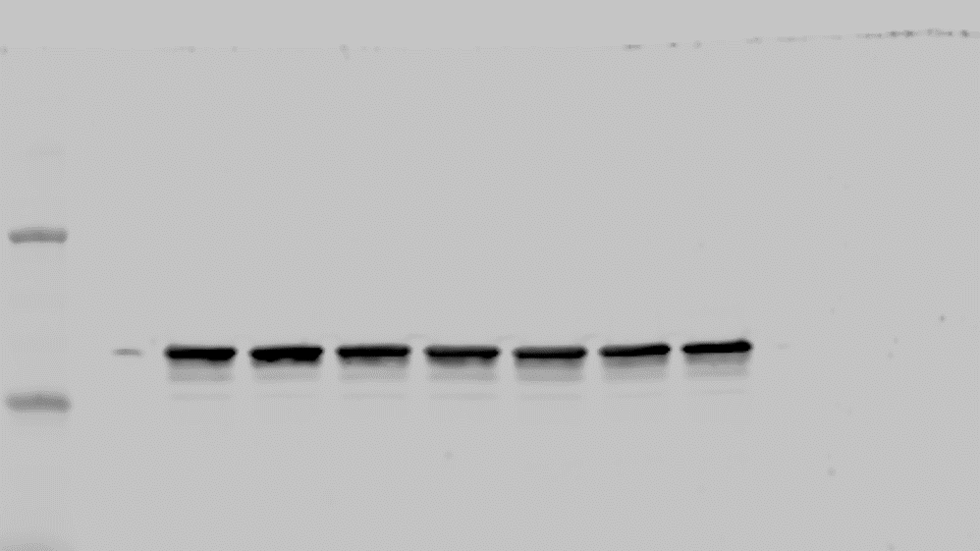

Supplementary Figure 2
A
B
42105
Parent
543
5311
42105
CD3ζ (55kDa)
5311
CD3ζ (15kDa)
543
GAPDH
Parent
Count
GFP
C
CD74 ECD-Fc
100kDa
75kDa
50kDa

