Slide 1
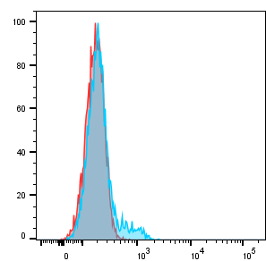
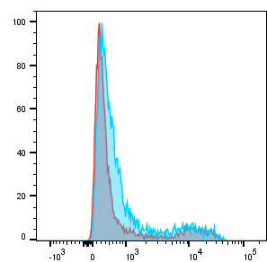
Supplementary Figure 3
T cells
B cells
Resting
Count
Activated
CD74

