Slide 1
Supplementary Figure 5
A
B cell
Monocyte
G-MDSC
M-MDSC
NK
15000
800
200
50
300
600
150
40
Day 3
10000
30
200
Absolute cell number
(cell/100uL blood)
400
100
5000
20
100
200
50
10
0
0
0
0
0
UTT
74bbz
UTT
74bbz
UTT
74bbz
UTT
74bbz
UTT
74bbz
B cell
Monocyte
G-MDSC
M-MDSC
NK
15000
800
200
50
300
600
150
40
Day 11
10000
30
200
Absolute cell number
(cell/100uL blood)
400
100
5000
20
100
200
50
10
0
UTT
74bbz
0
UTT
74bbz
0
UTT
74bbz
0
UTT
74bbz
0
UTT
74bbz
B cell
Monocyte
G-MDSC
M-MDSC
NK
15000
800
200
50
300
600
150
40
Day 23
10000
30
200
Absolute cell number
(cell/100uL blood)
400
100
5000
20
100
200
50
10
0
UTT
74bbz
0
UTT
74bbz
0
74bbz
0
0
UTT
74bbz
UTT
UTT
74bbz

Slide 2
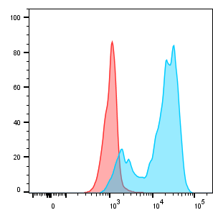
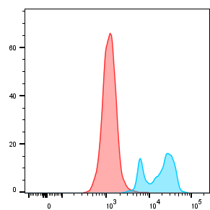
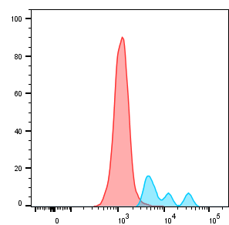
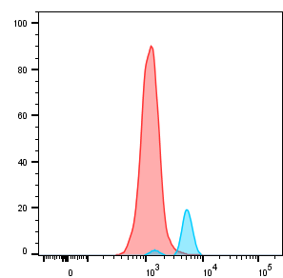
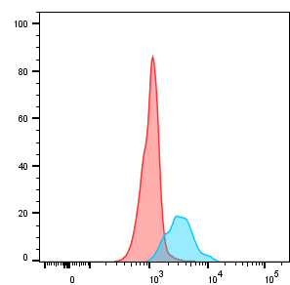
Supplementary Figure 5
B
B cell
Monocyte
G-MDSC
M-MDSC
NK
Day 18
CD74

