Slide 1
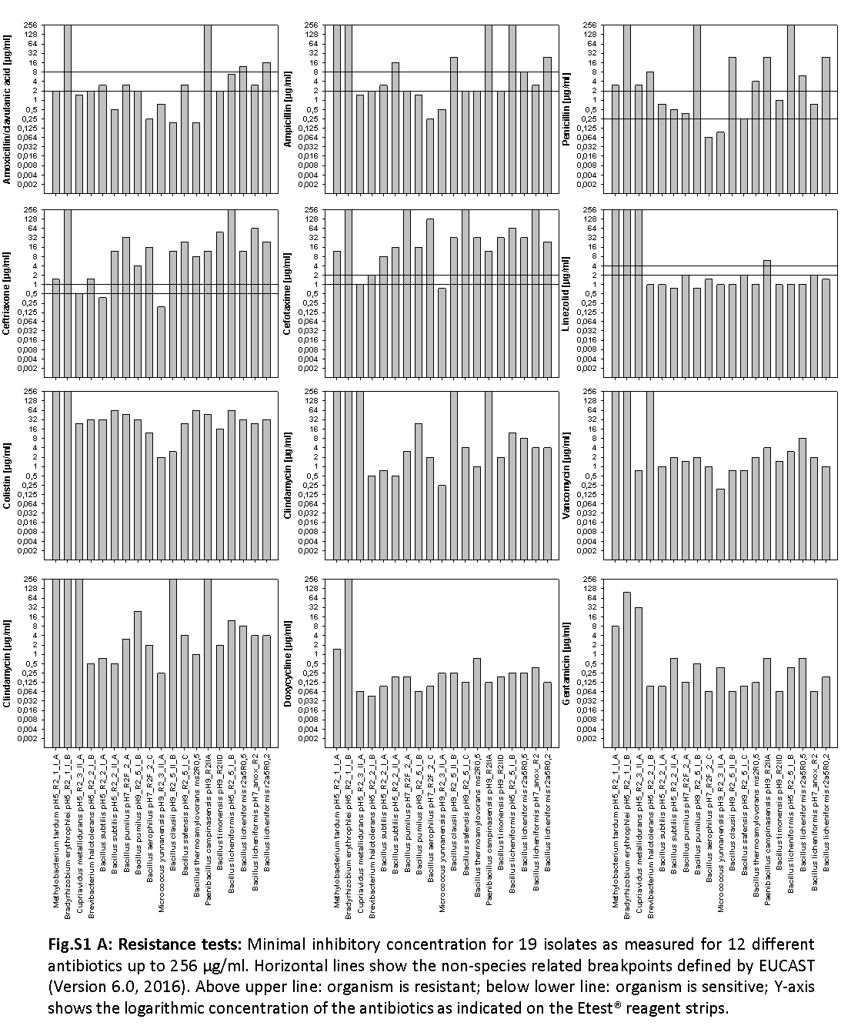

Slide 2
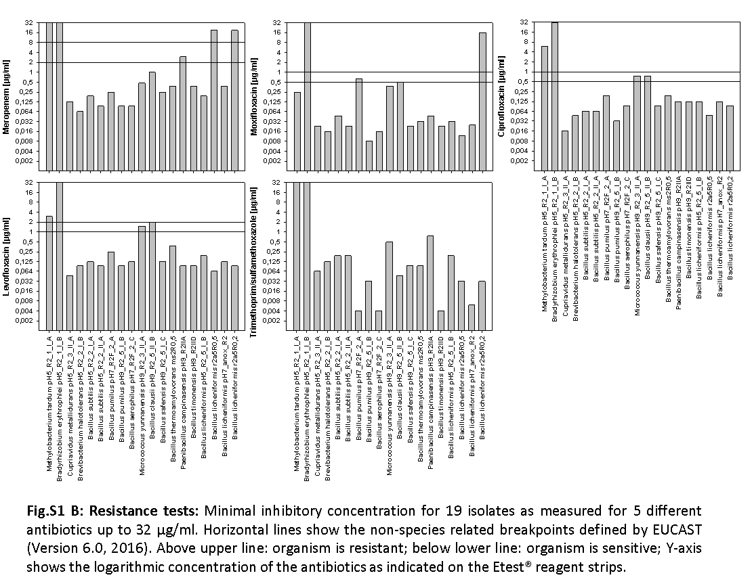

Slide 3
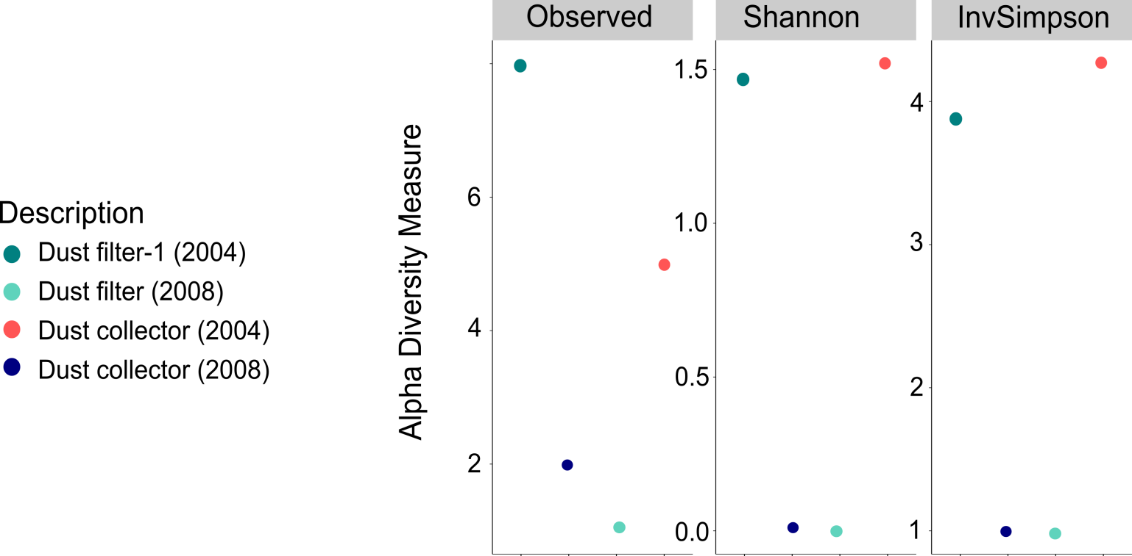
Fig. S2: Diversity of Archaea signatures in ISS samples. Displayed are observed taxa (richness), Shannon Index and InvSimpson Index.

Slide 4
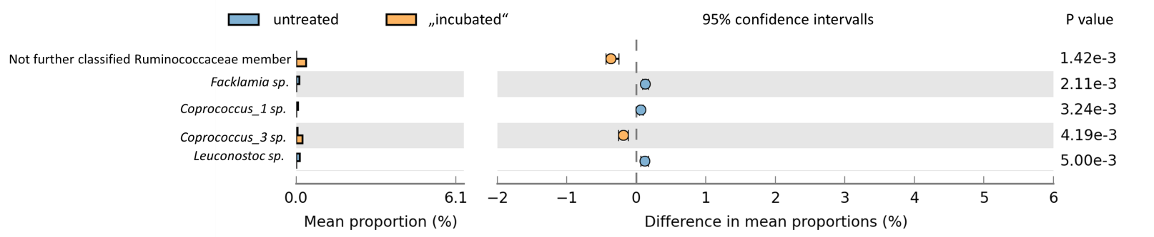
Fig. S3: Differentially abundant genera in untreated and incubated samples.

Slide 5
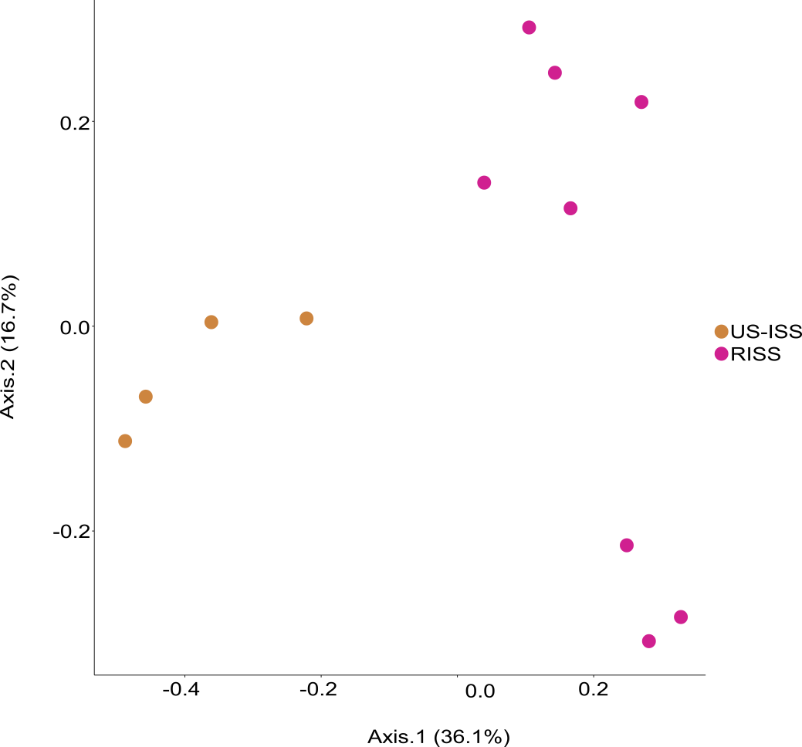
Fig. S4: PcoA plot (unweighted Bray Curtis distance) of US-ISS samples (US-ISS) and Russian ISS (RISS) samples. It has to be emphasized that only forward reads of both studies were processed here. Based on this approach, a clear, distinct clustering of Russian ISS samples and US-ISS samples is observed, which indicates dissimilarity in the microbial composition.

