Slide 1
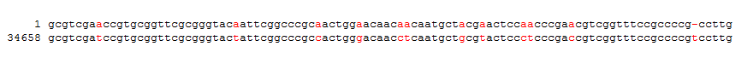
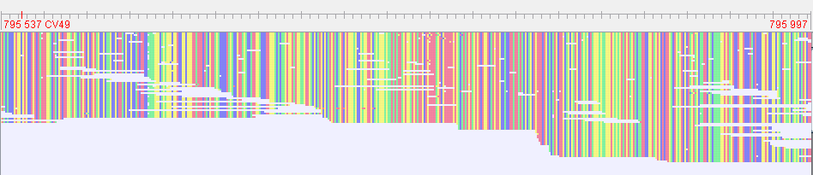
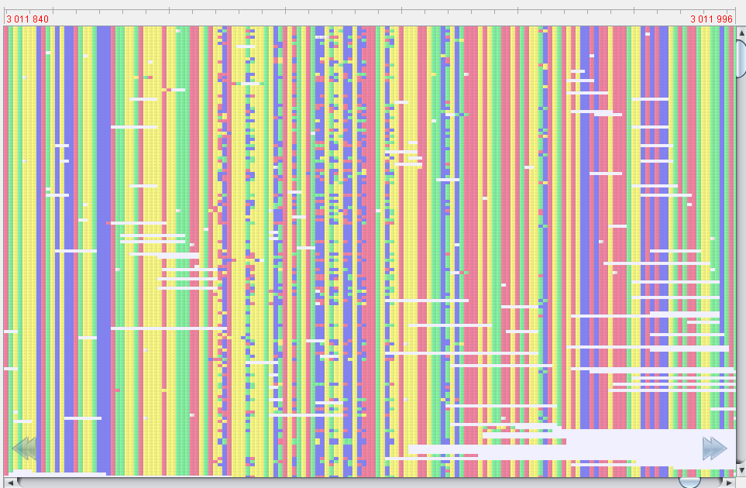
A
Prophage | Template repeat (TR) | Variable region (VR) | Size, % id | Target protein
Lagaffe | 22,449 – 22,563 | 23,032 – 23,146 | 114 pb, 88% | MTP, FGE superfamily
Mushu | 32 ,765 – 32,863 | 34,819 – 34 917 | 98 pb, 86% | T4 Hoc-like protein
Toutatis | 49,056 – 49,176 | 51,084 – 51,204 | 121 pb, 87%
Taranis | 46,565 – 46,700 | 45,525 – 45,659 | 136 pb, 86%
Epona | 41,556 – 41,668 | 41,299 – 41,409 | 113 pb, 86% | MTP, FGE superfamily
Brigit | 45,361 – 45,487 | 47,426 – 47,553 | 128 pb, 88% | T4 Hoc-like protein
B
Lagaffe DGR
VR
TR
fge
avd
brt
TR
VR
40 807
22 553
22 449
23 146
40 224
23 032
Mushu DGR
TR
VR
avd
brt
hoc
TR
VR
32 765
32 863
34 819
34 917
C
23,146
VR
23,032
Lagaffe
34,917
VR
34,819
Mushu

