Slide 1
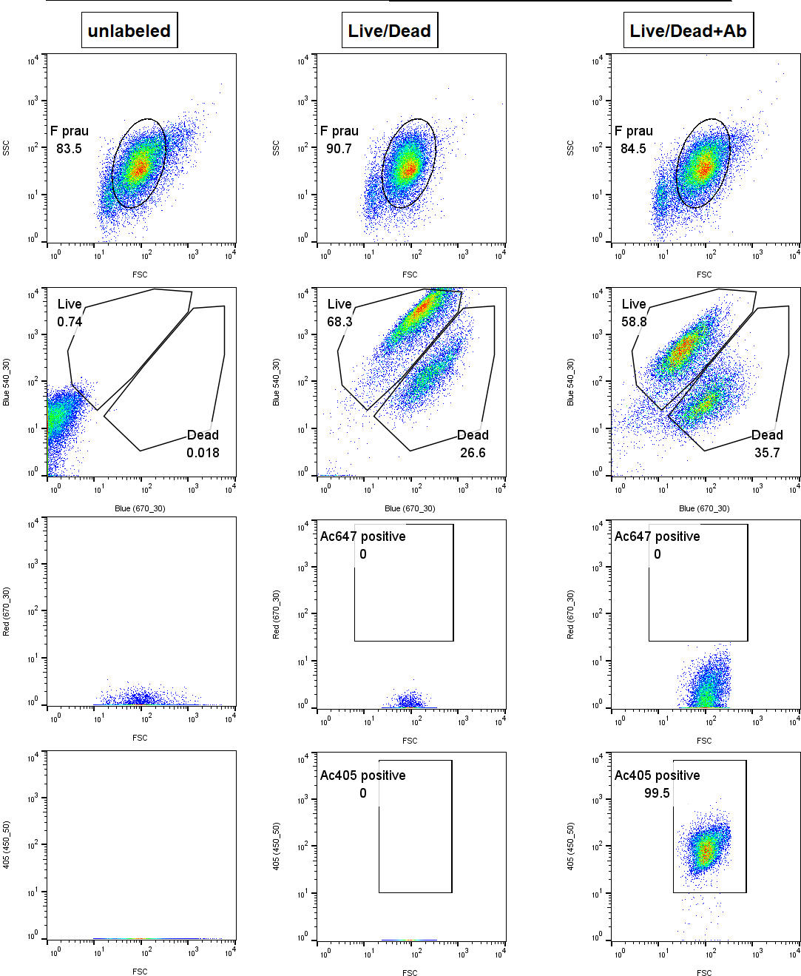
F. prausnitzii A2-165
SSC/FSC
SSC
FSC
LIVE/DEAD™
Syto9/PI
Blue 540/30 nm
Blue 670/30 nm
Anti-F. prau ATCC
R670/FSC
Red 670/30 nm
FSC
Anti-F. prau A2-165
V405/FSC
405 (450/50nm)
FSC

Slide 2
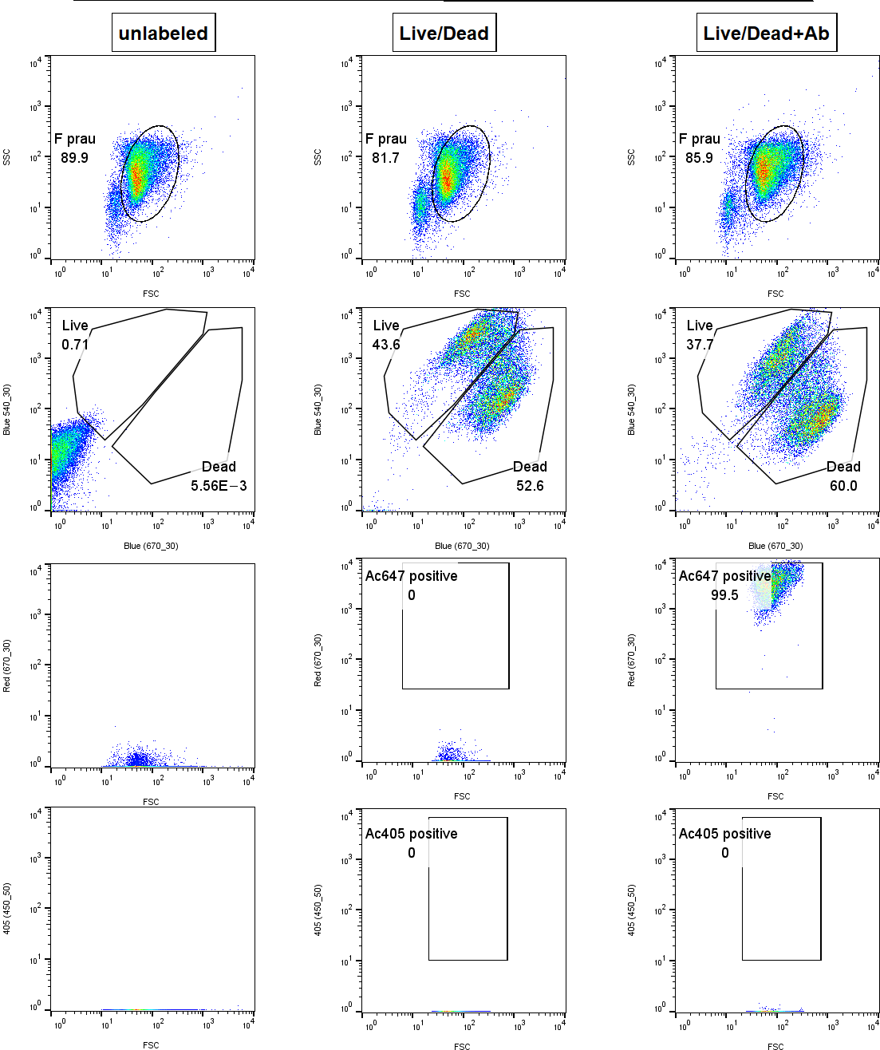
F. prausnitzii ATCC 27766
SSC/FSC
SSC
FSC
LIVE/DEAD™
Syto9/PI
Blue 540/30 nm
Blue 670/30 nm
Anti-F. prau ATCC
R670/FSC
Red 670/30 nm
FSC
Anti-F. prau A2-165
V405/FSC
405 (450/50nm)
FSC

Slide 3
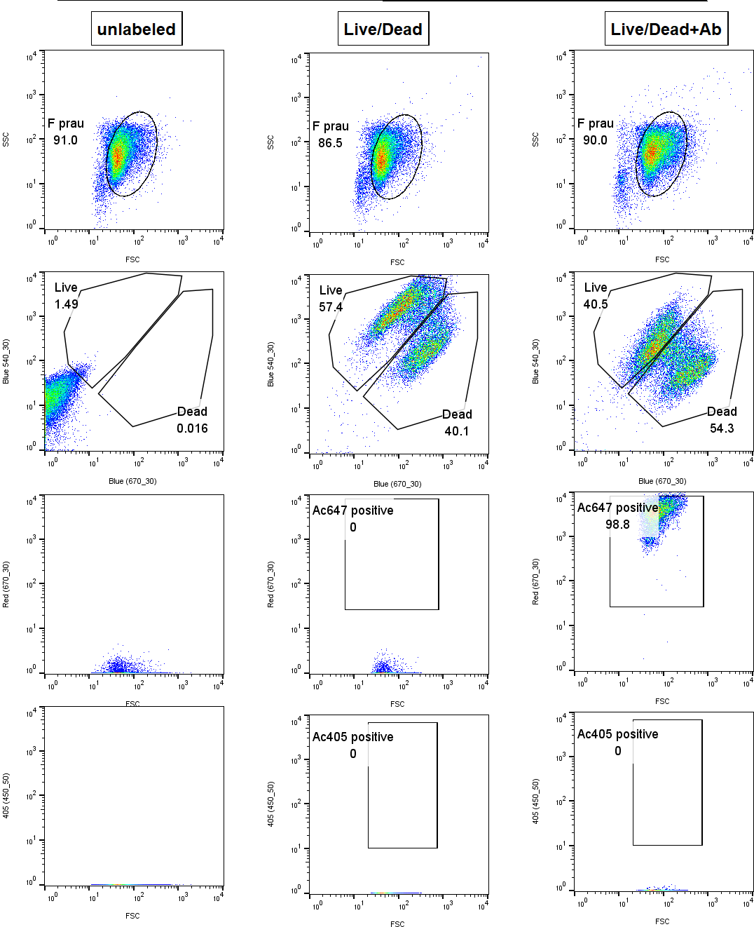
F. prausnitzii ATCC 27768
SSC/FSC
SSC
FSC
LIVE/DEAD™
Syto9/PI
Blue 540/30 nm
Blue 670/30 nm
Anti-F. prau ATCC
R670/FSC
Red 670/30 nm
FSC
Anti-F. prau A2-165
V405/FSC
405 (450/50nm)
FSC

Slide 4
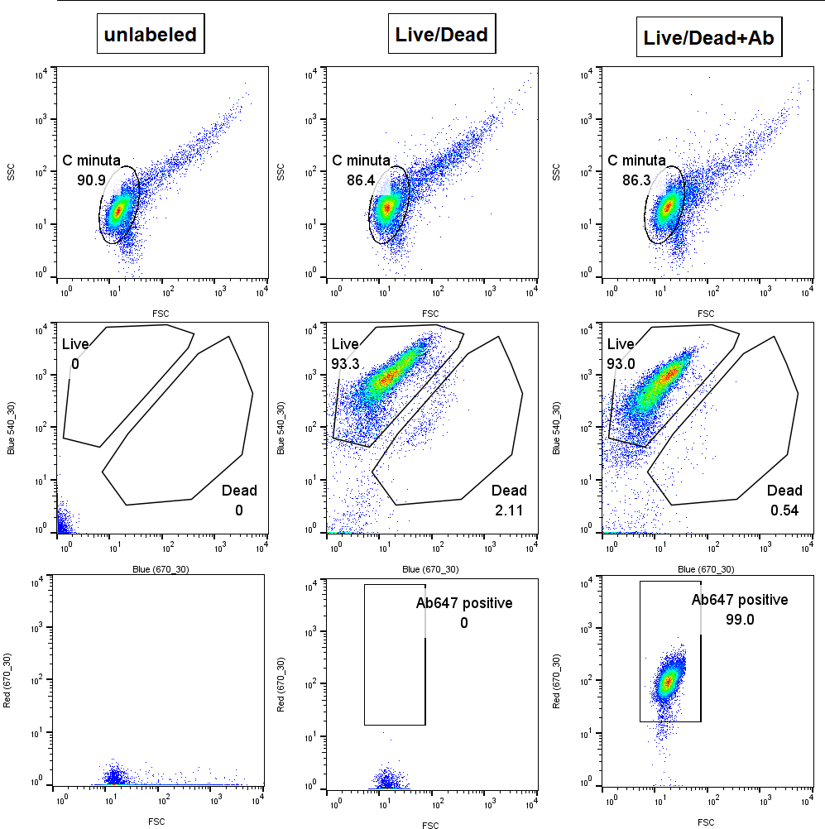
C. minuta DSM 22607
SSC/FSC
SSC
FSC
LIVE/DEAD™
Syto9/PI
Blue 540/30 nm
Blue 670/30 nm
Anti-C.minuta
R670/FSC
Red 670/30 nm
FSC

