Slide 1
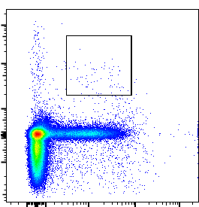
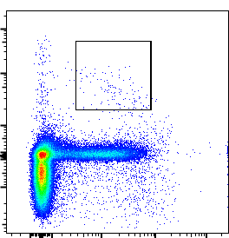
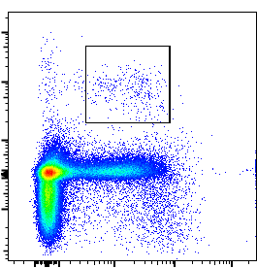
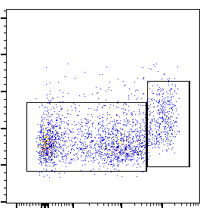
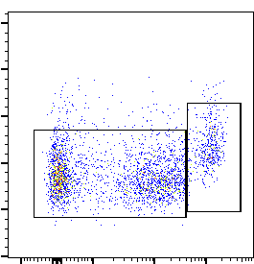
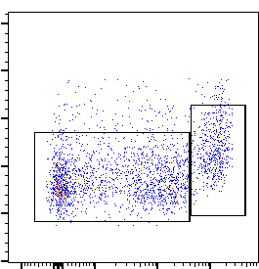
PBS
MI3
MI29
0.17±0.06
0.14±0.09
0.26±0.03
PDCA-1
CD11c
PBS
MI3
MI29
Ly6C^{low-}
Ly6C^{hi}
Ly6C^{low-}
Ly6C^{hi}
Ly6C^{low-}
Ly6C^{hi}
81.70±2.84
14.38±2.41
80.68±2.26
12.95±3.01
75.20±3.88
17.74±4.35
SSC-A
Ly6C
Fig. S1. Administration of L. paracasei MI29 promotes the population of pDCs and monocytes. Flow cytometry analysis was performed to identify pDCs gated from CD45⁺CD11c⁺PDCA-1⁺cells and monocytes gated from CD45⁺CD11b⁺Ly6G⁻ cells in lung tissues.

Slide 2
a
Gene ontology terms enriched in MI29 vs PBS
Gene ontology terms enriched in MI29 vs MI3
Regulation of immune system process
4
Inflammatory response
3
Inflammatory response
log₂ (fold change)
Antimicrobial humoral response
Leukocyte migration
2
Defense response
Immune system process
1
Response to bacterium
Defense response
0
Cfd
Lep
Ccl28
Egr3
Tacr1
Ltf
IL1b
Reg3g
Bpifb1
Nr4a3
Ccl12
Dusp1
Pdcd1
Thbs1
Aoc3
Bdkrb1
Antimicrobial humoral immune response mediated by antimicrobial peptide
Adipoq
Orm1
Tnfaip6
H4c12
Cellular response to tumor necrosis factor
Humoral immune response
4
Humoral immune response
Response to bacterium
3
Antimicrobial humoral immune response mediated by antimicrobial peptide
log₂ (fold change)
Cellular response to tumor necrosis factor
2
Acute inflammatory response
MAPK cascade
1
Response to tumor necrosis factor
Antimicrobial humoral immune response
Aoc3
F2
Lep
0
Antibacterial humoral response
Tacr1
Ccl24
Mylk3
Tnfai6
Orm1
Csrp3
Hamp
Bdkrb1
Fabp4
Adipoq
Thbs1
Trim55
4
3
2
1
0
0
2
4
6
- log₁₀ (q-value)
- log₁₀ (q-value)
b
Gene ontology terms enriched in MI29 vs PBS
Gene ontology terms enriched in MI29 vs MI3
Cellular response to interleukin-1
4
Cytokine activity
3
Response to cytokine
log₂ (fold change)
2
Receptor ligand activity
Response to interleukin-1
1
Signaling receptor acitivator activity
Defense response
0
Ccl20
Cxcl2
Pck1
Il1b
Il1r2
Fgg
Ccl3
Ccl11
Egr1
Has2
Mylk3
3
2
1
0
Inflammatory response
8
- log₁₀ (q-value)
6
Cellular response to cytokine stimulus
log₂ (fold change)
Response to bacterium
4
Cytokine activity
2
0
2
4
6
Fasl
Ccl3
Osm
Cxcl2
0
- log₁₀ (q-value)
Fig. S2. Oral administration of L. paracasei MI29 promotes host defense-related pathways in the lung from WT or A/PR8-infected mice. (a) Gene ontology assignments of differentially expressed genes significantly altered in the lungs from L. paracasei MI29-treated mice versus PBS or L. paracasei MI3-treated mice. (b) Gene ontology assignments of differentially expressed genes significantly altered in the lungs of A/PR8-infected mice treated with L. paracasei MI29 compared to those treated with PBS or L. paracasei MI3. Upregulated genes are shown for specific pathways of interest.

Slide 3
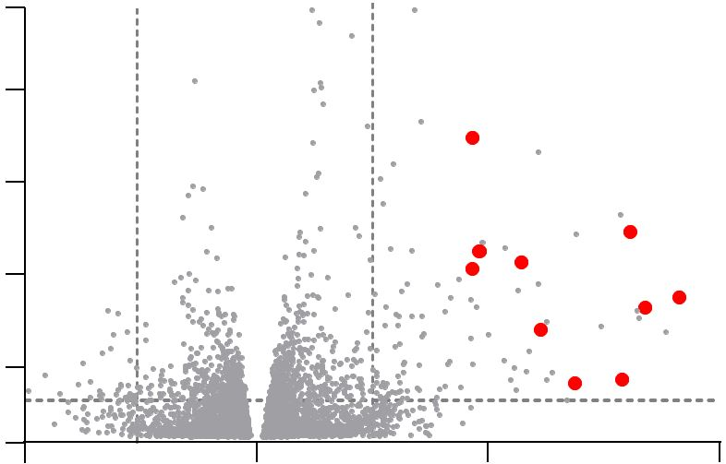
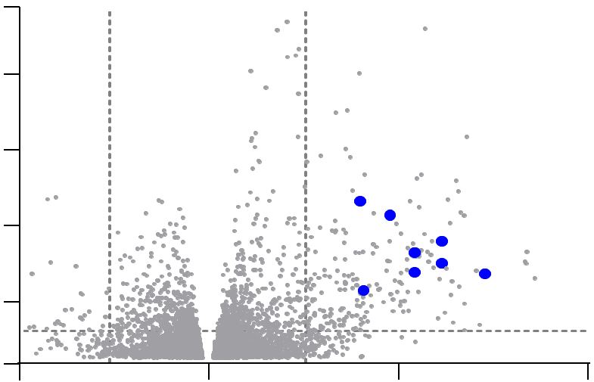
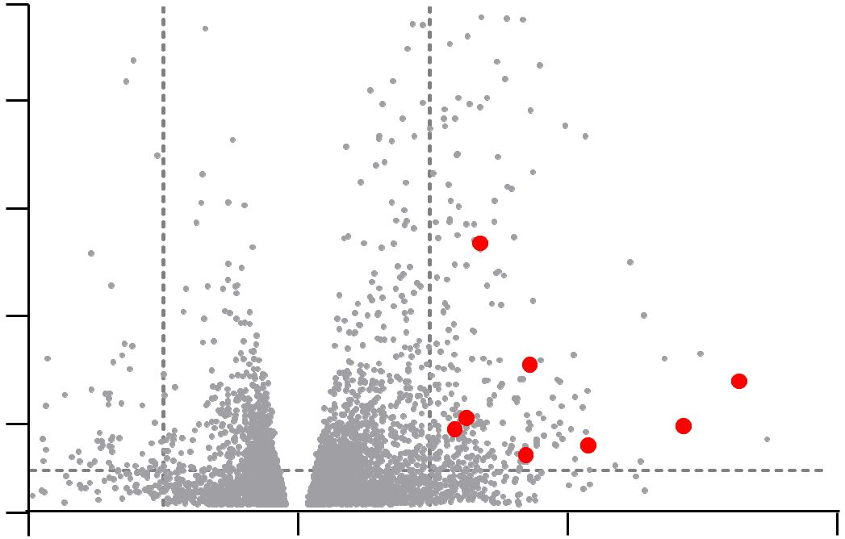
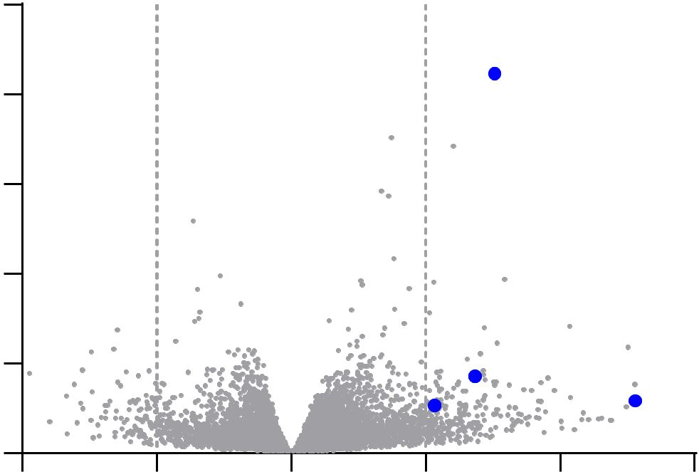
a
Genes upregulated in MI29 vs PBS
Genes upregulated in MI29 vs MI3
10
10
8
Nr4a3
8
6
Lep
6
- Log₁₀ (p-value)
Dusp1
Orm1
Tacr1
Fabp4
4
Pdcd1
Ccl28
Cfd
Adipoq
4
Trim55
Hamp
Csrp3
Lep
2
Bpifb1
Reg3g
2
Orm1
Adipoq
0
-2
0
2
4
0
-2
0
2
4
Log₂ (fold change MI29 / PBS)
Log₂ (fold change MI29 / MI3)
b
Genes upregulated in MI29 vs PBS
Genes upregulated in MI29 vs MI3
10
15
Osm
8
12
6
9
- Log₁₀ (p-value)
Fgg
4
Il1b
Ccl20
6
2
Ccl3
Il1r2
Pck1
Cxcl2
3
Fasl
Ccl3
Cxcl2
0
Ccl11
0
-2
0
2
4
-2
-1
0
1
2
3
Log₂ (fold change MI29 / PBS)
Log₂ (fold change MI29 / MI3)
Fig. S3. Oral administration of L. paracasei MI29 promotes the expression of genes related to the defense pathway in the lungs of WT or A/PR8-infected mice. (a) Volcano plot shows the log₂-fold change in gene expression in the lungs of L. paracasei MI29-treated mice versus PBS or L. paracasei MI3-treated mice. (b) Volcano plot shows the log₂ fold-change in gene expression in the lungs of A/PR8-infected mice treated with L. paracasei MI29 compared with those treated with PBS or L. paracasei MI3.

Slide 4

(Kim S. et al. SFigure 4)
a
Trifluoroacetic acid
Vitamin C
PG(16:0/22:6(4Z,7Z,10Z,13Z,16Z,19Z))
1-Oleoylglycerophosphocholine
gamma-Glu-gln
Choline
PG(16:0/16:1(9Z))
10-GINGEROL
Sphingosine 1-phosphate
Citric acid
Ginkgoic acid
Docosapentaenoic acid
Medroxyprogesterone
PI(18:1(9Z)/20:4(5Z,8Z,11Z,14Z))
PI(16:0/20:4(5Z,8Z,11Z,14Z))
PI(16:0/18:2(9Z,12Z))
Oleic acid
PS(22:6(4Z,7Z,10Z,13Z,16Z,19Z)/18:2(9Z,12Z))
Pregabalin
PI(18:0/0:0)
Palmitoylcarnitine
Adenosine monophosphate
Synaptamide
Ferulic acid 4-sulfate
Maleic acid
MI3
MI29
b
Low
High
P value < 0.05
Biosynthesis of unsaturated fatty acid
5e+06
Glycine, serine and threonine metabolism
Glycerophospholipid metabolism
Low
PC2 (34.5 %)
0
Citrate cycle
Alanine, aspartate and glutamate metabolism
Glyoxylate and dicarboxylate metabolism
p value
-5e+06
MI3
Sphingolipid metabolism
MI29
Purine metabolism
High
-2.0e+07
-1.0e+07
0
1.0e+07
1.5e+07
0
1
2
3
4
5
PC1 (64.1 %)
Enrichment ratio
Fig. S4. Metabolic profiles in the lung tissues from L. paracasei-treated mice. (a) Heat map displays the metabolic profiles in the lung tissues of mice treated with MI3 or MI29. (b) The principal component analysis plot shows the clustering between the mice treated with L. paracasei MI3 and MI29. A summary of metabolite enrichment analysis is provided based on the metabolites that showed significant variation in the lung tissues of MI29-treated mice compared with MI3-treated mice.

Slide 5
a
Summary of genome annotation of KCTC 3510, MI3 and MI29 strains.
Strain | Base (bp) | No. of CDS* | GC contents (%) | No. of tRNA | No. of rRNA | ANIb† (%)
Type | 2,991,737 | 3,042 | 46.5 | 61 | 15 | -
MI3 | 3,230,892 | 3,105 | 46.1 | 59 | 15 | 98.67
MI29 | 3,212,493 | 3,014 | 46.3 | 59 | 15 | 98.69
* Coding sequences
† Average nucleotide identity based BLAST to type strain KCTC 3510
b
c
MI3
MI29
Negative
MI3
MI29
D-Ribose
D-Adonitol
D-Galactose
D-Glucose
D-Fructose
D-Mannose
L-Sorbose
D-Mannitol
D-Sorbitol
N-Acetylglucosamine
Amygdalin
Arbutin
Esculin ferric citrate
Salicin
D-Cellobiose
D-Maltose
D-Lactose
D-Saccharose
D-Trehalose
Inulin
D-Melezitose
Gentiobiose
D-Turanose
D-Lyxose
D-Tagatose
Potassium Gluconate
Alkaline phosphatase
Esterase(C4)
Esterase lipase(C8)
Lipase(C14)
Leucine arylamidase
Valine arylamidase
Crystine arylamidase
Trypsin
α-chymotrypsin
Acid phospatase
Naphthol-AS-BI-phosphohydrolase
α-galactosidase
β-galactosidase
β-glucuronidase
α-glucosidase
β-glucosidase
N-acetyl-β-glucosaminidase
α-mannosidase
α-fucosidase
0
Weak
1
Positive
2
3
4
5
Fig. S5. Characterization of L. paracasei to determine a novel strain. (a) Summary of genome annotation. Profiling of carbohydrate fermentation (b) and enzyme activity (c).

