Slide 1
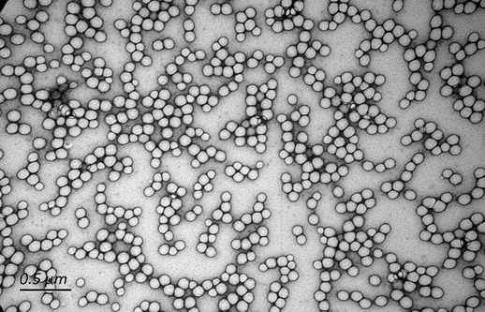
TEM imaging of synthetic microbeads used as procedural controls for EVs sample preparation

