Slide 1
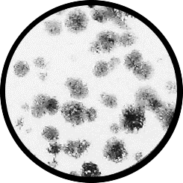
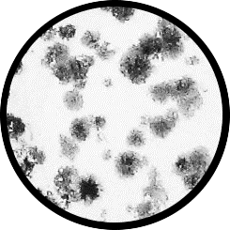
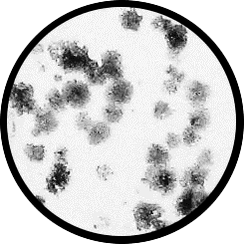






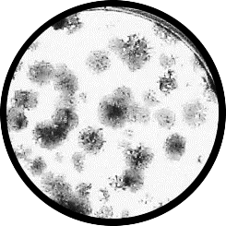
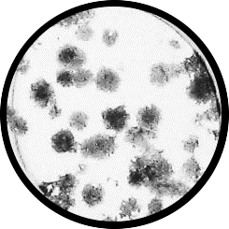
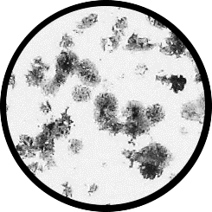






Figure S1
A
Hep3B:
B
Hep3B/shCtrl
Hep3B/shHK2-1
Hep3B/shHK2-2
shHK2-2^{DOX}
shHK2-1^{DOX}
shHK2-3^{DOX}
- DOX:
DOX:
- + - + - +
+ DOX:
HK2
GAPDH
C
D
Hep3B
Huh7
96%
96%
H460/
shHK2^{DOX}
H460HK1^{KO}/
shHK2^{DOX}
95%
98%
94%
93%
DOX:
- + - +
98%
94%
92%
HK1
90%
66%
94%
97%
93%
89%
92%
93%
93%
93%
94%
85%
94%
94%
HK2
94%
GAPDH
shHK2
shHK2
shHK2
shHK2
shHK2
shHK2
shCtrl
shCtrl
shCtrl
shCtrl
shCtrl
shCtrl
Day 0
Day 4
Day 8
Day 0
Day 4
Day 8

Slide 2
Figure S2
A
B
DPI (nM)
DPI (μM)
C
Hep3B/shCtrl^{DOX}
Hep3B/shHK2^{DOX}
Hep3B/shHK2.2^{DOX}
Control
Control
Control
D
(liver)
(breast)
(colon)
(colon)
(lung)

Slide 3




Figure S3
A
B
Relative viable cells
Relative viable cells
Relative viable cells
Relative viable cells
C
D
E
ROT:
- - + +
F
ROT:
- - + +
ROT:
- - + +
FDG:
- + - +
FDG:
- + - +
FDG:
- + - +
p-S6K(T389)
Relative viable cells
p-AMPKα (T172)
S6K
Cleaved Caspase 3
p-S6 (S235/236)
Cleaved PARP
AMPKα
S6
MCl1
GAPDH
p-4E-BP1(T37/46)
GAPDH
4E-BP1
GAPDH
Notes:
A. NADPH oxidase inhibitors

Slide 4


Figure S4
Liver
CTRL
shHK2
DPI
shHK2/DPI
Brain
HK2
HK1
HK4
GAPDH

Slide 5
Figure S5
A
B
PER combination:
ETX combination:
CTRL
shHK2
DPI
shHK2/DPI
pACC
Relative viable cells
Relative viable cells
ACC
GAPDH
C

Slide 6
Figure S6
A
Cell Number
(X 1,000)
B
1 h
2 h
4 h

Slide 7
Figure S7

