Slide 1
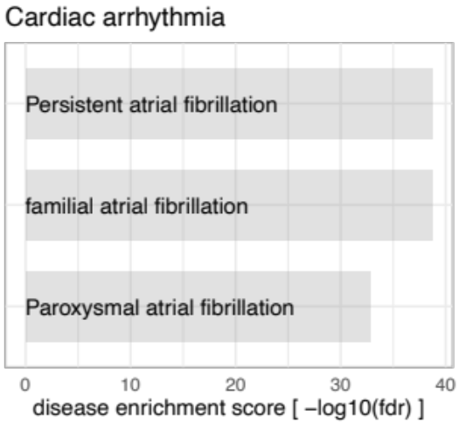
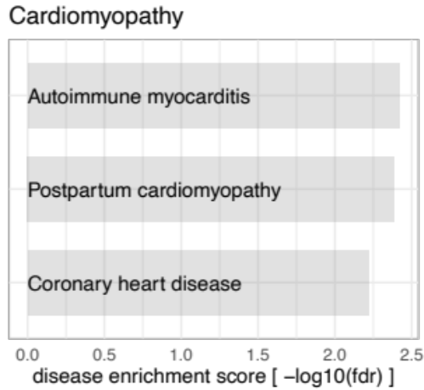
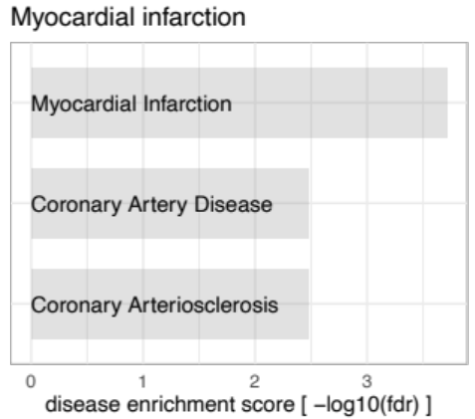
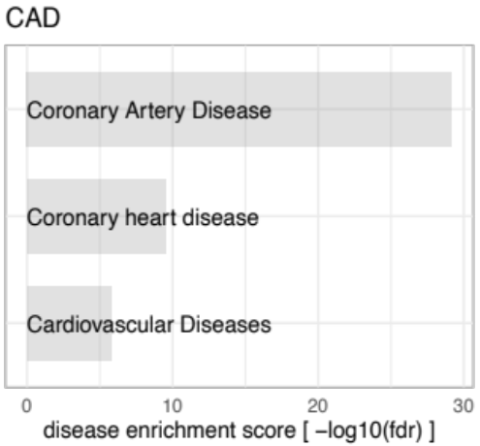
Figure S1
Phenotypes from DisGeNet
Phenotypes from DisGeNet
Phenotypes from DisGeNet
Phenotypes from DisGeNet

Slide 2
Figure S2
60
40
20
0
Ctrl
MI
Rel. RNA Levels
*
*
*
*
RP11-98F14.11 RPL23AP92 IGBP1P1 CTD-2383I20.1

Slide 3
Figure S3
A
1.5
1.0
0.5
0
B
1.5
1.0
0.5
0
Rel. RP11-98F14.11 RNA Level
Rel. RPL23AP92 RNA Level
*
**
*
**
GM Ctrl #1 #2 #3 #4
GM Ctrl #1 #2 #3 #4
GM RP11-98F14.11
GM RPL23AP92
C
1.5
1.0
0.5
0
D
1.5
1.0
0.5
0
Rel. IGBP1P1 RNA Level
Rel. CTD-2383I20.1 RNA Level
**
*
*
*
*
GM Ctrl #1 #2 #3 #4
GM Ctrl #1 #2 #3 #4
GM IGBP1P1
GM CTD-2383I20.1

Slide 4
Figure S4
6
4
2
0
Normoxia GM Ctrl
Normoxia GM CTD-2383l20.1
Hypoxia GM Ctrl
Hypoxia GM CTD-2383l20.1
Rel. RNA Level
**
**
**
%
**
**
**
**
**
CTD-2383I20.1 COL3A1 MMP2 TGFb1 NPPA NPPB MYH7

Slide 5
Figure S5
A
B
C
GM Ctrl
GM RP11-98F14.11
Amplitude
(fluroscence in RFU x 10⁴)
Normoxia GM Ctrl
Normoxia GM IGBP1P1
Hypoxia GM Ctrl
Hypoxia GM IGBP1P1
Amplitude
(fluroscence in RFU x 10⁴)
GM Ctrl
GM IGBP1P1
Beating Frequency (beats/min)
40
30
20
10
0
8
6
4
2
0
8
6
4
2
0
**
%
ns
**
0 1 2 3 4 5
Time (s)
Normoxia Hypoxia
Normoxia Hypoxia
D
Normoxia GM Ctrl
Normoxia GM RP11-98F14.11 Hypoxia GM Ctrl
Hypoxia GM RP11-98F14.11
E
GM Ctrl
GM RP11-98F14.11
F
GM Ctrl
GM RPL23AP92
Amplitude
(fluroscence in RFU x 10⁴)
8
6
4
2
0
Amplitude
(fluroscence in RFU x 10⁴)
8
6
4
2
0
40
30
20
10
0
Beating Frequency (beats/min)
**
ns
ns
**
0 1 2 3 4 5
Time (s)
Normoxia Hypoxia
Normoxia Hypoxia
G
Normoxia GM Ctrl
Normoxia GM RPL23AP92
Hypoxia GM Ctrl
Hypoxia GM RPL23AP92
H
Amplitude
(fluroscence in RFU x 10⁴)
GM Ctrl
GM RPL23AP92
Amplitude
(fluroscence in RFU x 10⁴)
8
6
4
2
0
8
6
4
2
0
ns
**
0 1 2 3 4 5
Time (s)
Normoxia Hypoxia

