Slide 1
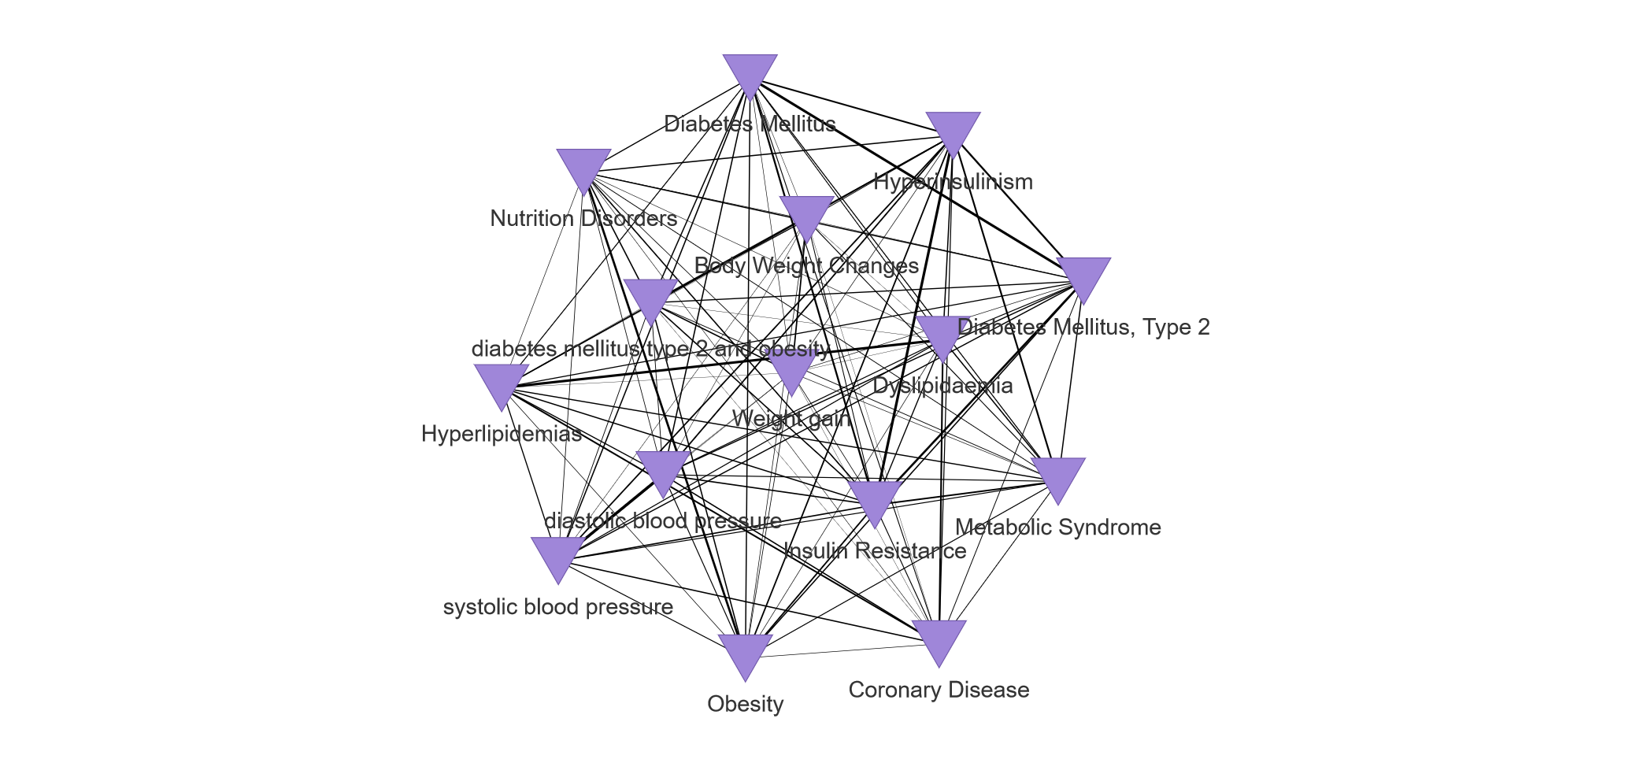
Gkouskou et al., Suppl. Figure 1

