Slide 1
Comparative data for Dried Blood Spot (DBS) extracted DNA and Manual blood extracted DNA
Shrutikaa Kale
Junior Research fellow

Slide 2
Assay details
The samples taken for comparative study was from lysosomal storage disorder (LSD), Pompe disease, Fabry Disease and Gaucher Disease
The Dried Blood Spot (DBS) DNA and Manually extracted DNA from blood were subjected to smMIP-NGS assay
Aim and Objective of the study was to determine the number of unique molecules with less input of the DNA sample obtained from DBS in comparison to manually extracted blood DNA
Input DNA for Manually extracted DNA was 100ng and for DBS DNA was around 20ng
All other criteria for both the setup was same

Slide 3
S-193: POMPE sample comparison with Manual extracted DNA from Blood Vs DBS
INSIDE OF REGION (Manual Extraction by Blood) | OUTPUT
Number of reads (inside of regions) | 453,239
Mapped read (inside of region) | 436,807 / 96.37%
Overlapping read pairs | 217,256 / 95.87%
Duplicated reads (flagged) | 201,017 / 46.02%
GC Percentage | 50%
Mean Coverage (inside of regions) | 709.6948
Mean Mapping Quality | 58.65
INSIDE OF REGION (DBS) | OUTPUT
Number of reads (inside of regions) | 416,741
Mapped read (inside of region) | 405,098 / 97.21%
Overlapping read pairs | 201,753 / 96.82%
Duplicated reads (flagged) | 208,863 / 51.56%
GC Percentage | 53.04%
Mean Coverage (inside of regions) | 654.1372
Mean Mapping Quality | 58.74
Mismatches and indels (General error rate) | 0.44%
Mismatches and indels (General error rate) | 0.39%
VARIANT DEPTH | 146x
VARIANT DEPTH | 199x

Slide 4
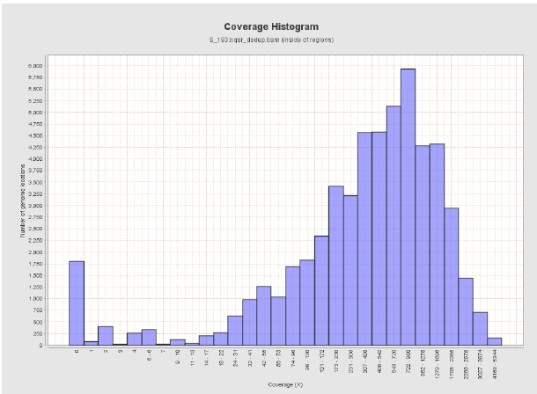
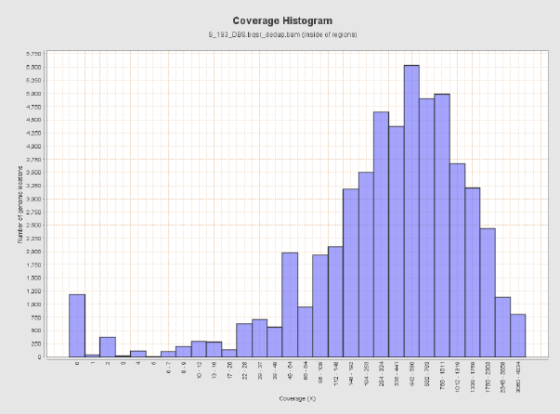
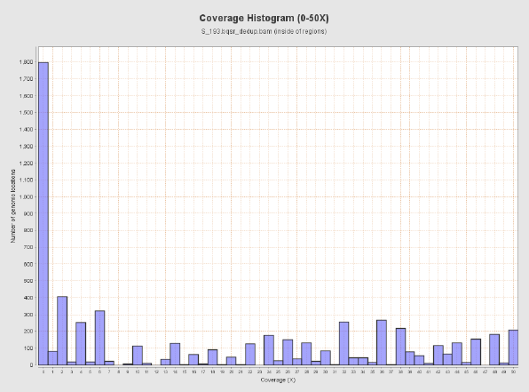
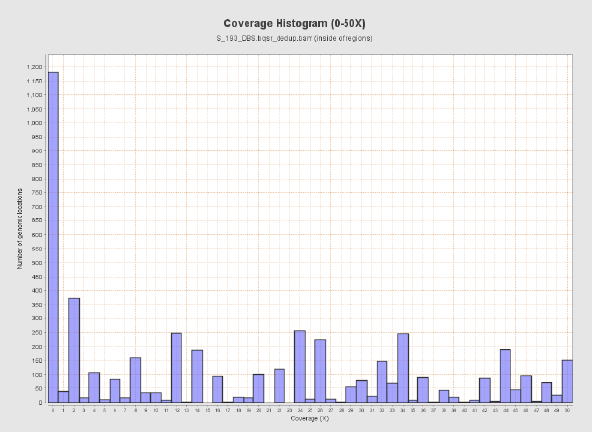
S-193
COVERAGE HISTOGRAM FOR BLOOD
S-193
COVERAGE HISTOGRAM FOR DBS
S-193
COVERAGE HISTOGRAM FOR BLOOD (0-50X)
S-193
COVERAGE HISTOGRAM FOR DBS (0-50X)

Slide 5
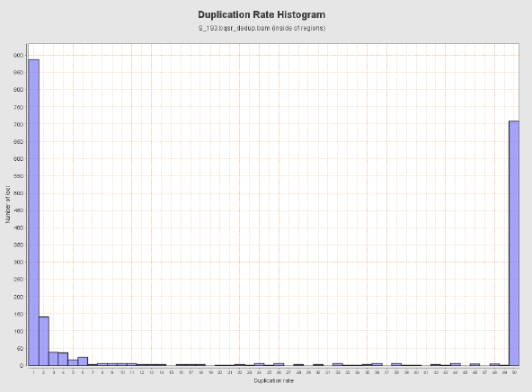
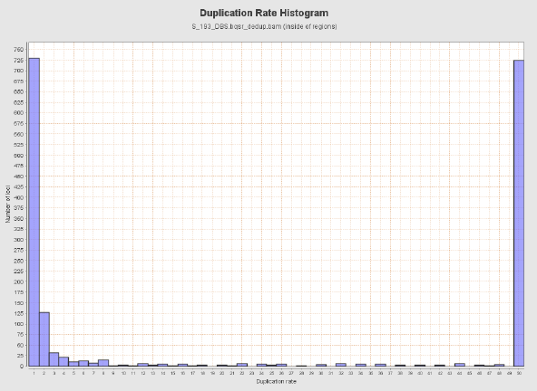
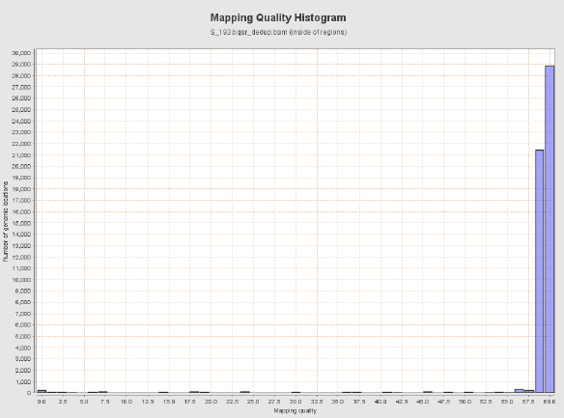
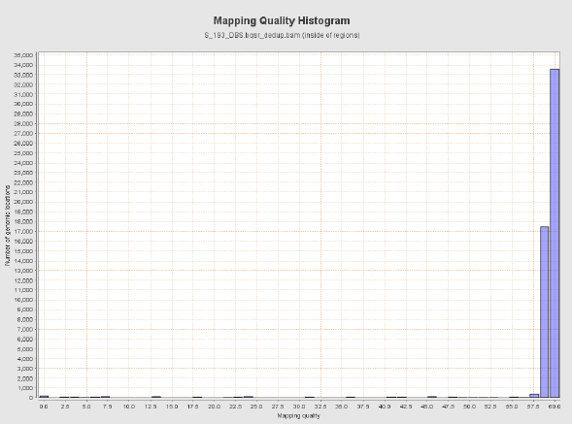
S-193
DUPLICATION RATE HISTOGRAM FOR BLOOD
S-193
DUPLICATION RATE HISTOGRAM FOR DBS
S-193
MAPPING QUALITY HISTOGRAM FOR BLOOD
S-193
MAPPING QUALITY HISTOGRAM FOR DBS

Slide 6
S-203: FABRY sample comparison with Manual extracted DNA from Blood Vs DBS
INSIDE OF REGION (Manual Extraction by Blood) | OUTPUT
Number of reads (inside of regions) | 366,884
Mapped read (inside of region) | 354,696 / 96.68%
Overlapping read pairs | 176,487 / 96.21%
Duplicated reads (flagged) | 174,084 / 49.08%
GC Percentage | 50.46%
Mean Coverage (inside of regions) | 572.9778
Mean Mapping Quality | 58.72
INSIDE OF REGION (DBS) | OUTPUT
Number of reads (inside of regions) | 192,655
Mapped read (inside of region) | 187,535 / 97.34%
Overlapping read pairs | 93,349 / 96.91%
Duplicated reads (flagged) | 94,265 / 50.27%
GC Percentage | 53.8%
Mean Coverage (inside of regions) | 301.5849
Mean Mapping Quality | 58.9
Mismatches and indels (General error rate) | 0.46%
Mismatches and indels (General error rate) | 0.4%
VARIANT DEPTH | 26x
VARIANT DEPTH | 20x

Slide 7
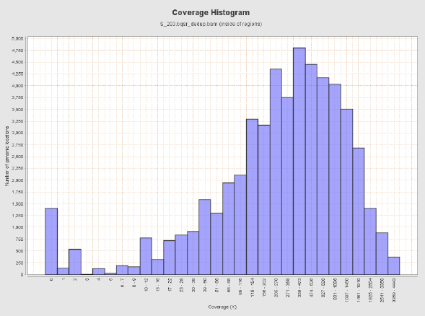
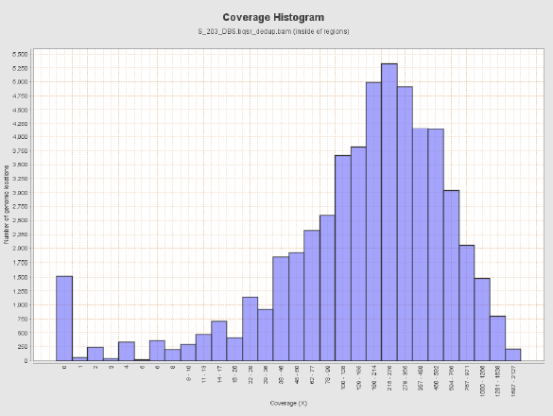
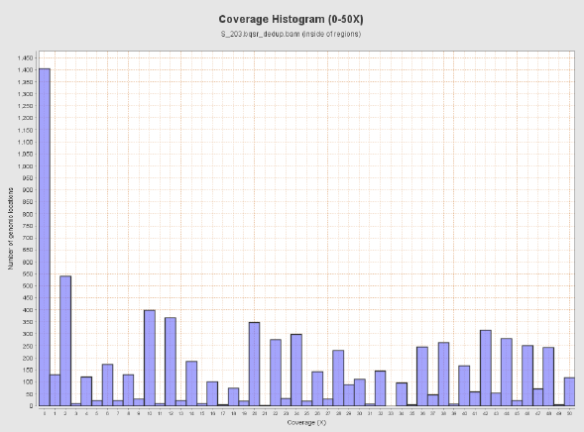
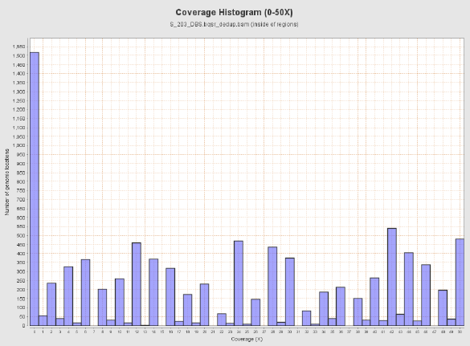
S-203
COVERAGE HISTOGRAM FOR BLOOD
S-203
COVERAGE HISTOGRAM FOR DBS
S-203
COVERAGE HISTOGRAM FOR BLOOD (0-50X)
S-203
COVERAGE HISTOGRAM FOR DBS (0-50X)

Slide 8
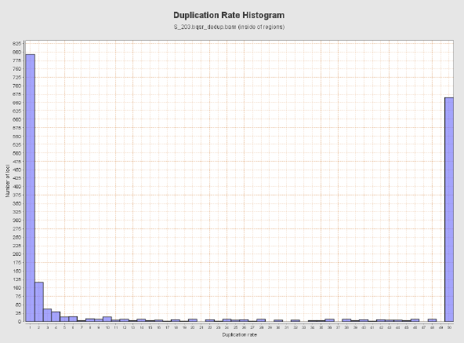
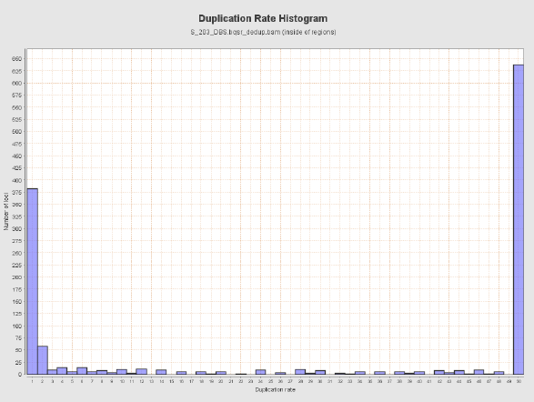
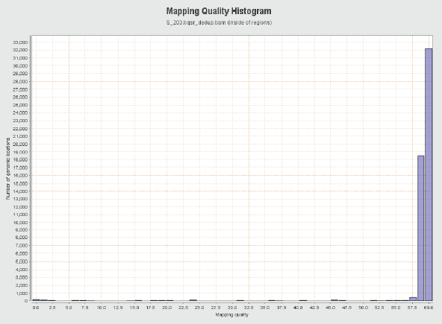
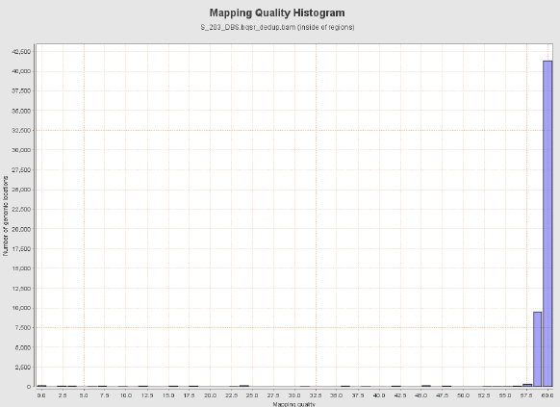
S-203
DUPLICATION RATE HISTOGRAM FOR BLOOD
S-203
DUPLICATION RATE HISTOGRAM FOR DBS
S-203
MAPPING QUALITY HISTOGRAM FOR BLOOD
S-203
MAPPING QUALITY HISTOGRAM FOR DBS

Slide 9
B -10120: GAUCHER DISEASE sample comparison with Manual extracted DNA from Blood Vs DBS
INSIDE OF REGION (Manual Extraction by Blood) | OUTPUT
Number of reads (inside of regions) | 377,795
Mapped read (inside of region) | 369,002 / 97.67%
Overlapping read pairs | 183,719 / 97.26%
Duplicated reads (flagged) | 170,259 / 46.14%
GC Percentage | 50.21%
Mean Coverage (inside of regions) | 601.6601
Mean Mapping Quality | 58.63
INSIDE OF REGION (DBS) | OUTPUT
Number of reads (inside of regions) | 188,746
Mapped read (inside of region) | 184,443 / 97.72%
Overlapping read pairs | 91,935 / 97.42%
Duplicated reads (flagged) | 87,029 / 47.18%
GC Percentage | 52.62%
Mean Coverage (inside of regions) | 297.6513
Mean Mapping Quality | 58.9
Mismatches and indels (General error rate) | 0.4%
Mismatches and indels (General error rate) | 0.34%
VARIANT DEPTH | 349x
VARIANT DEPTH | 297x

Slide 10
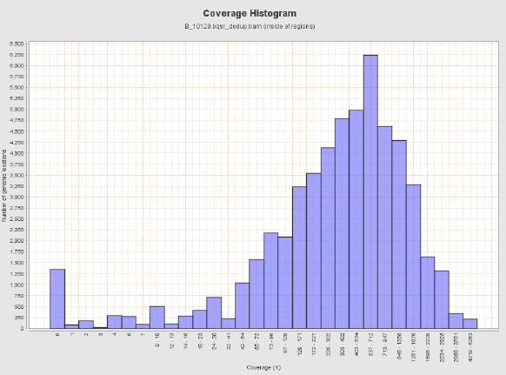
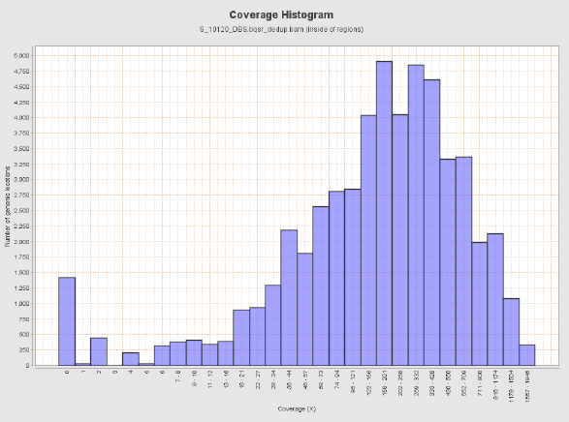
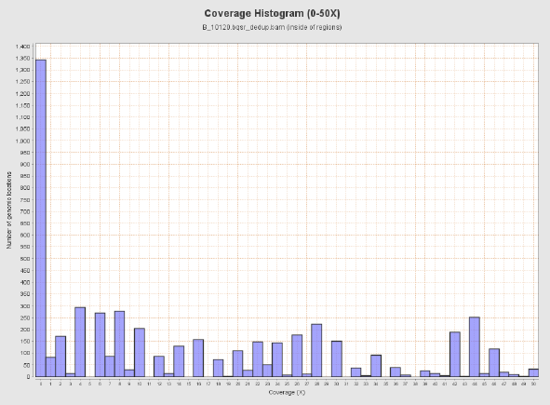
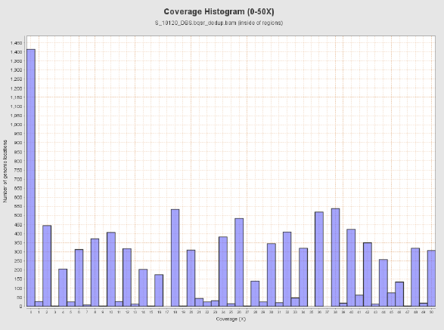
B-10120
COVERAGE HISTOGRAM FOR BLOOD
B-10120
COVERAGE HISTOGRAM FOR DBS
B-10120
COVERAGE HISTOGRAM FOR BLOOD (0-50X)
B-10120
COVERAGE HISTOGRAM FOR DBS (0-50X)

Slide 11
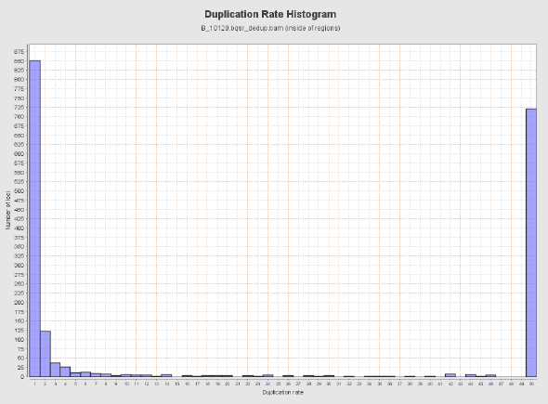
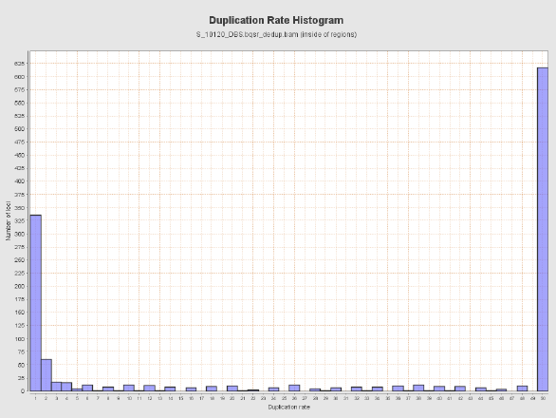
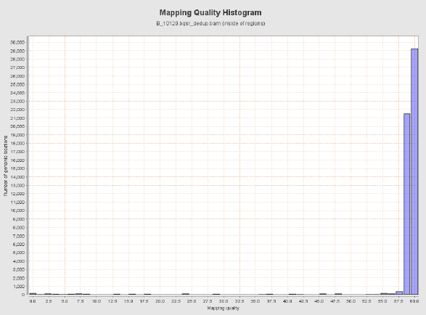

B-10120
DUPLICATION RATE HISTOGRAM FOR BLOOD
B-10120
DUPLICATION RATE HISTOGRAM FOR DBS
B-10120
MAPPING QUALITY HISTOGRAM FOR BLOOD
B-10120
MAPPING QUALITY HISTOGRAM FOR DBS

Slide 12
Statistical output of Data for barcodes captured by 904 probes
 | Manually extracted DNA from blood (Data for Barcodes captured)
 | 10120 | 203 | 193
Average percentage of Duplicate data | 38 | 40 | 37
S.D. | 12.0 | 11.9 | 12.1
Min mol. captured | 0 | 0 | 0
Max mol. captured | 80 | 68 | 66
 |  | DBS DNA (Data for Barcodes captured)
 | 10120 | 203 | 193
Average percentage of Duplicate data | 44 | 45 | 44
S.D. | 11.6 | 11.7 | 11.6
Min mol. captured | 0 | 0 | 0
Max mol. captured | 68 | 67 | 68

Slide 14
Conclusion
Duplication rate was 10% more in DBS as compared to manually extracted DNA
The average unique molecules captured by DBS is 160 and by manually extracted was 258. Thus there was 40% less unique molecule captured by DBS
The variants previously identified by manually extracted DNA were accurately detected using DBS
To conclude, DBS method for DNA extraction can be used for future smMIP-NGS studies

Slide 15
Thank You

