Slide 1
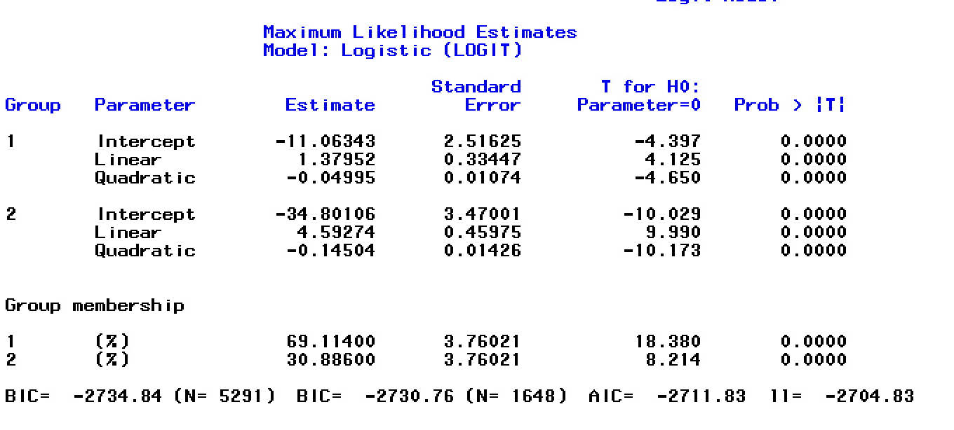
Additional file 1. Developmental trajectories of eating disorder symptoms: A longitudinal study from early adolescence to young adulthood
Breton, Dufour, et al.
A. Model of overall ED symptoms (with the weight loss item)

Slide 2
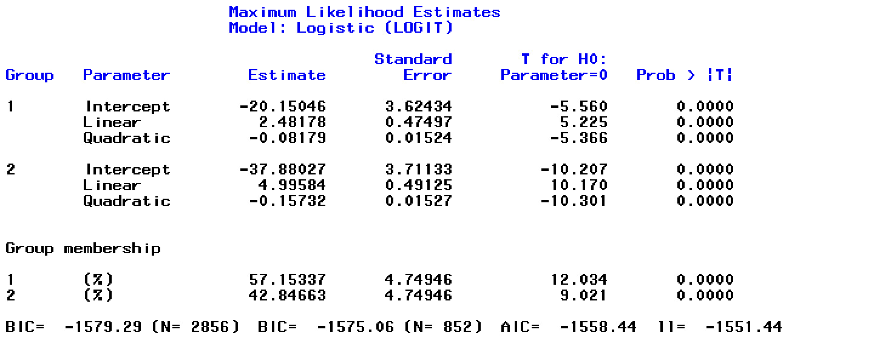
B. Model of overall ED symptoms in girls

Slide 3
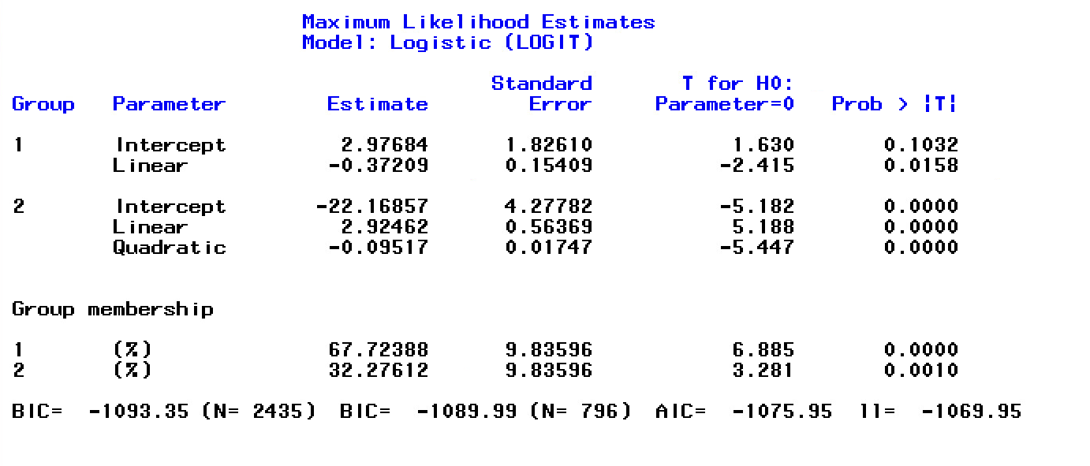
C. Model of overall ED symptoms in boys

Slide 4
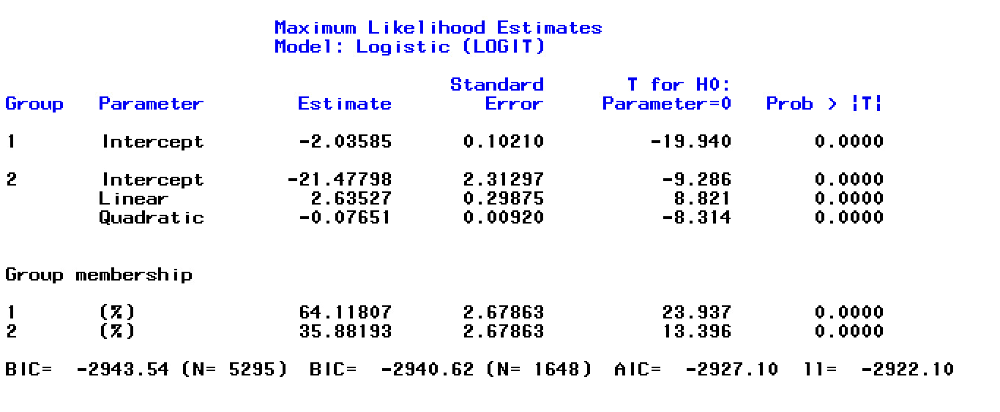
D. Model of overall ED symptoms (without the weight loss item)

Slide 5
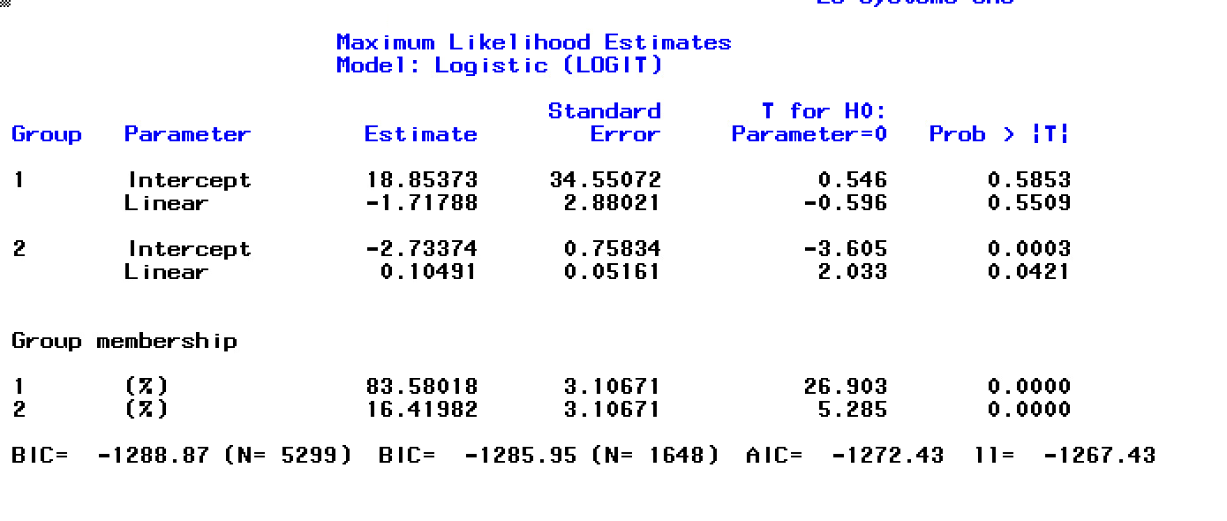
E. Model for each symptom type – purging

Slide 6
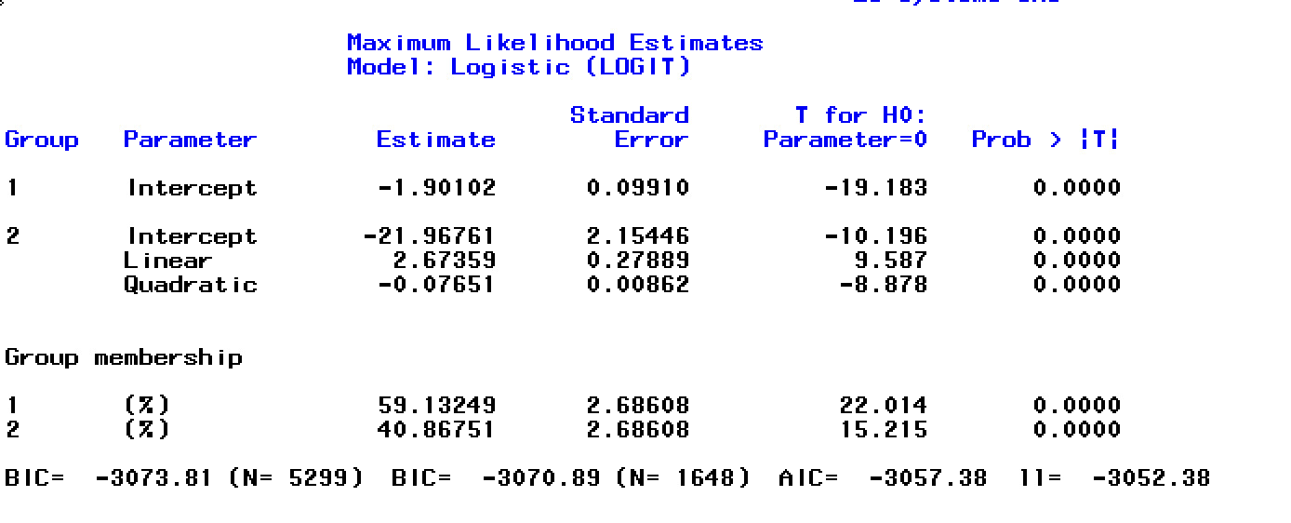
F. Model for each symptom type – loss of control

Slide 7
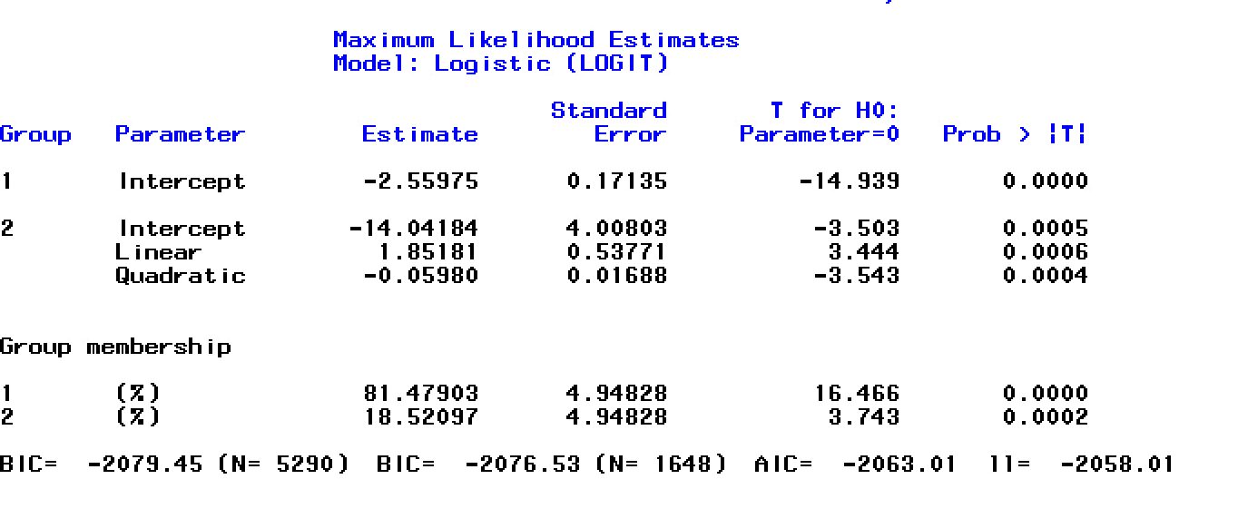
G. Model for each symptom type – loss weight

Slide 8
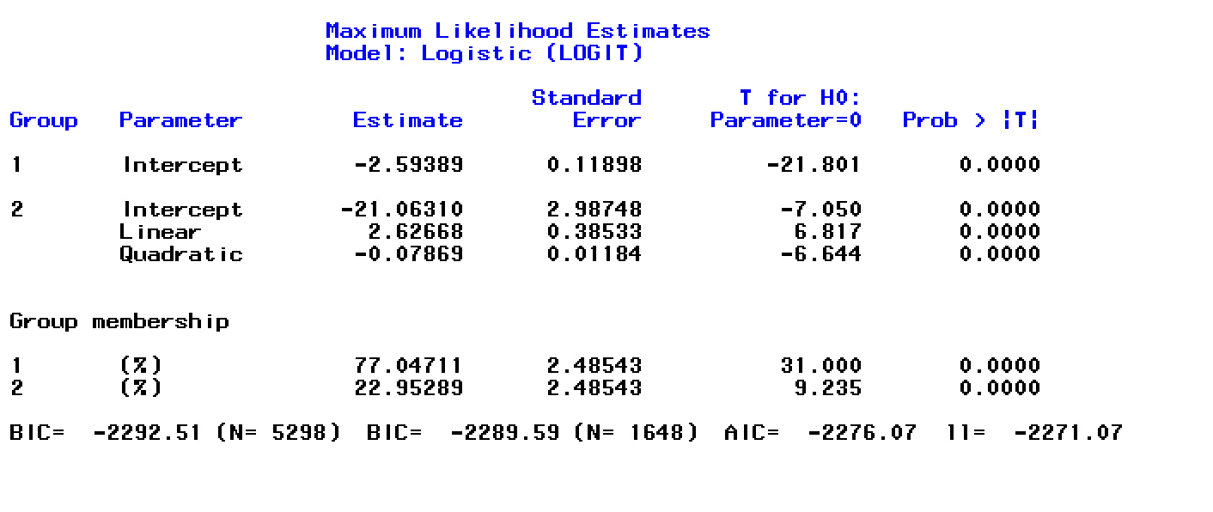
H. Model for each symptom type – fat

Slide 9
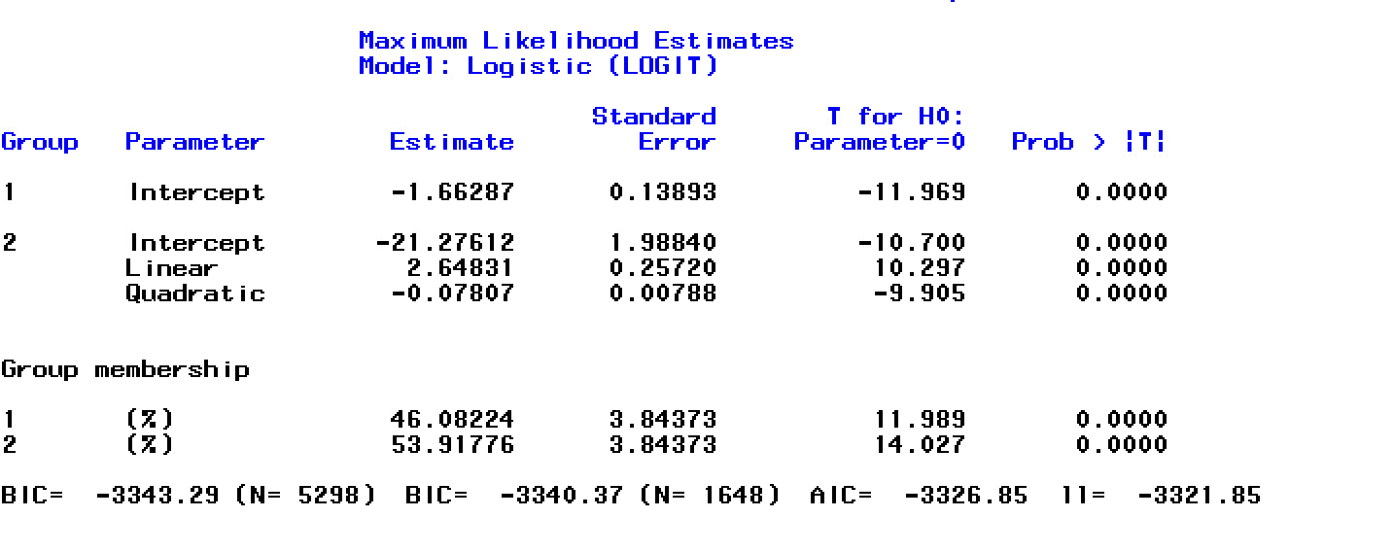
I. Model for each symptom type – food

