Slide 1

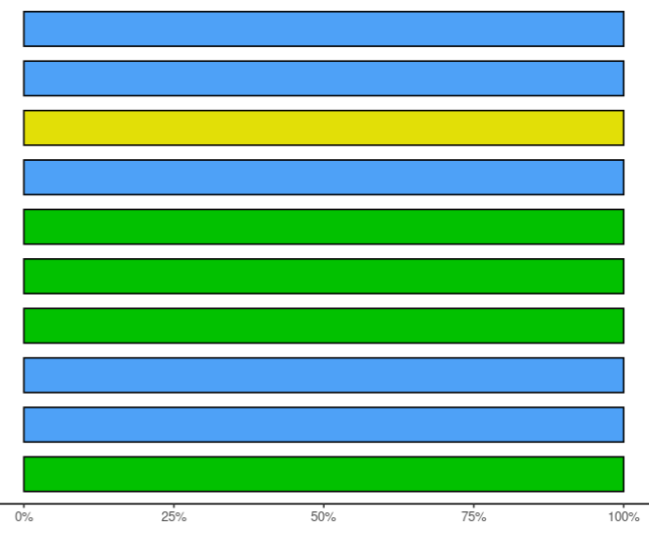
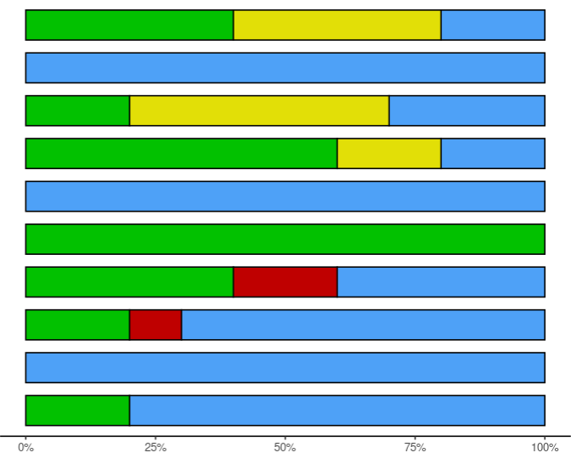

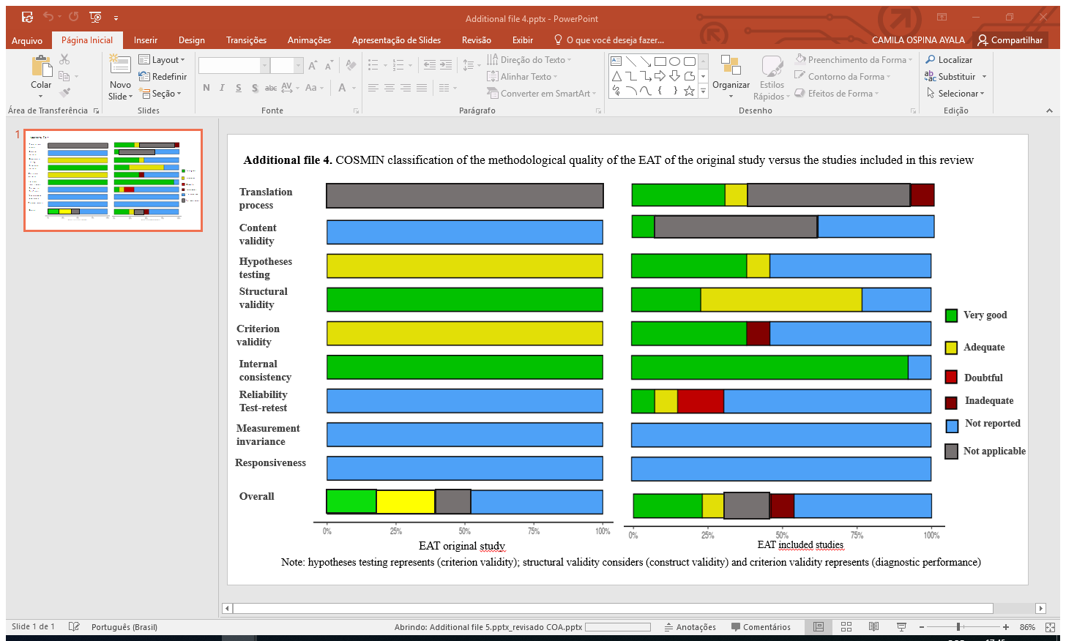

Additional file 8. COSMIN classification of the methodological quality of the EDE-Q of the original study versus the studies included in this review
Translation process
Content validity
Hypotheses testing
Structural validity
Very good
Criterion validity
Adequate
Internal consistency
Doubtful
Reliability Test-retest
Inadequate
Measurement invariance
Not reported
Not applicable
Responsiveness
Overall
EDE-Q original study
EDE-Q included studies
Note: hypotheses testing considers (criterion validity); structural validity considers (construct validity) and criterion validity considers (diagnostic performance)

