Slide 1
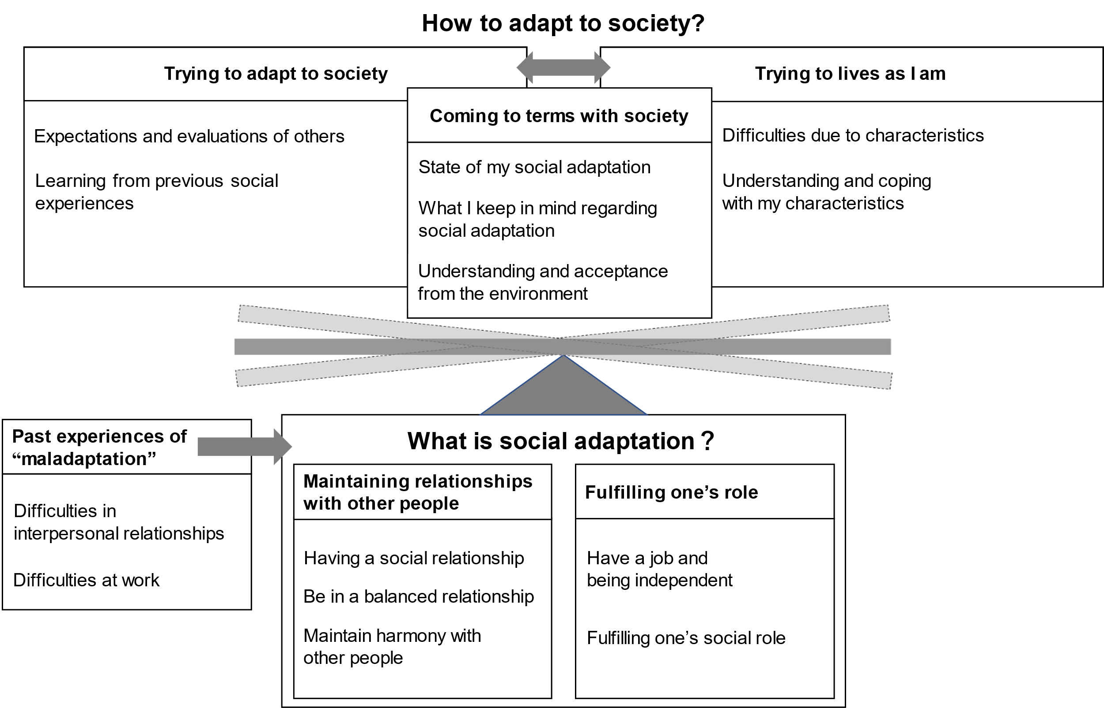
Appendix 3. Perception of social adaptation of autistic women

