Slide 1
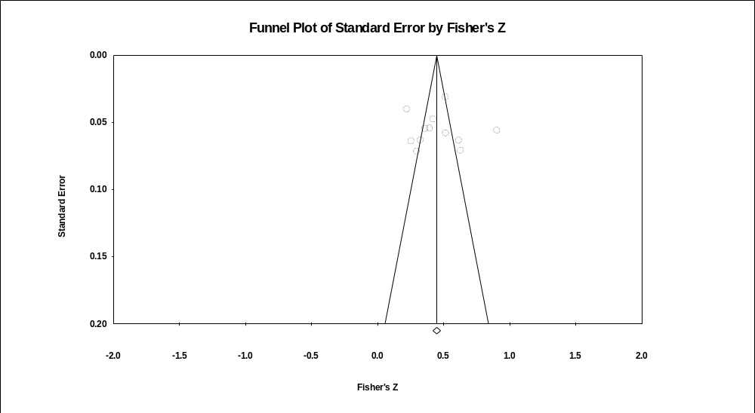
Funnel plot of effect sizes for Perceived Usefulness
Notes:
Funnel plot of effect sizes for Perceived Usefulness

Slide 2
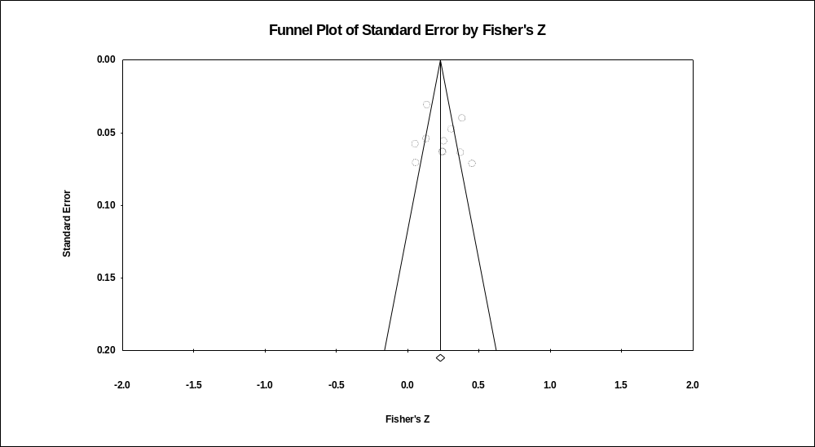
Funnel plot of effect sizes for Perceived Ease-of-Use
Notes:
Funnel plot of effect sizes for Perceived Ease-of-Use

Slide 3
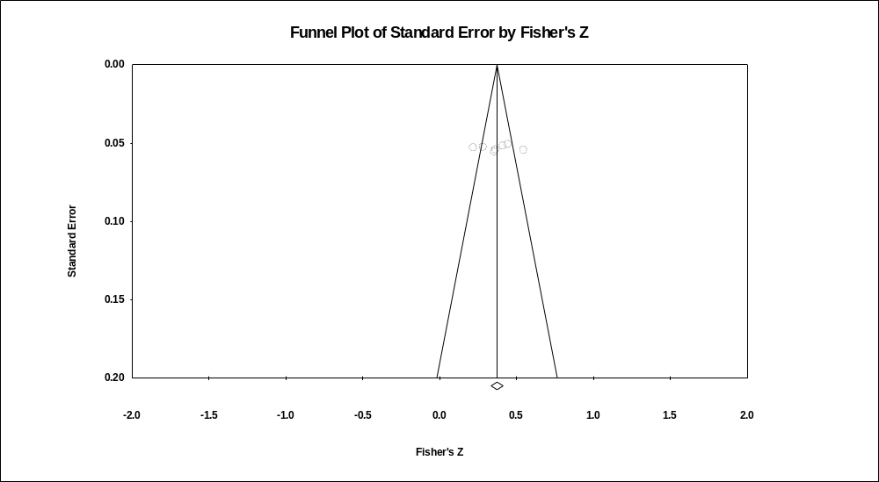
Funnel plot of effect sizes for Satisfaction
Notes:
Funnel plot of effect sizes for Satisfaction

Slide 4
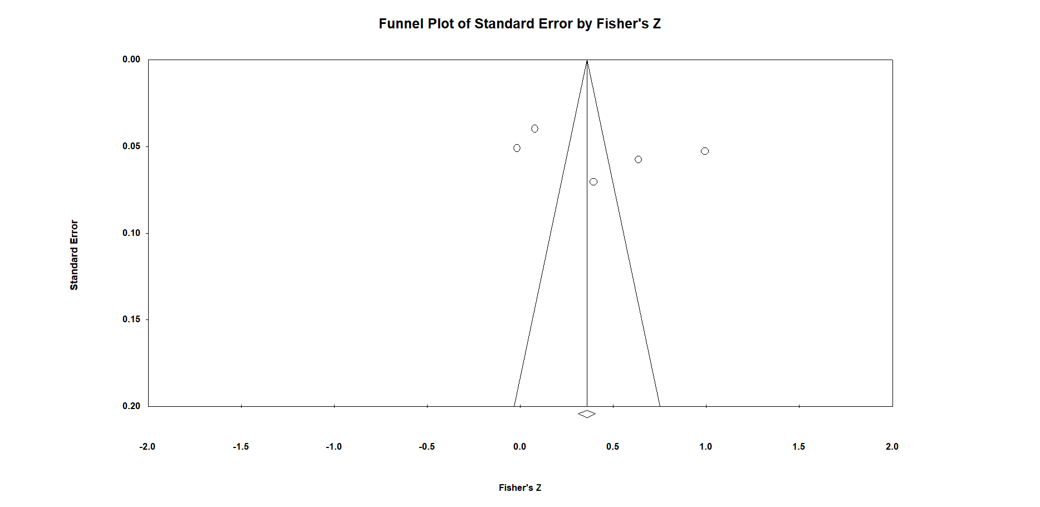
Funnel plot of effect sizes for Subjective Norms
Notes:
Funnel plot of effect sizes for Subjective Norms

Slide 5
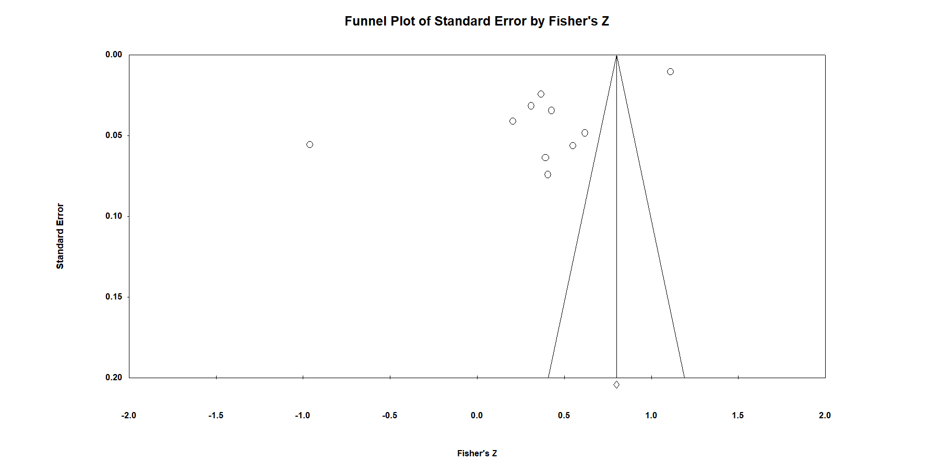
Funnel plot of effect sizes for Performance Expectancy
Notes:
Funnel plot of effect sizes for Performance Expectancy

Slide 6
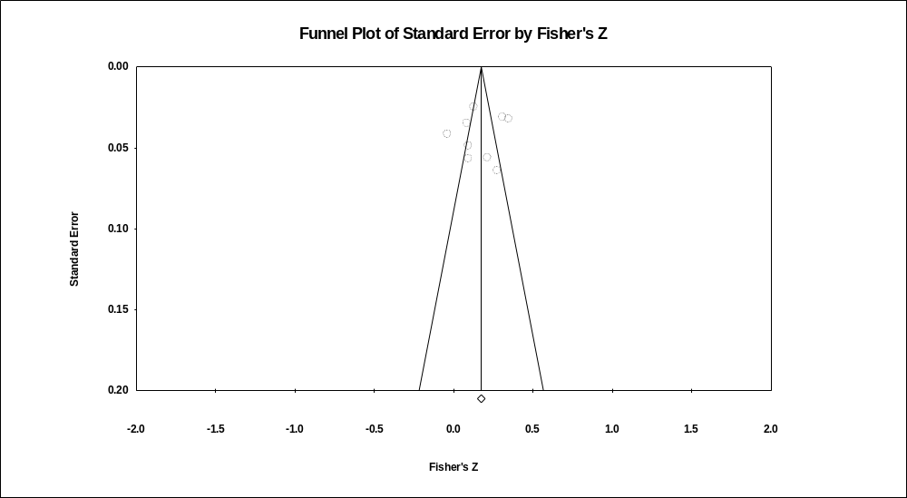
Funnel plot of effect sizes for Social Influence
Notes:
Funnel plot of effect sizes for Social Influence

Slide 7
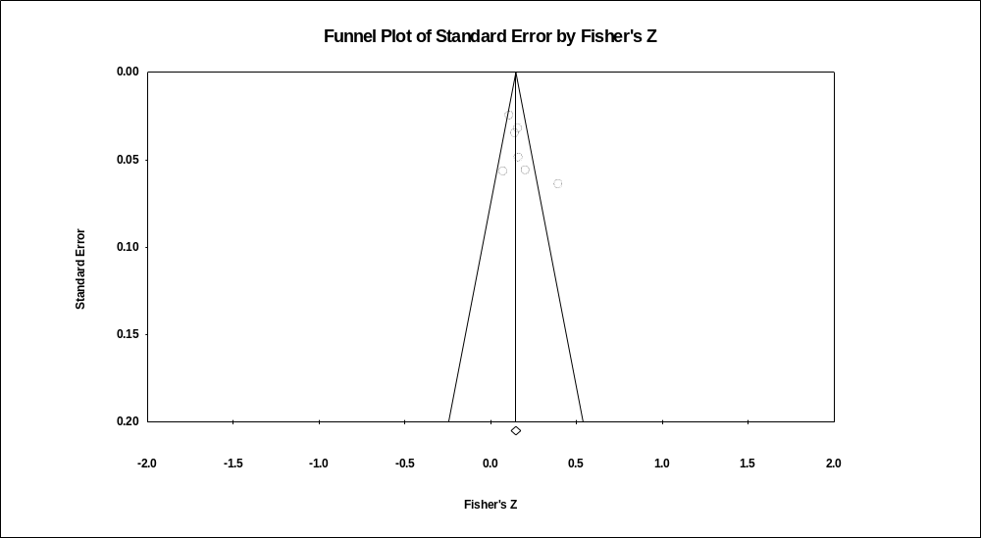
Funnel plot of effect sizes for Effort Expectancy
Notes:
Funnel plot of effect sizes for Effort Expectancy

Slide 8
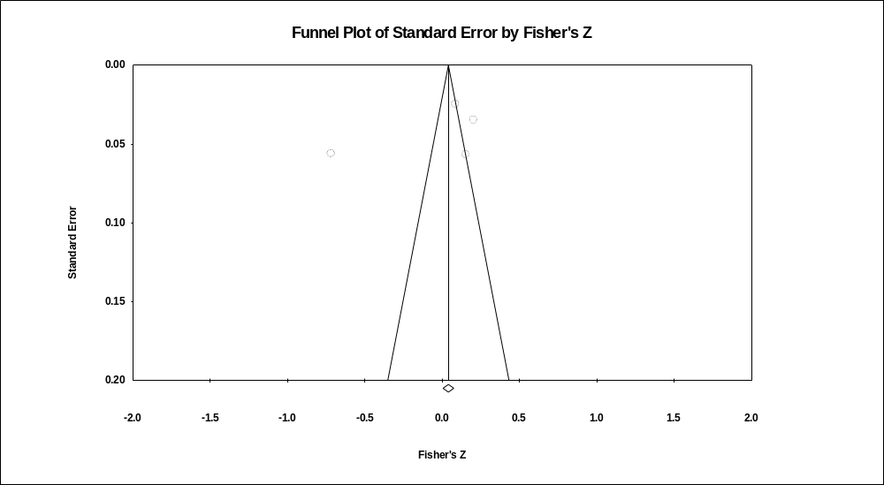
Funnel plot of effect sizes for Facilitating Conditions
Notes:
Funnel plot of effect sizes for Facilitating Conditions

Slide 9

Funnel plot of effect sizes for Price Value
Notes:
Funnel plot of effect sizes for Price Value

Slide 10

Funnel plot of effect sizes for Habit
Notes:
Funnel plot of effect sizes for Habit

Slide 11

Funnel plot of effect sizes for Hedonic Motivation
Notes:
Funnel plot of effect sizes for Hedonic Motivation

Slide 12

Funnel plot of effect sizes for Perceived Enjoyment
Notes:
Funnel plot of effect sizes for Perceived Enjoyment

