Slide 1
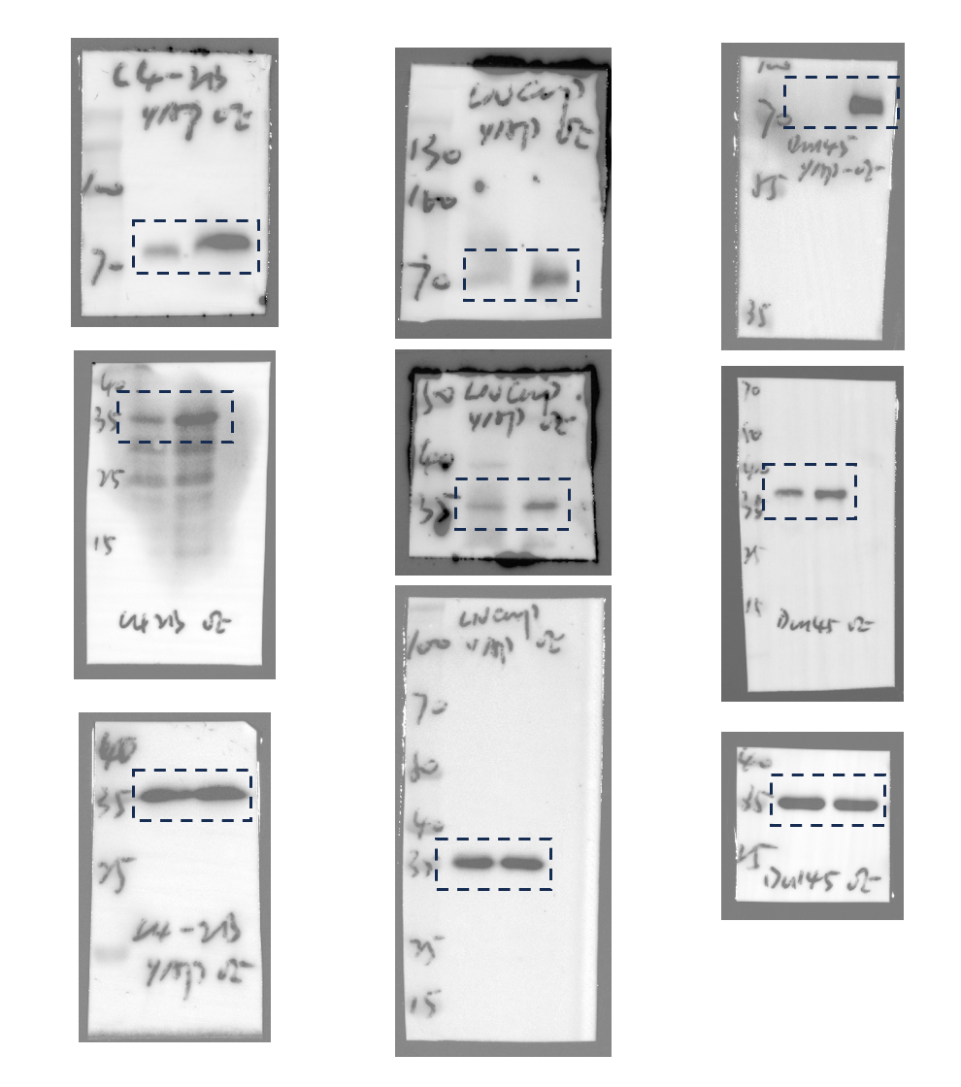
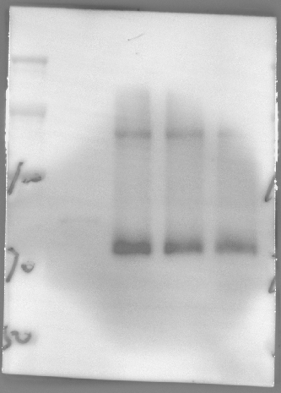
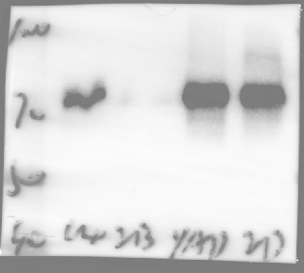
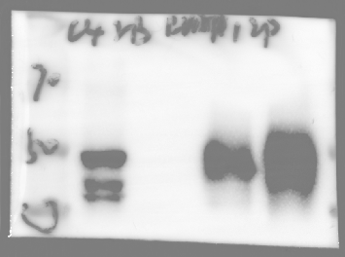
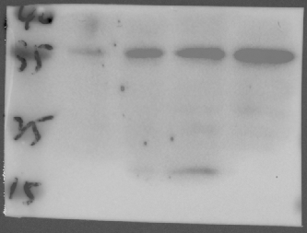
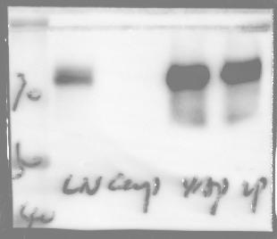
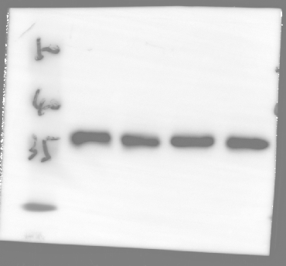
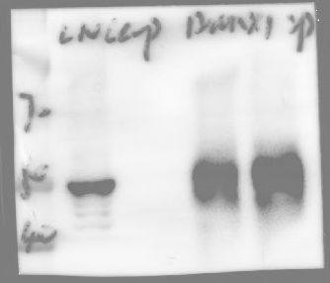
Figure 1D
Figure 1N
Figure 1Q
IP: RUNX1
YAP1-5SA
IP: YAP1
YAP1-6SA
YAP1-WT
Input
Vector
IgG
FLAG tag:
YAP1
FLAG
RUNX1
CD70
(67749-1-AP, Proteintech)
YAP1
GAPDH
RUNX1

Slide 2
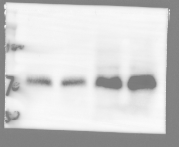
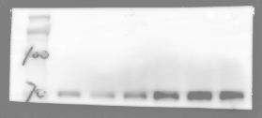
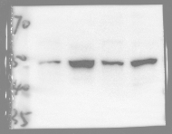

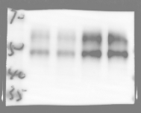

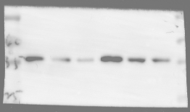
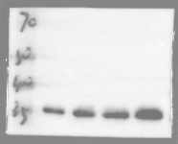
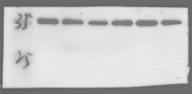

Figure 1R
FLAG-YAP1
-
-
+
+
FLAG-RUNX1
-
+
-
+
Figure 1S
FLAG-YAP1
-
-
-
+
+
+
YAP1
siRUNX1
-
#1
#2
-
#1
#2
YAP1
RUNX1
RUNX1
PD-L1
PD-L1
CD70
(67749-1-AP, Proteintech)
CD70
(67749-1-AP, Proteintech)
GAPDH
GAPDH

Slide 3
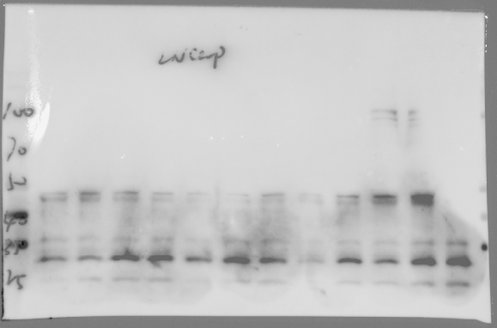
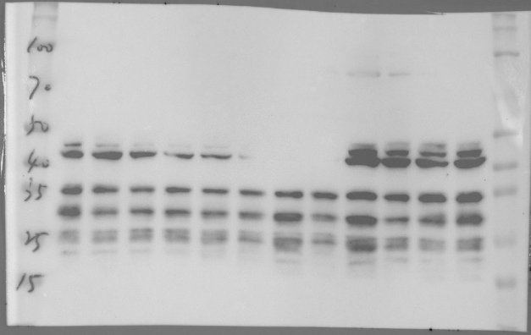
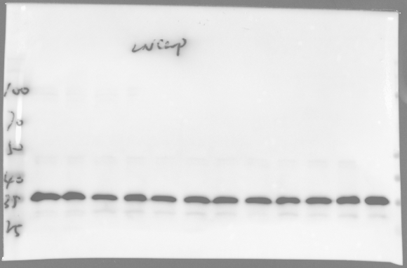
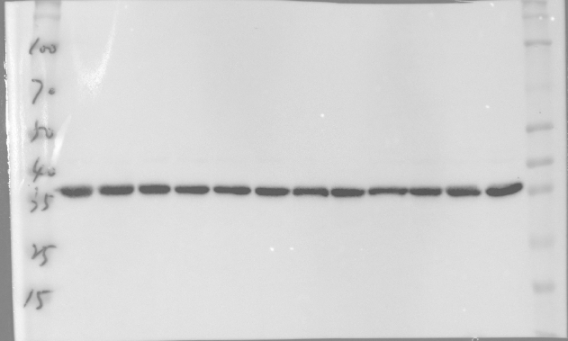
Figure S9A
KDM2B
RAD51
RUNX1
KDM2B
RAD51
RUNX1
Vector
NFKB2
Vector
NFKB2
PAX5
PAX8
PAX5
ELF4
KLF1
RELA
SPI1
ELF4
KLF1
PAX8
RELA
SPI1
RFX
RFX
CD70
(sc-365539, Santa Cruz)
CD70
(sc-365539, Santa Cruz)
GAPDH
GAPDH

Slide 4
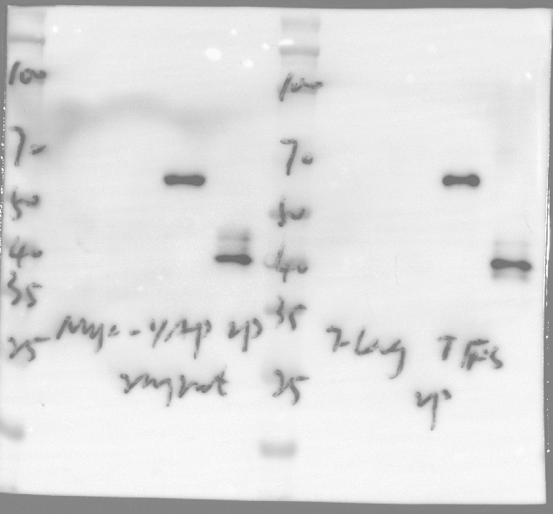
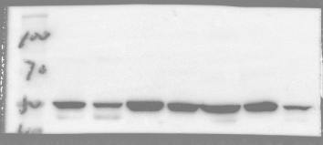
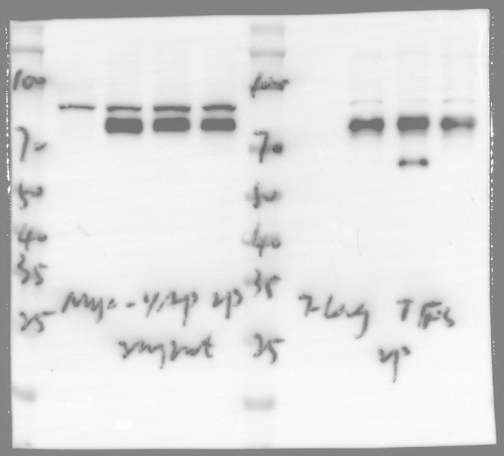
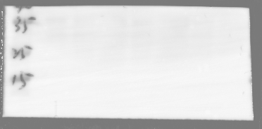
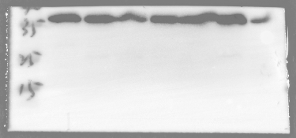
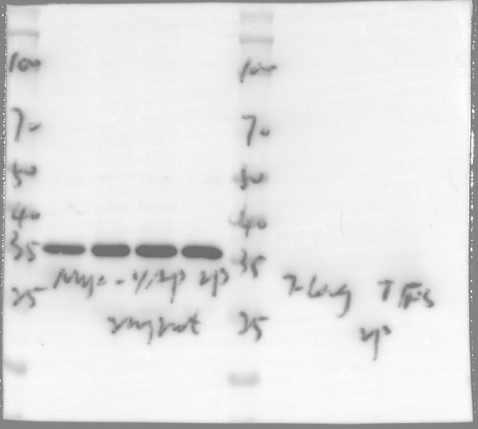
Figure S9C
Input
IP: MYC
MYC-YAP1
-
+
+
+
-
+
+
+
Figure S9D
FLAG-RUNX1
-
-
+
-
-
-
+
-
FLAG-SPI1
-
-
-
+
-
-
-
+
DU145
LNCaP
C4-2B
22RV1
PC-3
C4-2
VCAP
FLAG
RUNX1
SPI1
MYC
GAPDH
GAPDH

Slide 5
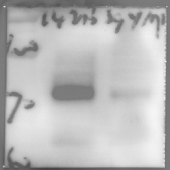
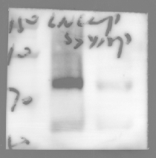
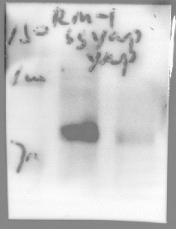
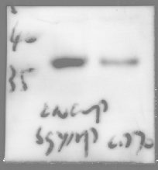
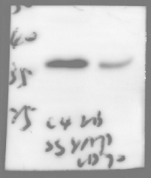
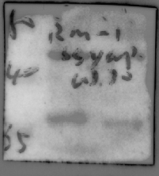
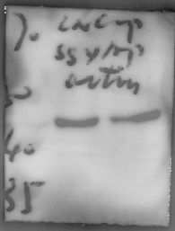
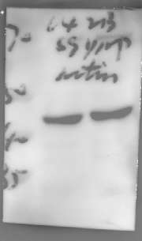
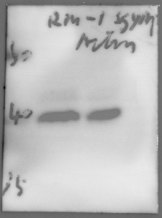
Figure S6A
YAP1
YAP1
YAP1
CD70
CD70
CD70
Actin
LNCaP
Actin
Actin
RM-1
C4-2B

Slide 6
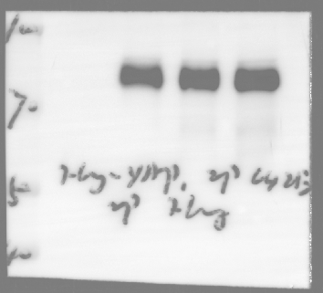
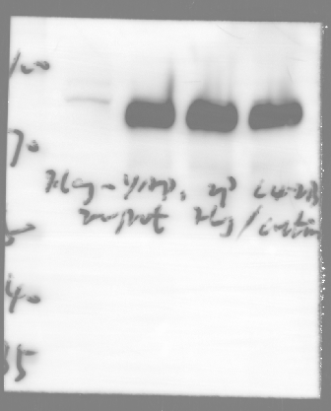
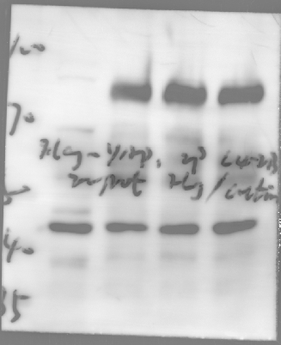
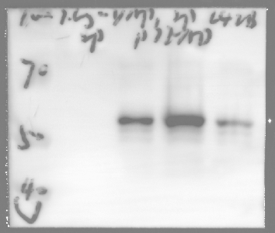
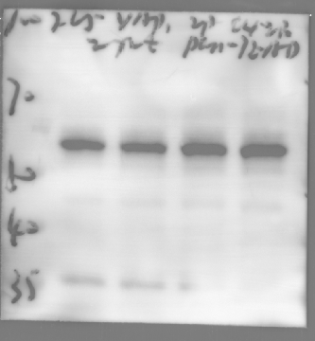
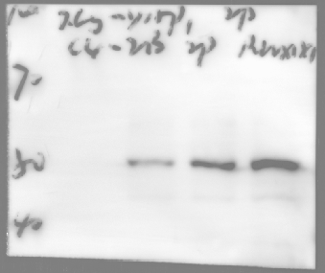
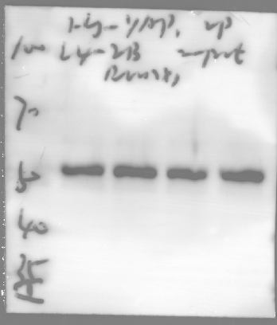
Figure S9G (C4-2B)
5SA+S94A
5SA+S94A
5SA+S94A
Vector
5SA
Vector
5SA
Vector
WT
WT
5SA
FLAG-YAP1:
WT
FLAG
Β-actin
RUNX1
pan-TEADs
pan-TEADs
RUNX1

Slide 7
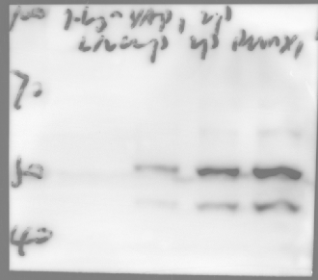
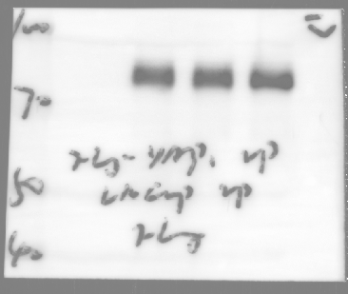
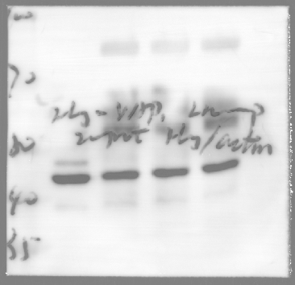
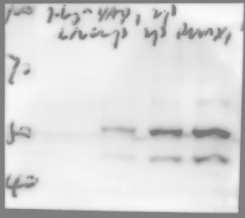
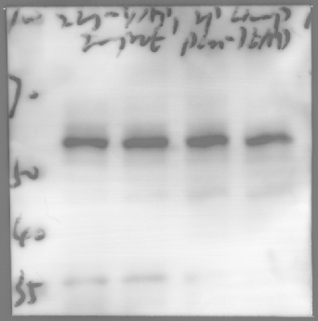
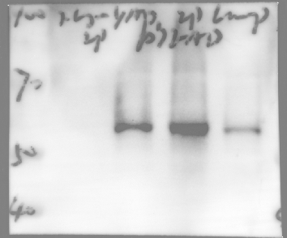
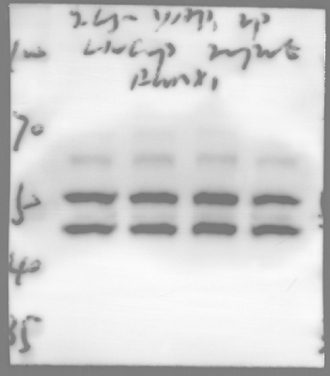
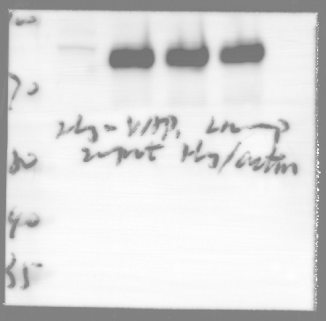
Figure S9G (LNCaP)
5SA+S94A
5SA+S94A
5SA+S94A
Vector
5SA
Vector
5SA
Vector
WT
WT
5SA
FLAG-YAP1:
WT
FLAG
FLAG
Β-actin
pan-TEADs
RUNX1
pan-TEADs
RUNX1

Slide 8
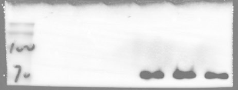





Figure S9F
FLAG-YAP1
-
-
-
+
+
+
FLAG-YAP1
-
-
-
+
+
+
siTEADs
-
-
+
-
-
+
siTEADs
-
-
+
-
-
+
siRUNX1
-
+
-
-
+
-
siRUNX1
-
+
-
-
+
-
YAP1
PD-L1
RUNX1
CD70
(67749-1-AP, Proteintech)
TEADs
GAPDH

