Slide 1
Supplementary Table 1: primer sequences
Gene | Forward primer | Reverse primer
CD274 | CAGGACGCAGGCGTTTACTG | CTTCCCACTCACGGGTTGGT
CD4 | GCTGGTTCTGGCAACCTGAC | CTCAGGGGCCACCACTTGAA
CD8A | TTCTGCCATGAGGGACACGA | GGTGCACAGGTGAGGGAGTT
GAPDH | GACGGCCGCATCTTCTTGTG | TGTGCCGTTGAATTTGCCGT
GATA3 | GTATCCTCCGACCCACCACG | GAAGCCGGAGGGTAAACGGA
GZMB | AGTCAAGCCCCACTCTCGAC | AGGGATGACTTGCTGGGTCT
IFNg | TCAGCAACAGCAAGGCGAAA | CAATCTCTTCCCCACCCCGA
PDCD1 | AGAAGGCCGGTTTCAAGGCA | GGCCACACTAGGGACAGGTG
PRF | GAACCCTAGGCCAGAGGCAA | TTAAAGTTGCGGGGGAGGGC
TBX21 | TCACCAACAACAAGGGGGCT | TGCGTTCTGGTAGGCAGTCA

Slide 2
Supplementary Table 2: R9F-clone library. Mice (C57BL/6, n=3) were implanted with C3 tumors. On study day 14, when tumors were measureable, mice were treated with mCPA for one week and then vaccinated with DPX-R9F on study day 21. Mice were euthanized and spleens collected on study day 27. R9F-specific CD8α+ T cells were purified from spleens using FACS and TCRβ sequencing performed by Adaptive Biotechnologies. From the 3 mice, 26 different clones were identified at a frequency >1% and considered R9F-specific. The table lists the amino acid sequence of each clone, the TCRbV and TCRbJ gene associated with each clone, and the frequency of each clone among the three samples. Highlighted in grey are the clones found in all samples. Highlighted in red are the most frequent clones of each sample.

Slide 3
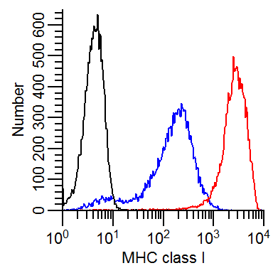
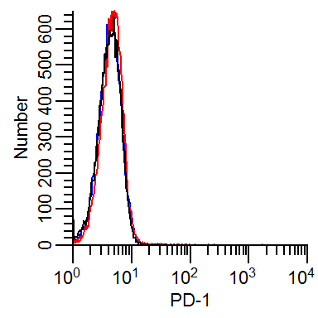
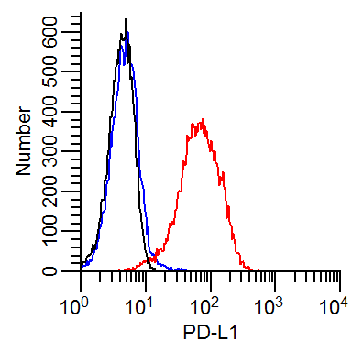
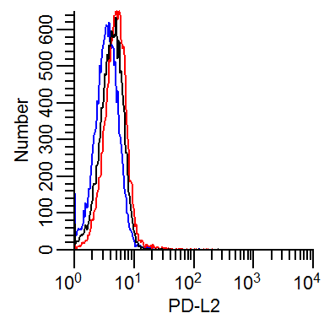
Supplementary Figure 1: Upregulation of surface antigens on C3 tumor cells in vitro after culture with IFN-g. C3 tumor cells were stimulated for 48 hours with 50 U/mL IFN-g. Surface expression determined by flow cytometry. Results representative of 3 separate experiments. Black: isotype control, blue: unstimulated, red: IFN-γ stimulated.

Slide 4
A)
B)
C)
Supplementary Figure 2: (A, B) C57BL6 mice (n=10) were implanted with B16-F10 tumors on day 0 and treated with mCPA starting 3 days later for one week one, one week off. Mice were vaccinated with DPX containing the TRP2180-188 peptide (DPX-S9L) on the first day of each mCPA treatment week, days 3 and 17. Anti-PD-1 or isotype control was administered on days 3, 6, 9, 17, 20, 23. (C) HLA-A2 transgenic mice (n=5) were implanted subcutaneously with syngeneic ovarian tumors on day 0 and treated using the same schedule as the B16-F10, however in this experiment, mice were vaccinated with DPX-Survivac.

Slide 5
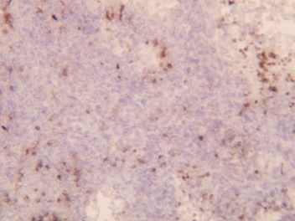
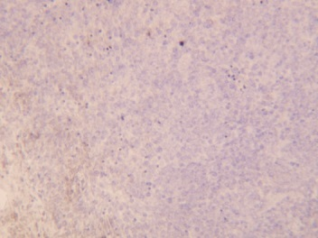
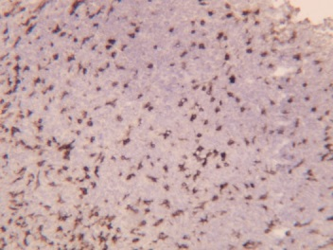
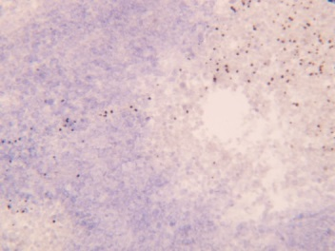
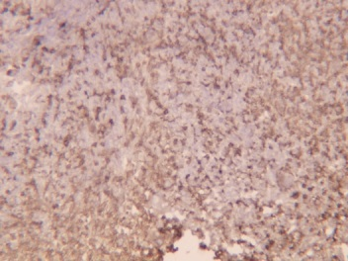
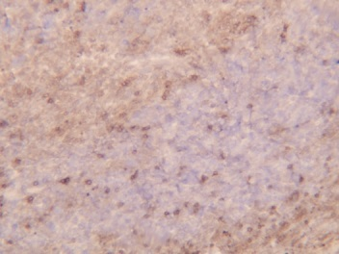
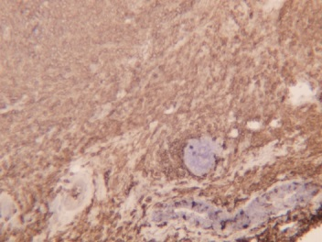
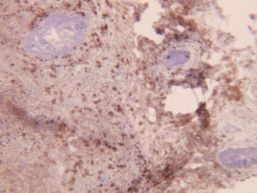
CD45
CD8α
Untreated
10x
10x
Anti-PD-1
10x
10x
DPX/ mCPA/
isotype
10x
10x
DPX/ mCPA/
anti-PD1
10x
10x
Supplementary Figure 3: Immunohistochemical (IHC) staining of tumor sections for CD45 and CD8α expression. Samples were cryoprotected in 20% sucrose for 2 hours at 4°C, embedded in OCT compound (Sakura Finetek), snap frozen and sectioned at 10 µm. Sections were fixed in acetone for 10 minutes and blocked with 10% normal goat serum (Sigma) for 1 hour at room temperature. Anti-CD8a (53-6.7) or anti-CD45 (30-F11) antibodies were applied at 10ng/mL and incubated at room temperature for 3 hours. Sections were washed three times with PBS, and incubated with biotinylated anti-rat IgG (Vector Labs) at 2µg/mL for 1 hour at room temperature. After washing, slides were incubated with Vectastain ABC kit (Vector Laboratories) for 30 minutes, developed with DAB substrate (Vector Laboratories) for 2 minutes and then counterstained with Gill’s Hematoxylin (EMS) for 1 minute. After soaking in water, sections were coverslipped using Immunohistomount (Sigma) and microscopy was performed at a 10X magnification.
Notes:
Untreated: 1-2; anti-PD-1: 3-6, 3-8; DPX/mCPA/isotype: 5-10, 5-7; DPX/mCPA/aPD1: 6-4

